Slide 1
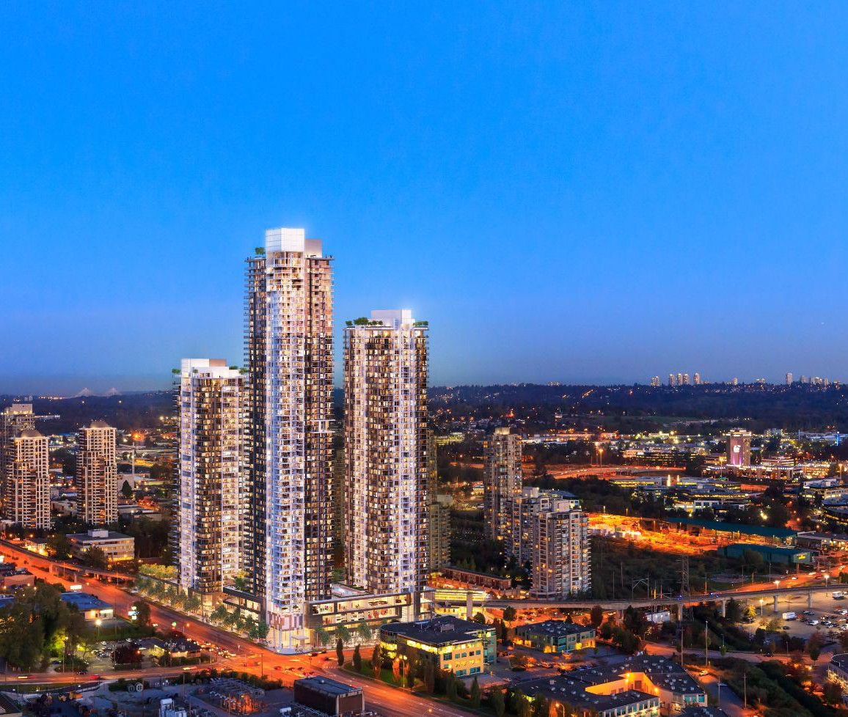
CANADA COMMERCIAL LEASING RETAIL AVAILABILITIES
MAY 2026
RETAIL
200 - 1010 SEYMOUR STREET, VANCOUVER, BC
604.688.8783 | LEASING@ONNI.COM
ONNI.COM

Slide 2
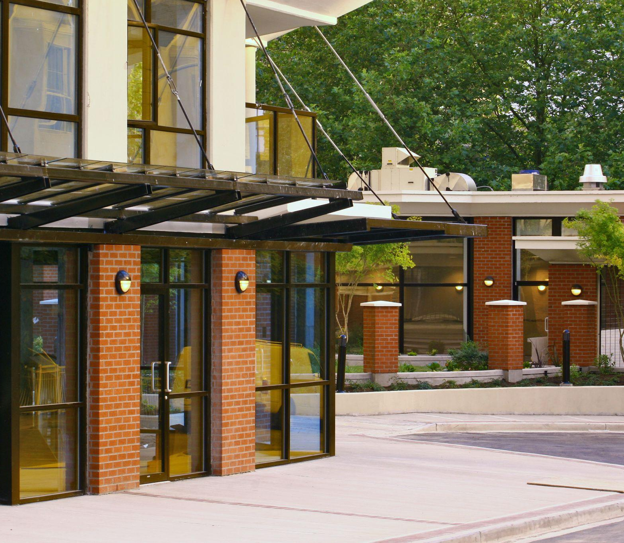

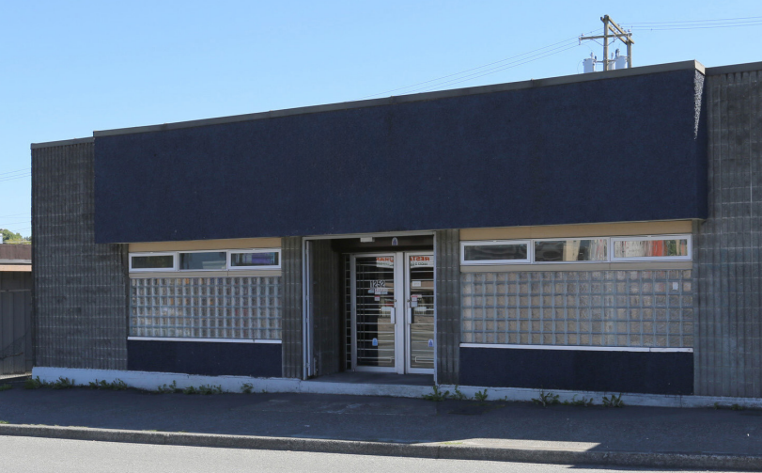
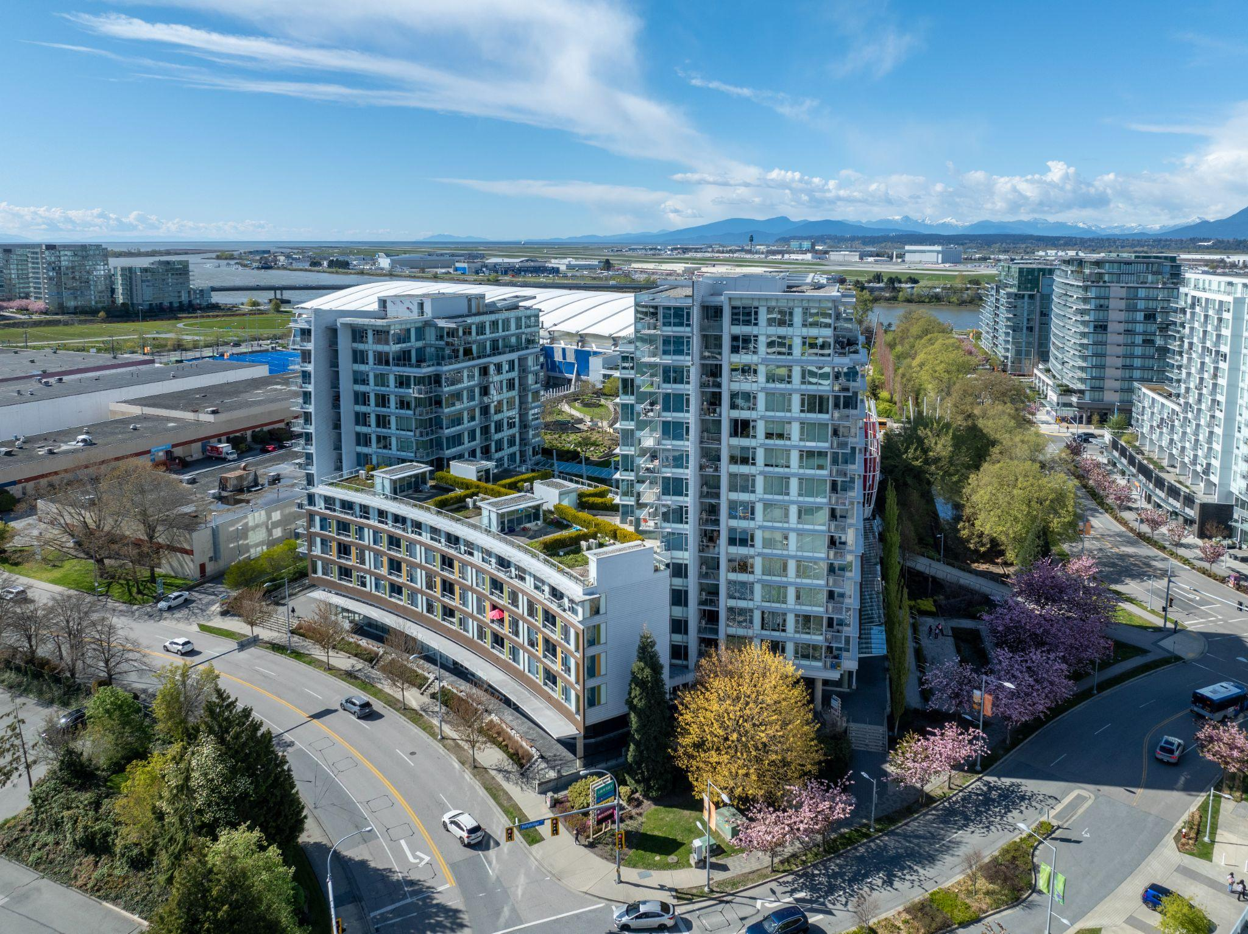
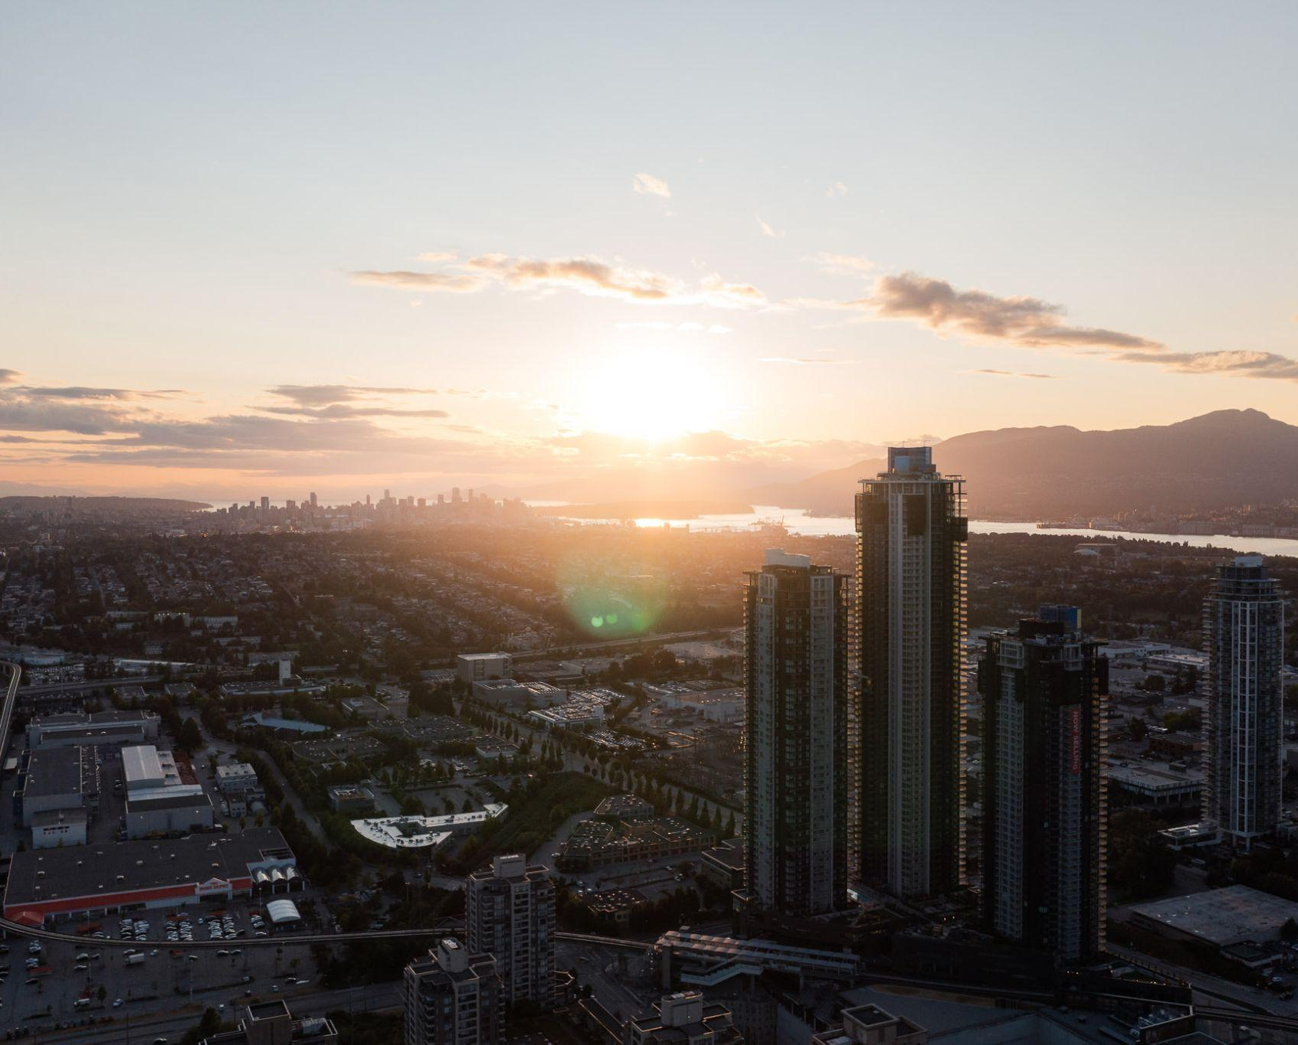
NOW LEASING
NEW WESTMINSTER, BC
The Point
ADDRESS: 561-610 Victoria Street
CONTACT: DEREK TULLIS
COMPANY: Macdonald Realty
PHONE: 604.831.7140
AVAILABILITY:
BUILDING FEATURES:
Located next to the New Westminster Law Courts
Located beneath 200 residential units
Amply parking available
#605 | 1,732 SF | Available Immediately
VANCOUVER BC
Hastings
ADDRESS: 1252 EAST HASTINGS STREET
CONTACT: BAHAREH TABAR & GRAHAM WILLIAMS
COMPANY: CUSHMAN & WAKEFIELD
PHONE: 604.640.5869
AVAILABILITY:
BUILDING FEATURES:
Warehouse/showroom space
Excellent signage and branding opportunities
Located along major arterial route
Many coffee shops, breweries and restaurants within immediate vicinity
1252 E Hastings | 4,800 SF | Available Immediately
RICHMOND, BC
Ora
BUILDING FEATURES:
Anchored by T&T Supermarket and Bank of Montreal
Excellent signage and visibility
Across from the Richmond Olympic Oval
Surrounded by thousands of new residential units
ADDRESS: 6951 ELMBRIDGE WAY
CONTACT: JOHN WASLEN & BLAKE DAVIES
COMPANY: COLLIERS
PHONE: 604.662.2634
AVAILABILITY:
#175 | 1,577 SF | Available Immediately
#180 | 1,622 SF | Available Immediately
BURNABY, BC
Gilmore Place | Phase 1
PROJECT FEATURES:
Prime location at Gilmore Avenue & Lougheed Highway
Transit-oriented community with direct access to Gilmore SkyTrain Station
High-growth area within the Brentwood Town Centre community plan
Large-format retail, big-box, and CRU opportunities available
High-exposure site with extensive signage opportunities
ADDRESS: 4112 LOUGHEED HWY
CONTACT: MARK REID
COMPANY: ONNI GROUP
PHONE: 604 488 2773
AVAILABILITY:
Units available from 476 sq.ft. to 458,000 sq.ft.
200 - 1010 SEYMOUR STREET, VANCOUVER, BC | 604.688.8783 | LEASING@ONNI.COM

Slide 3
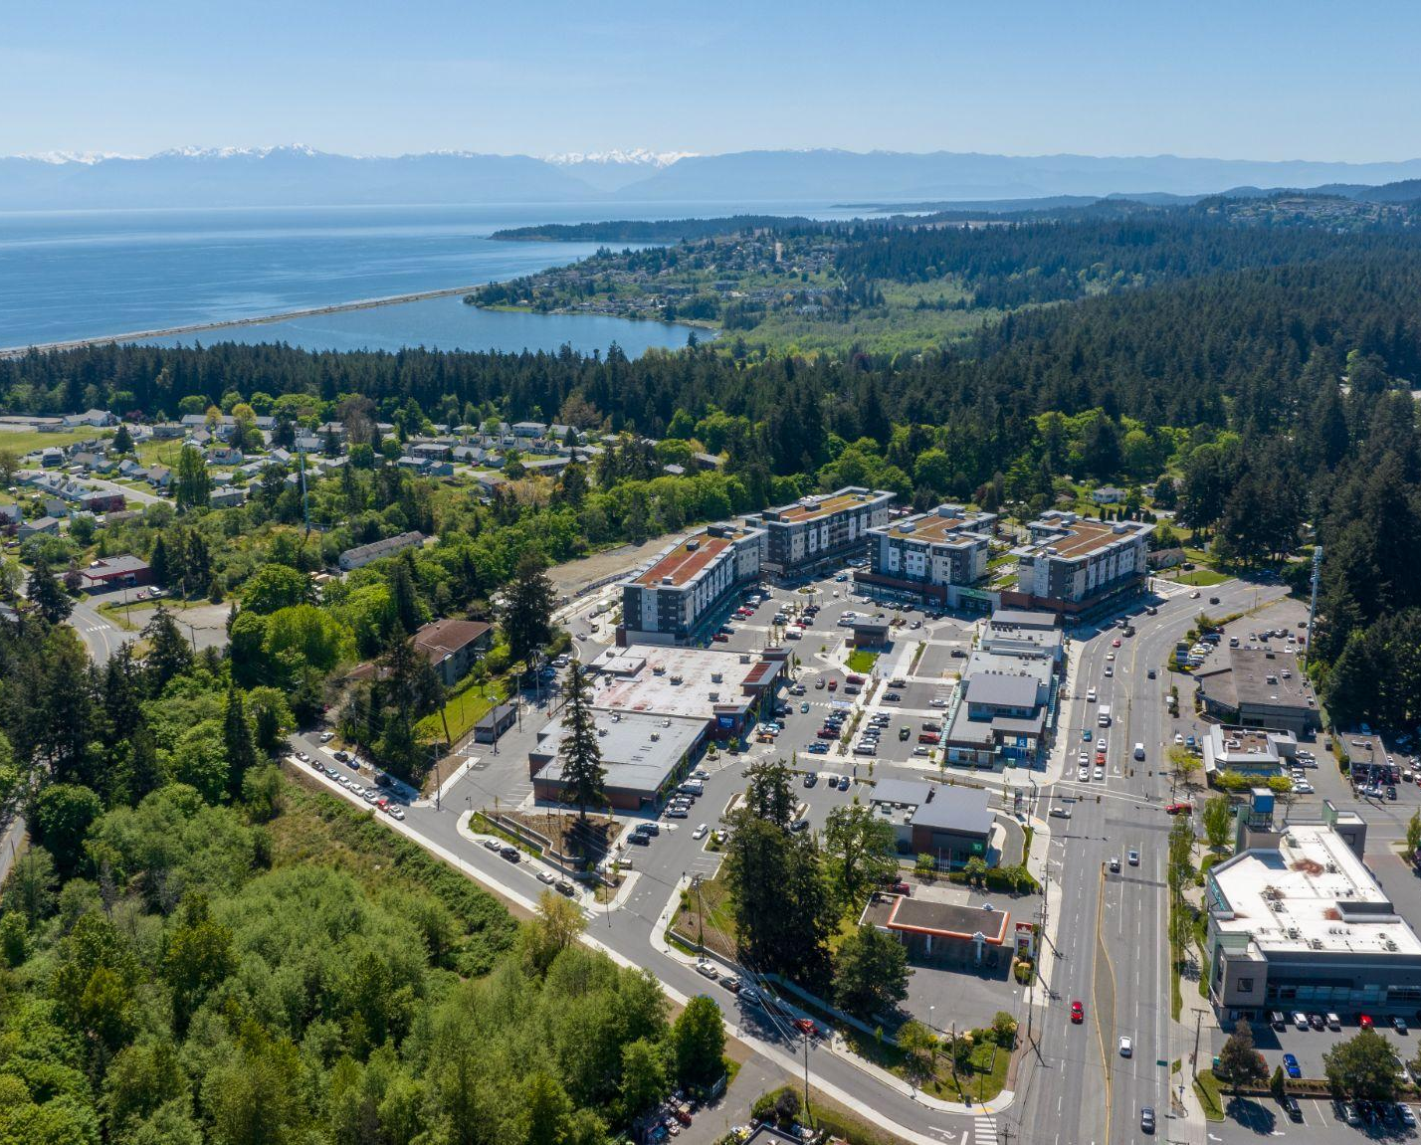

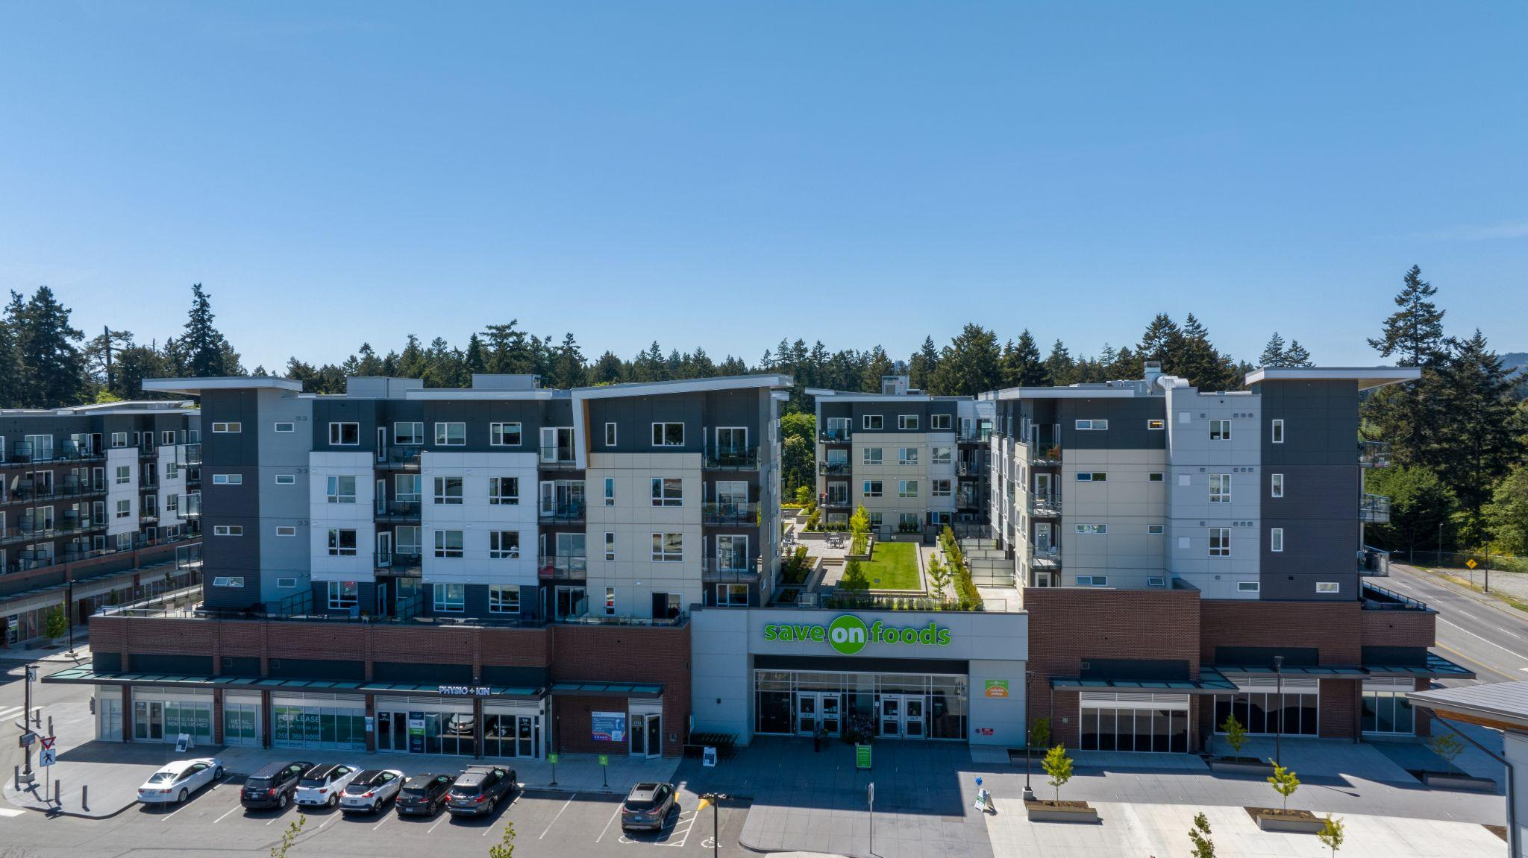
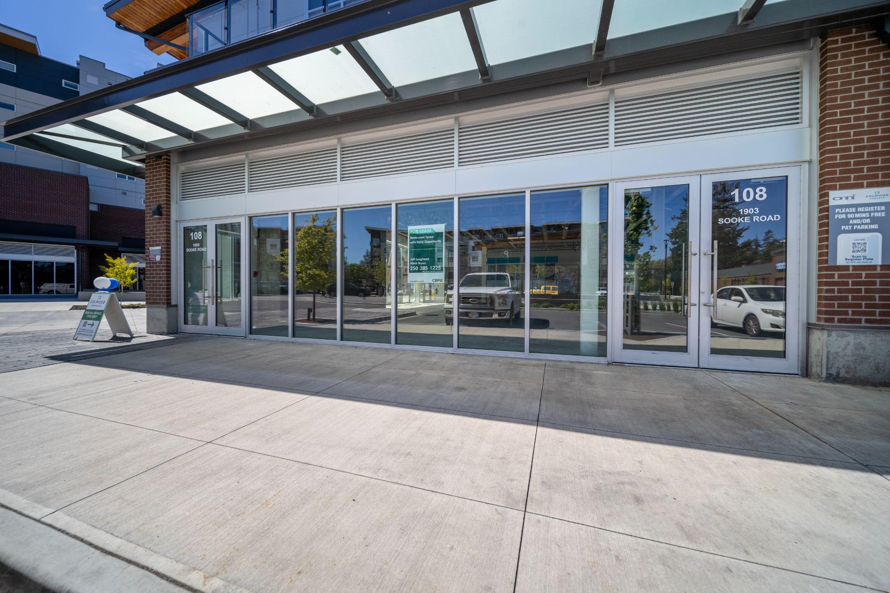
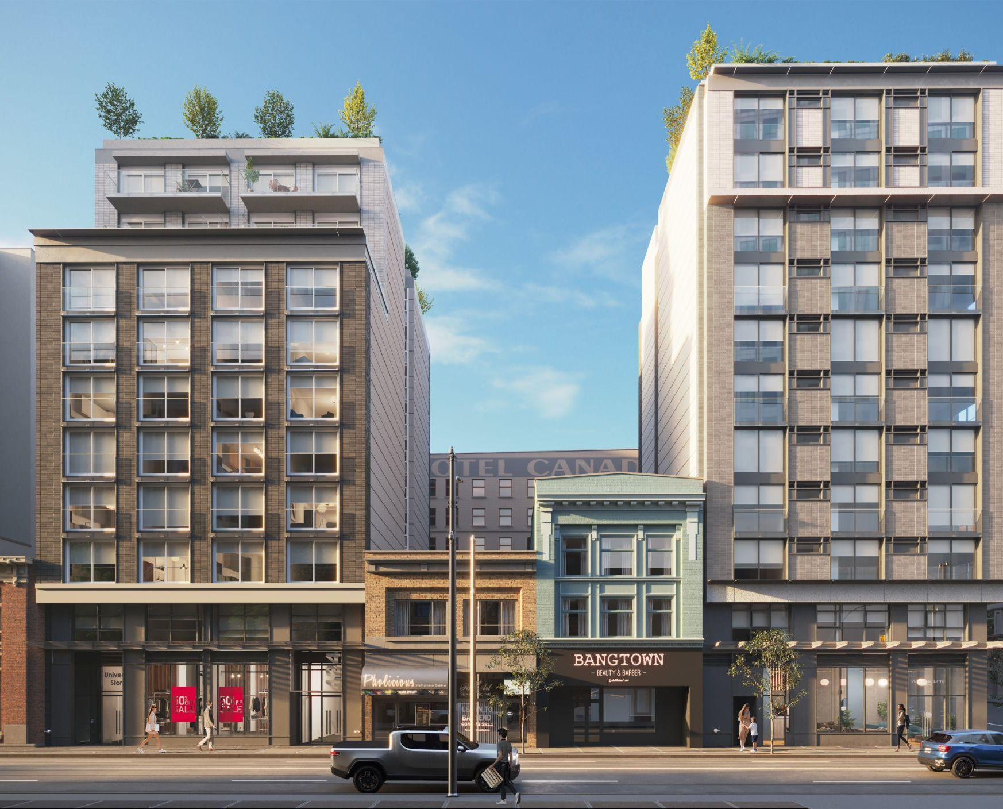
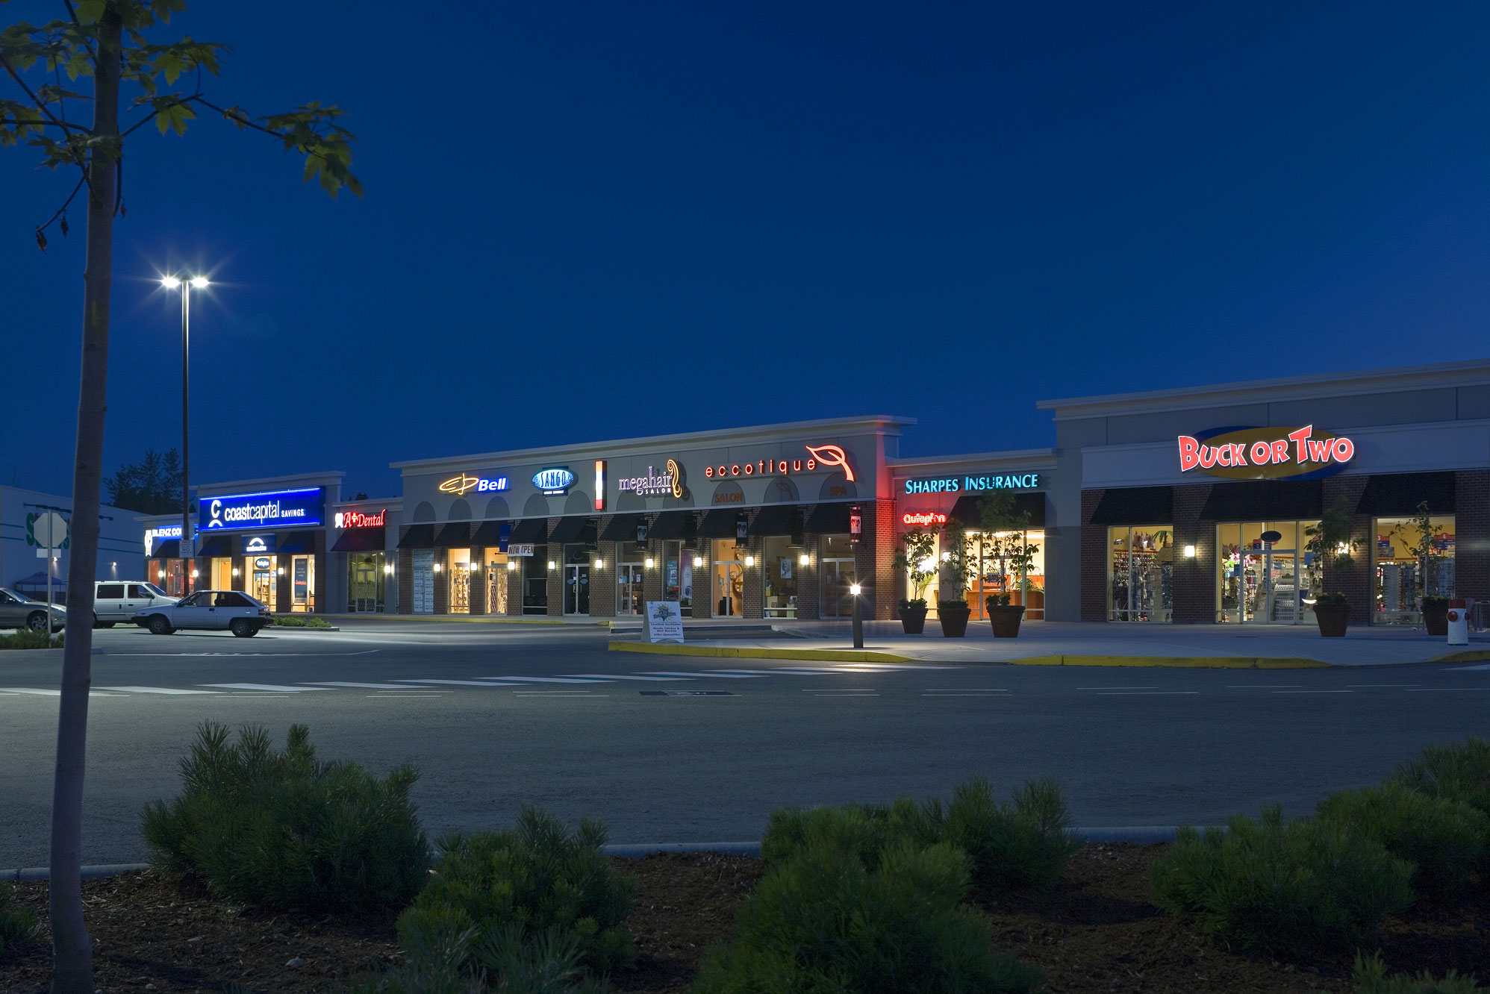
NOW LEASING
COLWOOD, BC
Colwood Corners
ADDRESS: SOOKE RD. & BELMONT RD.
CONTACT: MARK REID
COMPANY: ONNI GROUP
PHONE: 604.488.2773
AVAILABILITY:
COMMUNITY FEATURES:
Join Save On Foods, London Drugs and Coast Capital Savings in this exciting new project
Located next to Royal Roads University
Great exposure to Sooke Road
Building 1 - 1913 Sooke Road
140 |  | 1,921 SF | Under Contract
Building 3 - 1909 Sooke Road
113 | 1,905 SF | Under Contract
109 | 1,905 SF | Under Contract
105 | 1,894 SF | Under Contract
101 | 2,088 SF | Available Immediately
Building 4 - 1903 Sooke Road
108 | 3,326 | Available Immediately
Building 7
100 | 512 SF | Available Immediately
VANCOUVER, BC
Richards & Pender
BUILDING FEATURES:
New retail opportunity in downtown Vancouver
Opportunities for venting
140 residential units above
ADDRESS: 454 WEST PENDER STREET
CONTACT: STEFAN SAFRATA & MARTIN MORIARTY
COMPANY: MARCUS & MILLICHAP
PHONE: 604.675.5255
AVAILABILITY:
510 Richards
CRU #1 | 1,236 SF | Under Contract
424 Pender
CRU #3 | 1,837 SF | Available Immediately
PITT MEADOWS, BC
Meadowtown Centre
ADDRESS: 19800 LOUGHEED HIGHWAY
CONTACT: MARK REID
COMPANY: ONNI GROUP
PHONE: 604 488 2773
AVAILABILITY:
PROJECT FEATURES:
420,000 SF of retail space
Direct access to the Golden Ears amd Lougheed Highway
Strong existing tenant mix with diverse retail offerings
#930 5,458 SF
Available July 1, 2026
200 - 1010 SEYMOUR STREET, VANCOUVER, BC | 604.688.8783 | LEASING@ONNI.COM

Slide 4
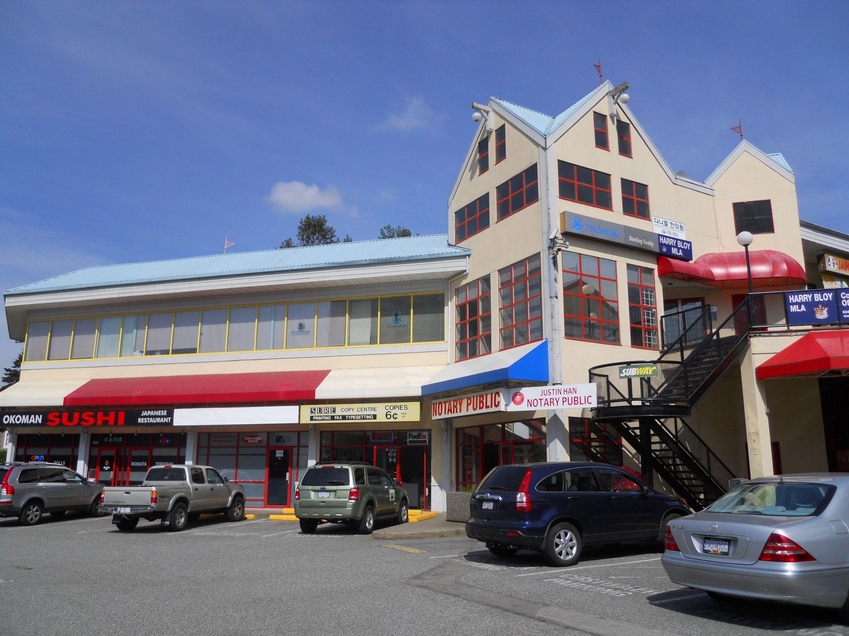
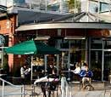
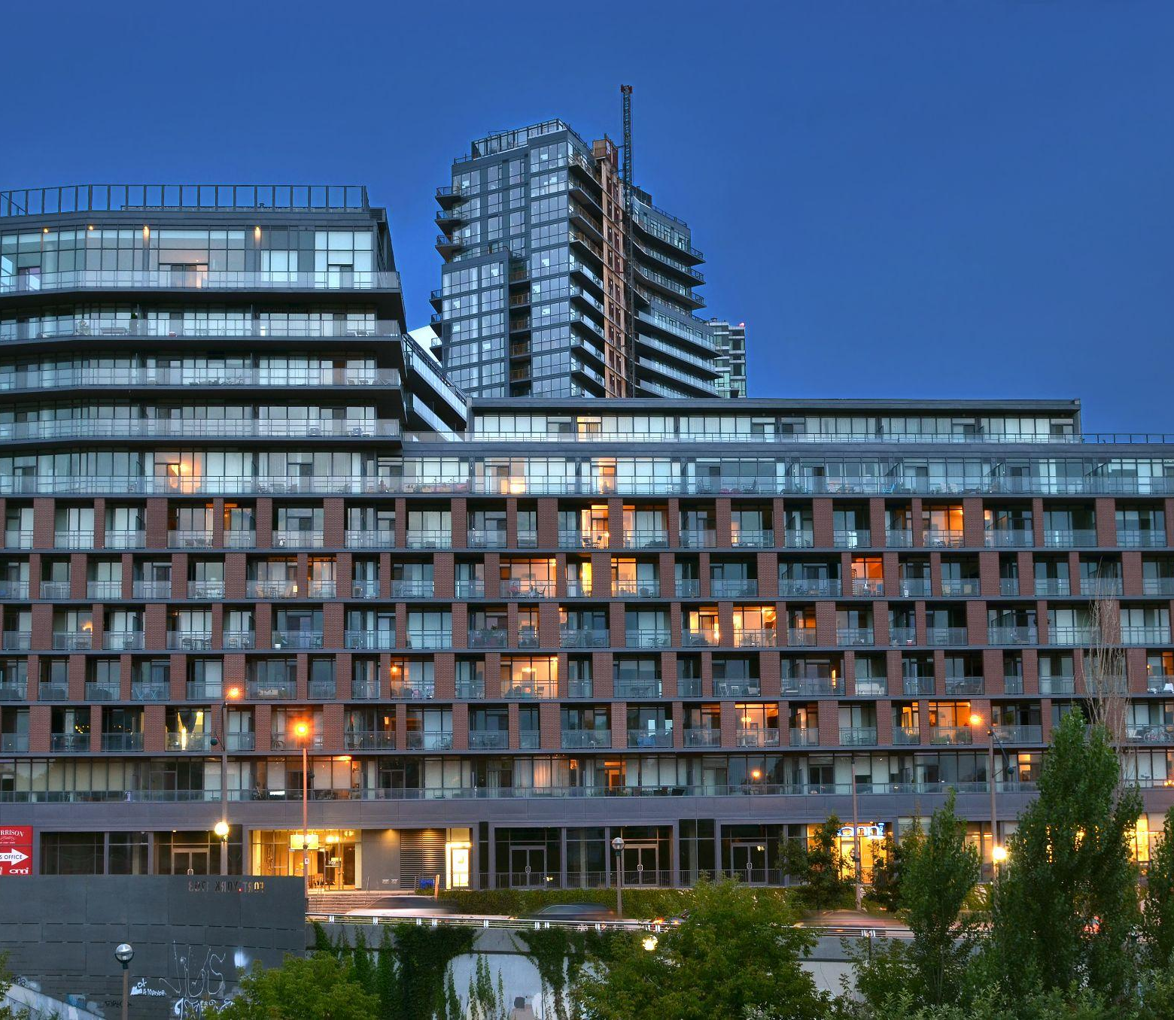
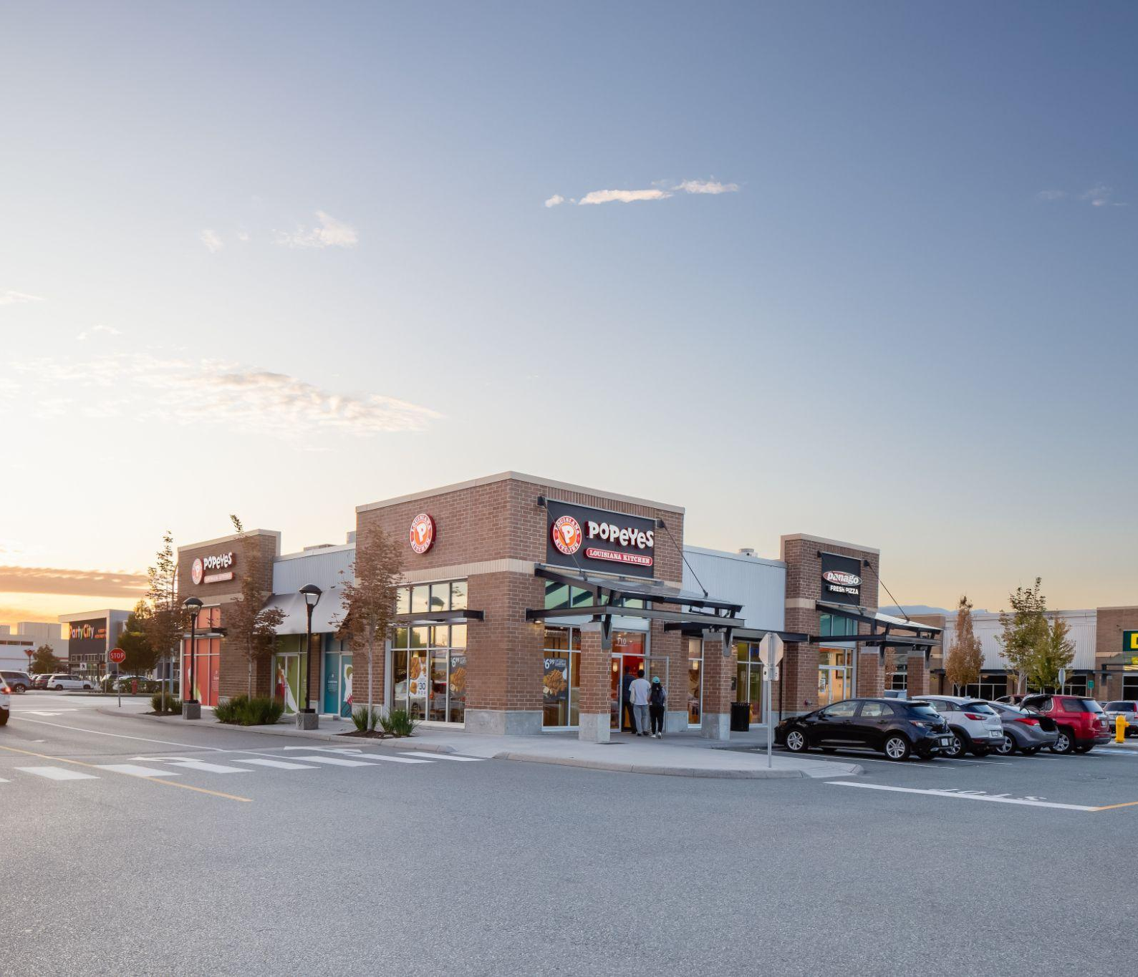
NOW LEASING
BURNABY, BC
3355 North Road
ADDRESS: 3355 NORTH ROAD
CONTACT: WAYNE TULLIS
COMPANY: MACDONALD REALTY
PHONE: 604.931.5551
AVAILABILITY:
BUILDING FEATURES:
Located at the corner of North Road and Cameron Street
Within close proximity to Lougheed Skytrain Station
Across the street from Lougheed Mall
#230 | 1,499 SF | Available Immediately
#240 | 841 SF | Under Contract
#270 | 1,032 SF | Available Immediately
#286 | 3,989 SF | Available Immediately
RICHMOND, BC
The Brunswick
BUILDING FEATURES:
Strong neighbouring tenants include Starbucks, Good Co., Bosley’s and Lee’s Donuts.
High exposure location with great proximity to the Boardwalk
Close proximity to Fisherman’s Wharf and other key tourist attractions
Parking available for staff and customers
ADDRESS: 4111 BAYVIEW STREET
CONTACT: JOHN WASLEN & BLAKE DAVIES
COMPANY: COLLIERS
PHONE: 604.662.2634
AVAILABILITY:
ADDRESS: 4111 BAYVIEW STREET
CONTACT: JOHN WASLEN & BLAKE DAVIES
COMPANY: COLLIERS
PHONE: 604.662.2634
AVAILABILITY:
Unit 110 | 1,850 SF | Under Contract
TORONTO
The Garrison
177 Fort York Blvd
BUILDING FEATURES:
Strong neighbouring tenants include Starbucks, Good Co., Bosley’s and Lee’s Donuts.
High exposure location with great proximity to the Boardwalk
Close proximity to Fisherman’s Wharf and other key tourist attractions
Parking available for staff and customers
ADDRESS: 169 FORT YORK BLVD
CONTACT: BROCK MEDDICK
COMPANY: HORIZON BROKERS
PHONE: 647 382 3305
AVAILABILITY:
Unit 165 22A Bathurst | 2,706 SF 1,471 SF | Available Immediately Available Immediately
PORT COQUITLAM, BC
Fremont Village
BUILDING FEATURES:
Drive Thru Pad
High Exposure High-traffic location with all-directional access
Turnkey spaces available
Centralized outdoor plaza surrounded by The Residences rental homes
ADDRESS: 2115 HAWKINS STREET
CONTACT: MAUREEN MOUNZER
COMPANY: CBRE
PHONE: 604 727 4606
AVAILABILITY:
2115 Hawkins St | 4,798 SF | Available Immediately
200 - 1010 SEYMOUR STREET, VANCOUVER, BC | 604.688.8783 | LEASING@ONNI.COM

Slide 5
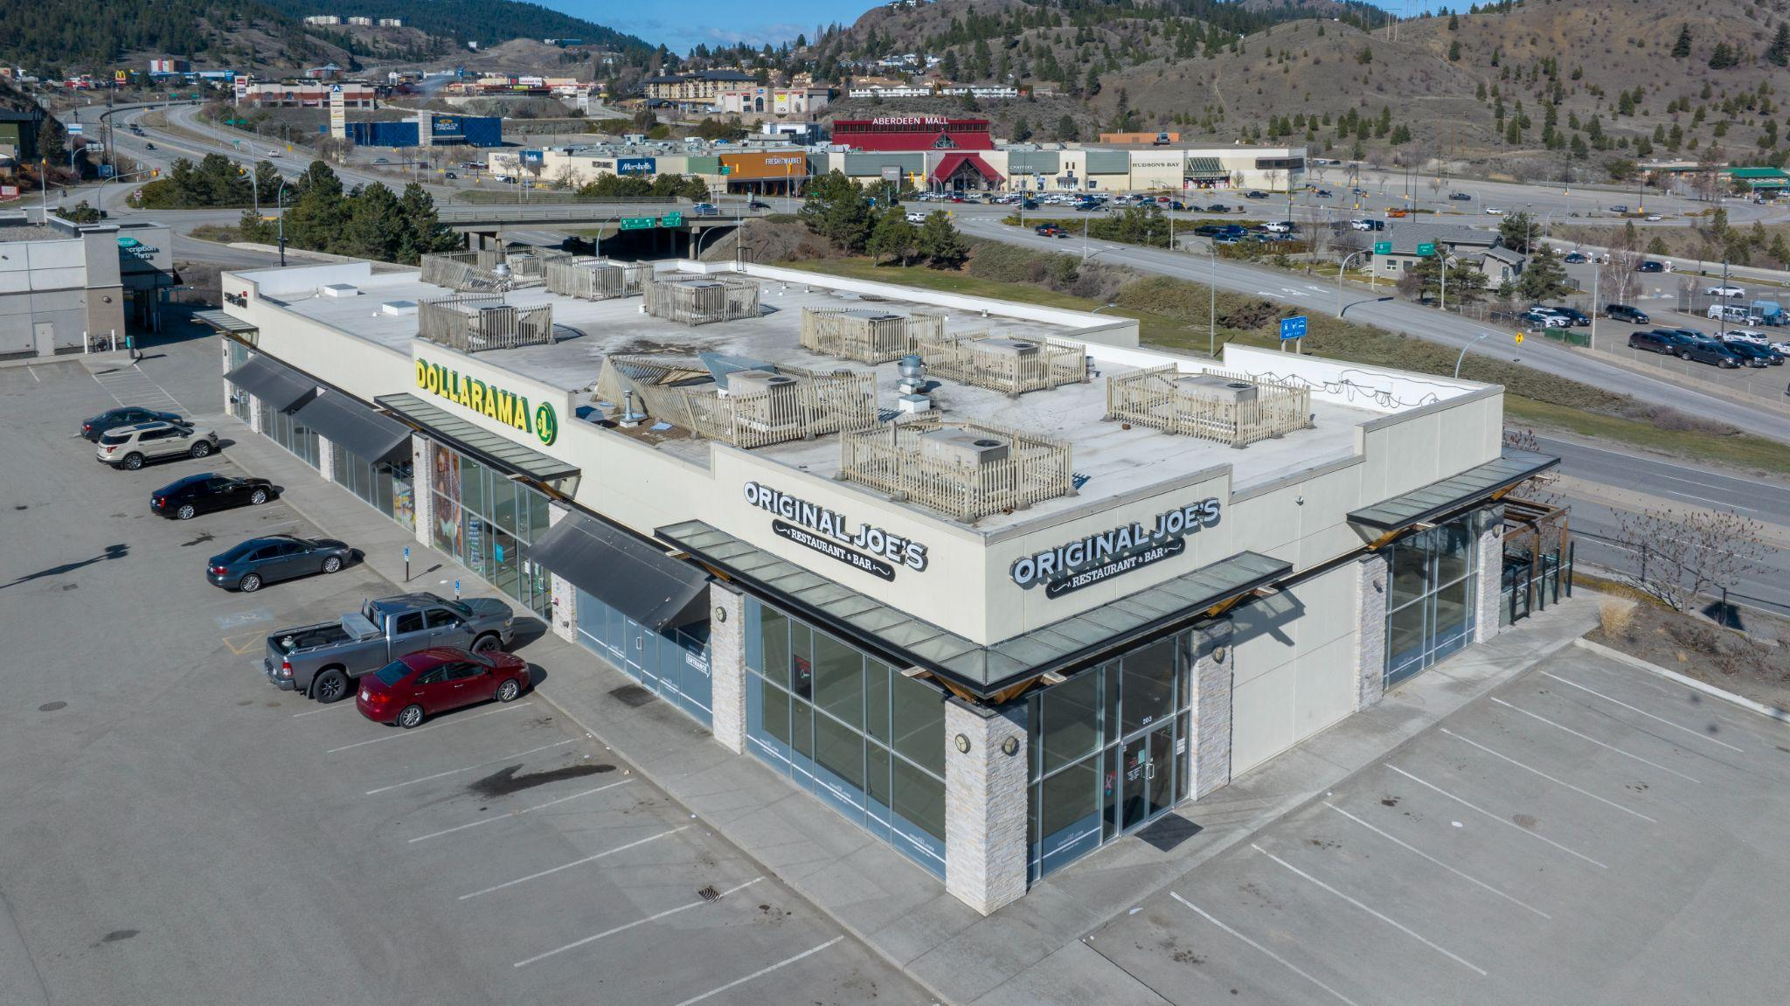
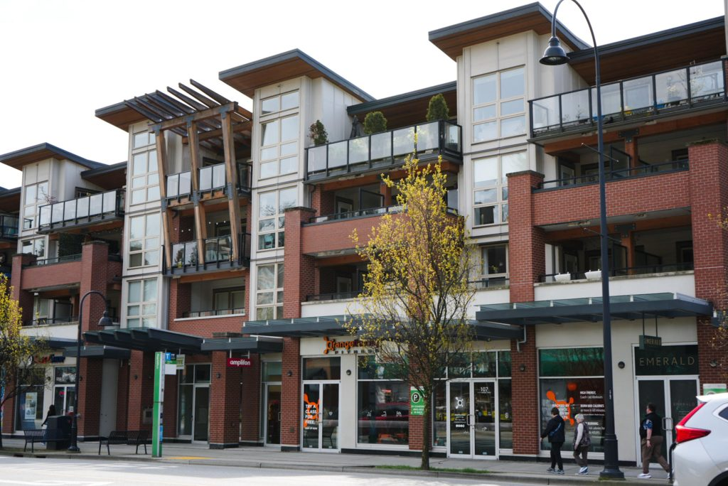
NOW LEASING
NOW LEASING
KAMLOOPS, BC
Cityview Centre
ADDRESS: 1801 PRINCETON-KAMLOOPS HIGHWAY
CONTACT: TANYA COKRAN
COMPANY: COLLIERS INTERNATIONAL
PHONE: 250.819.4595
AVAILABILITY:
BUILDING FEATURES:
Join Rexall, Dollarama, Anytime Fitness, and Starbucks in this exciting development
80,000 sq.ft. of new retail space in the affluent south end of Kamloops
Excellent exposure to Trans-Canada Highway and Highway 5A
Turnkey packages available for spaces, ready for immediate occupancy
Unit 201 | 1,115 SF | Under contract
Unit 407 | 1,325 SF | Available Immediately
NORTH VANCOUVER, BC
The Drive 2
ADDRESS: 1177 MARINE DRIVE
CONTACT: ROSS FORMAN & JEFF PILKINGTON
COMPANY: BABYCH GROUP REALTY LTD.
PHONE: 604.980.3003
AVAILABILITY:
BUILDING FEATURES:
Approximately 12,000 sq. ft. of commercial space with prime street front exposure
Convenient access to public transit
Strong area demographic with a growing residential and commercial community
Unit 105 | 958 SF | Available September 1, 2026

Slide 6
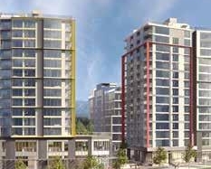
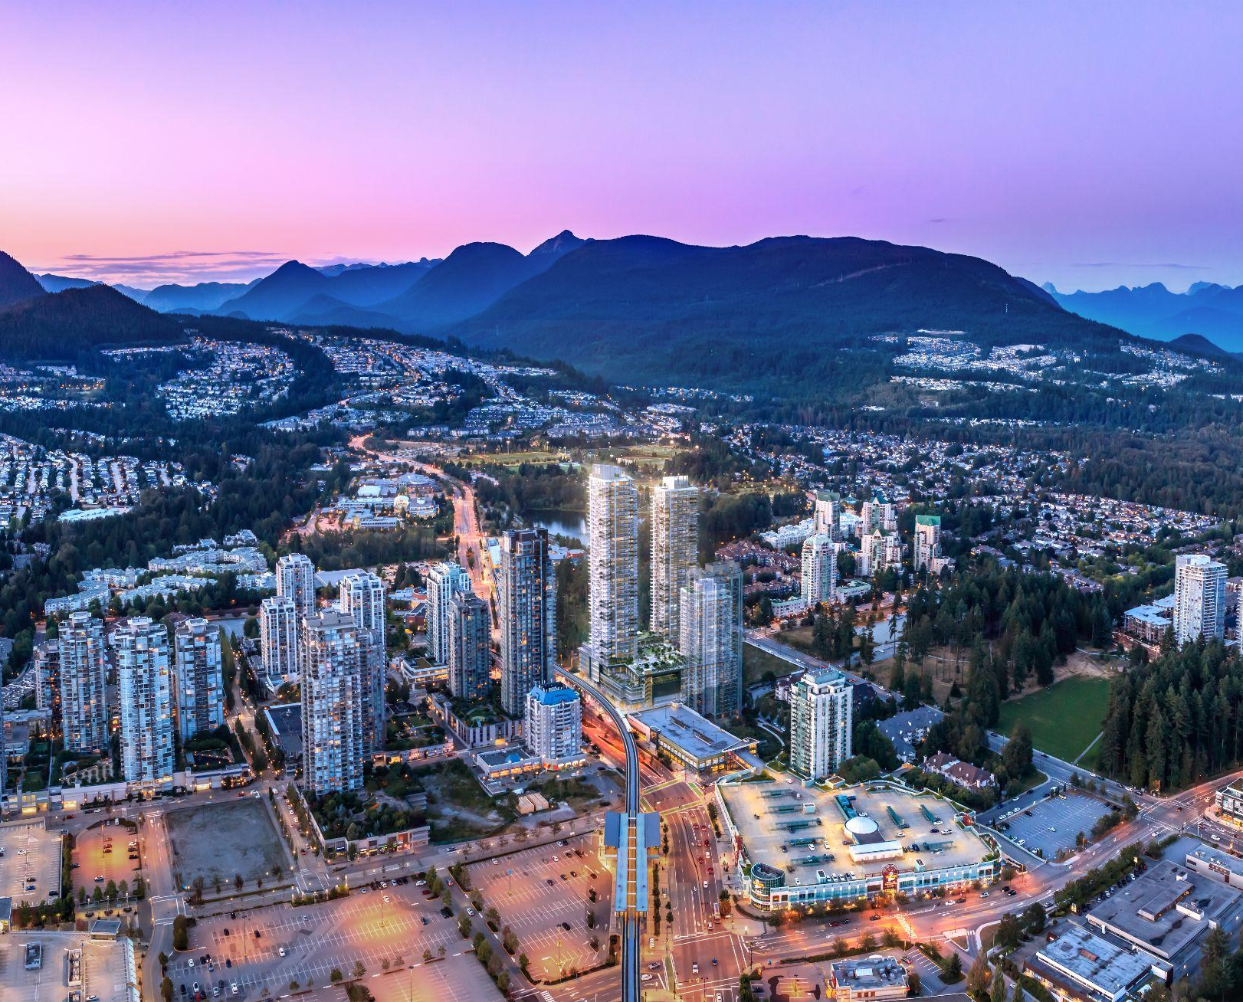

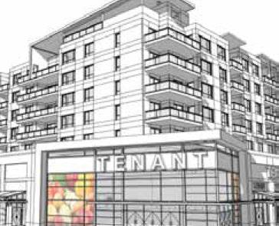
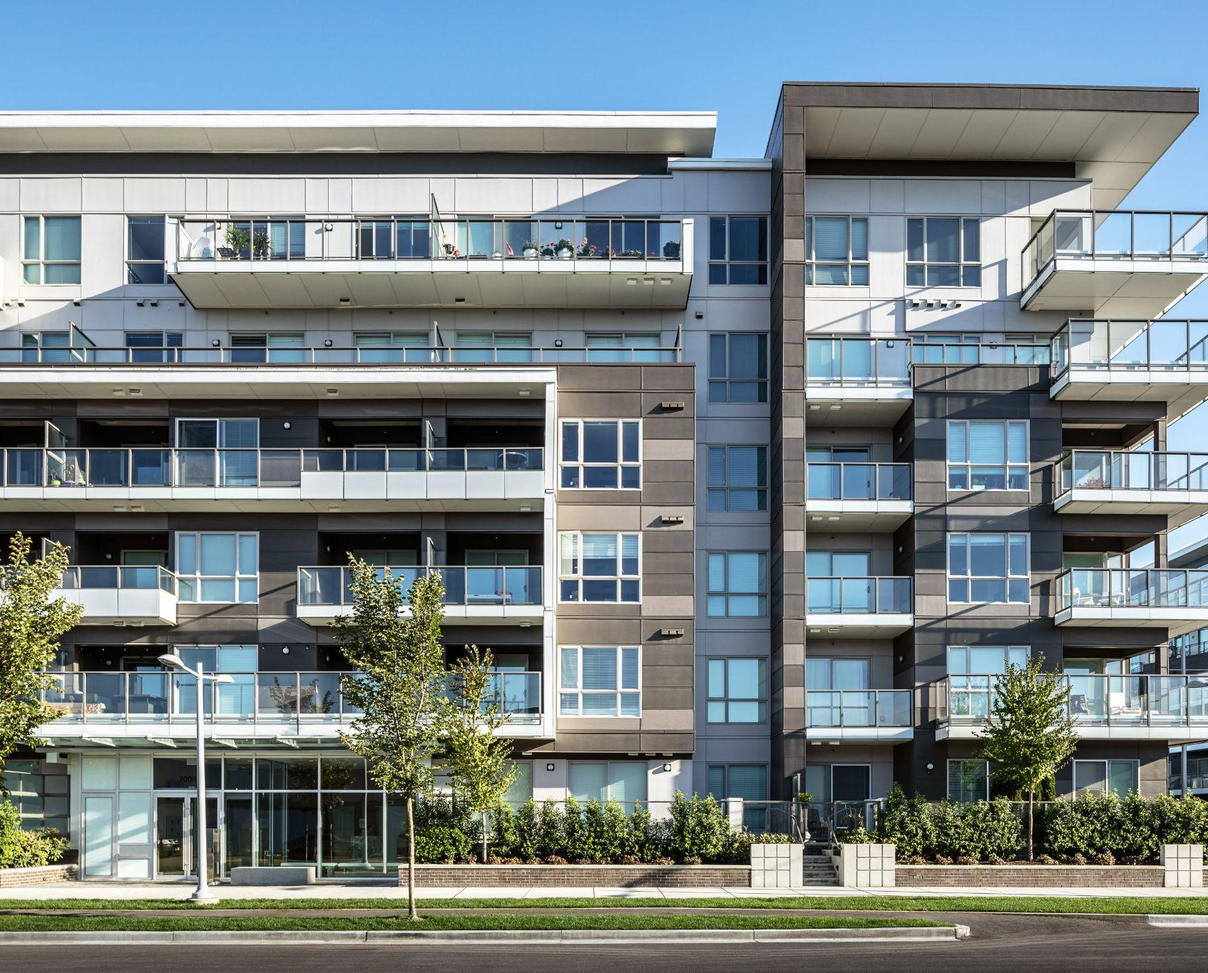
NOW PRE-LEASING
VANCOUVER, BC
East 1st
ADDRESS: 375 EAST 1ST AVENUE
CONTACT: PETER MCFETRIDGE
COMPANY: ONNI GROUP
PHONE: 604.688.8783
AVAILABILITY:
PROJECT FEATURES:
220 residential units
100,000 SF of hotel
129,000 SF of office
Dense neighbourhood with substantial growth projections
Adjacent to the future Great Northern Way SkyTrain Station
Approximately 43,000 SF
Available Q1 2031
COQUITLAM, BC
Pine & Glen
PROJECT FEATURES:
Mixed-use development in the heart of Coquitlam
Over 900 residential units, 35,000 SF of office space, and 13,000 SF of ground floor retail space
Transit-oriented site, within walking distance to both Coquitlam central and Lafarge Lake /Douglas Skytrain Stations
ADDRESS: 3022 GLEN DRIVE
CONTACT: HILARY TURNBULL
COMPANY: ONNI GROUP
PHONE: 604.488.8988
AVAILABILITY:
North CRU’s | 7,101 SF (Demise options) | Available Q1 2027
West CRU’s | 6,185 SF (Demise options) | Available Q1 2027
PORT COQUITLAM, BC
Fremont Village - New Phase
ADDRESS: LOUGHEED HWY & MARYHILL BYPASS
CONTACT: MARK REID
COMPANY: ONNI GROUP
PHONE: 604 488 2773
AVAILABILITY:
PROJECT FEATURES:
50-acre site neighboring Costco, Home Depot, Save- On-Foods
Anchored by Walmart, Canadian Tire, Mark’s, and Shoppers Drug Mart
High traffic counts and all-directional access
Ground floor commercial
200 residential units directly above
60,000 SF
Available Q4 2028
Units from 1,000 SF to 37,000 SF
RICHMOND, BC
Riva
ADDRESS: 7811 ALDERBRIDGE WAY
CONTACT: HILARY TURNBULL
COMPANY: ONNI GROUP
PHONE: 604.488.8988
AVAILABILITY:
PROJECT FEATURES:
Final phase of the Riva mixed use development
Approx. 160 residential units
Located across from Middle Arm Park in Richmond
CRU | 2,960 SF (Demise options) | Available Q2 2028
200 - 1010 SEYMOUR STREET, VANCOUVER, BC | 604.688.8783 | LEASING@ONNI.COM

Slide 7
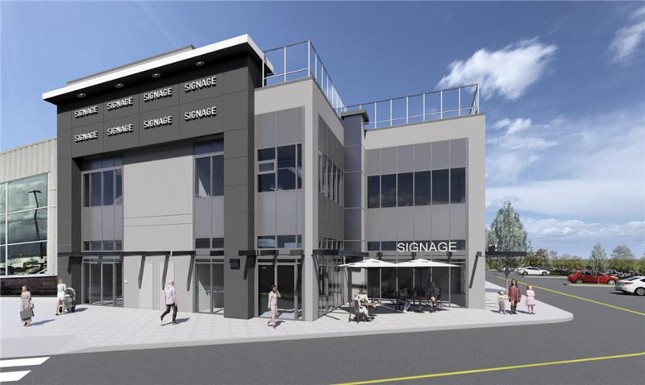
NOW PRE-LEASING
PITT MEADOWS, BC
Meadowtown Expansion Building
ADDRESS: 19800 LOUGHEED HIGHWAY
CONTACT: JACK ALLPRESS & ROBERT HAMILTON
COMPANY: MARCUS & MILLICHAP
PHONE: 604.398.2773
AVAILABILITY:
PROJECT FEATURES:
420,000 SF of retail space
Direct access to the Golden Ears amd Lougheed Highway
Strong existing tenant mix with diverse retail offerings
Approximately up to 13,603 SF (units may be demised)
Available Q4 2027
200 - 1010 SEYMOUR STREET, VANCOUVER, BC | 604.688.8783 | LEASING@ONNI.COM

Slide 8
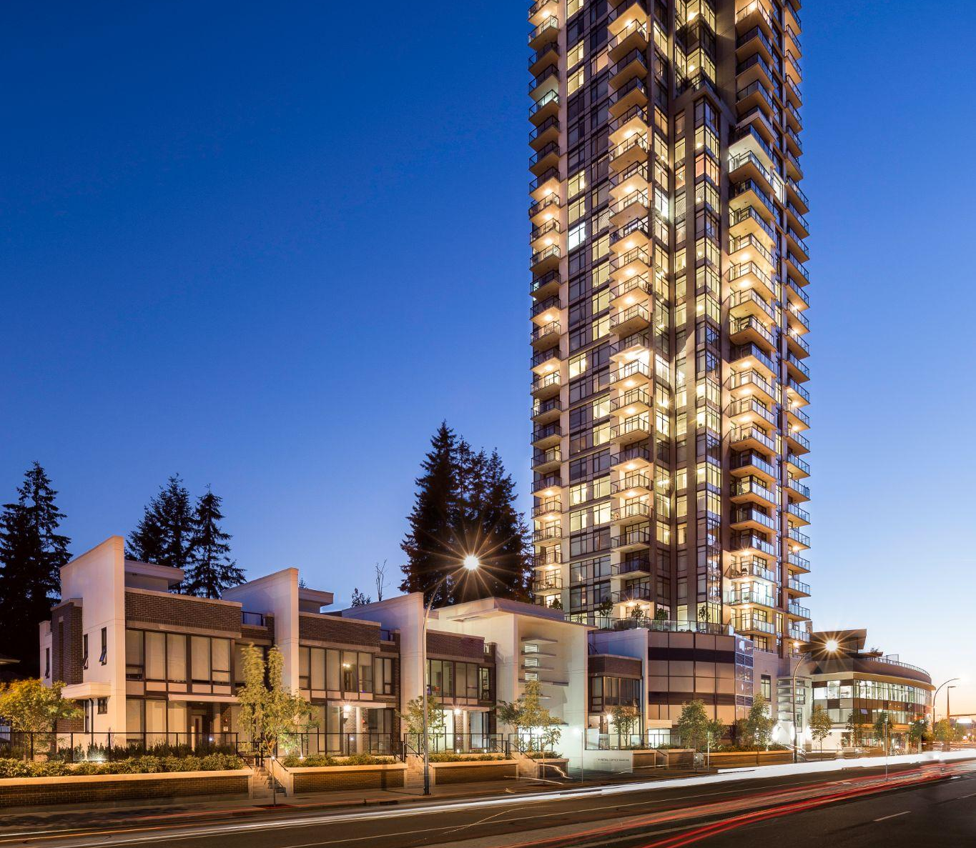
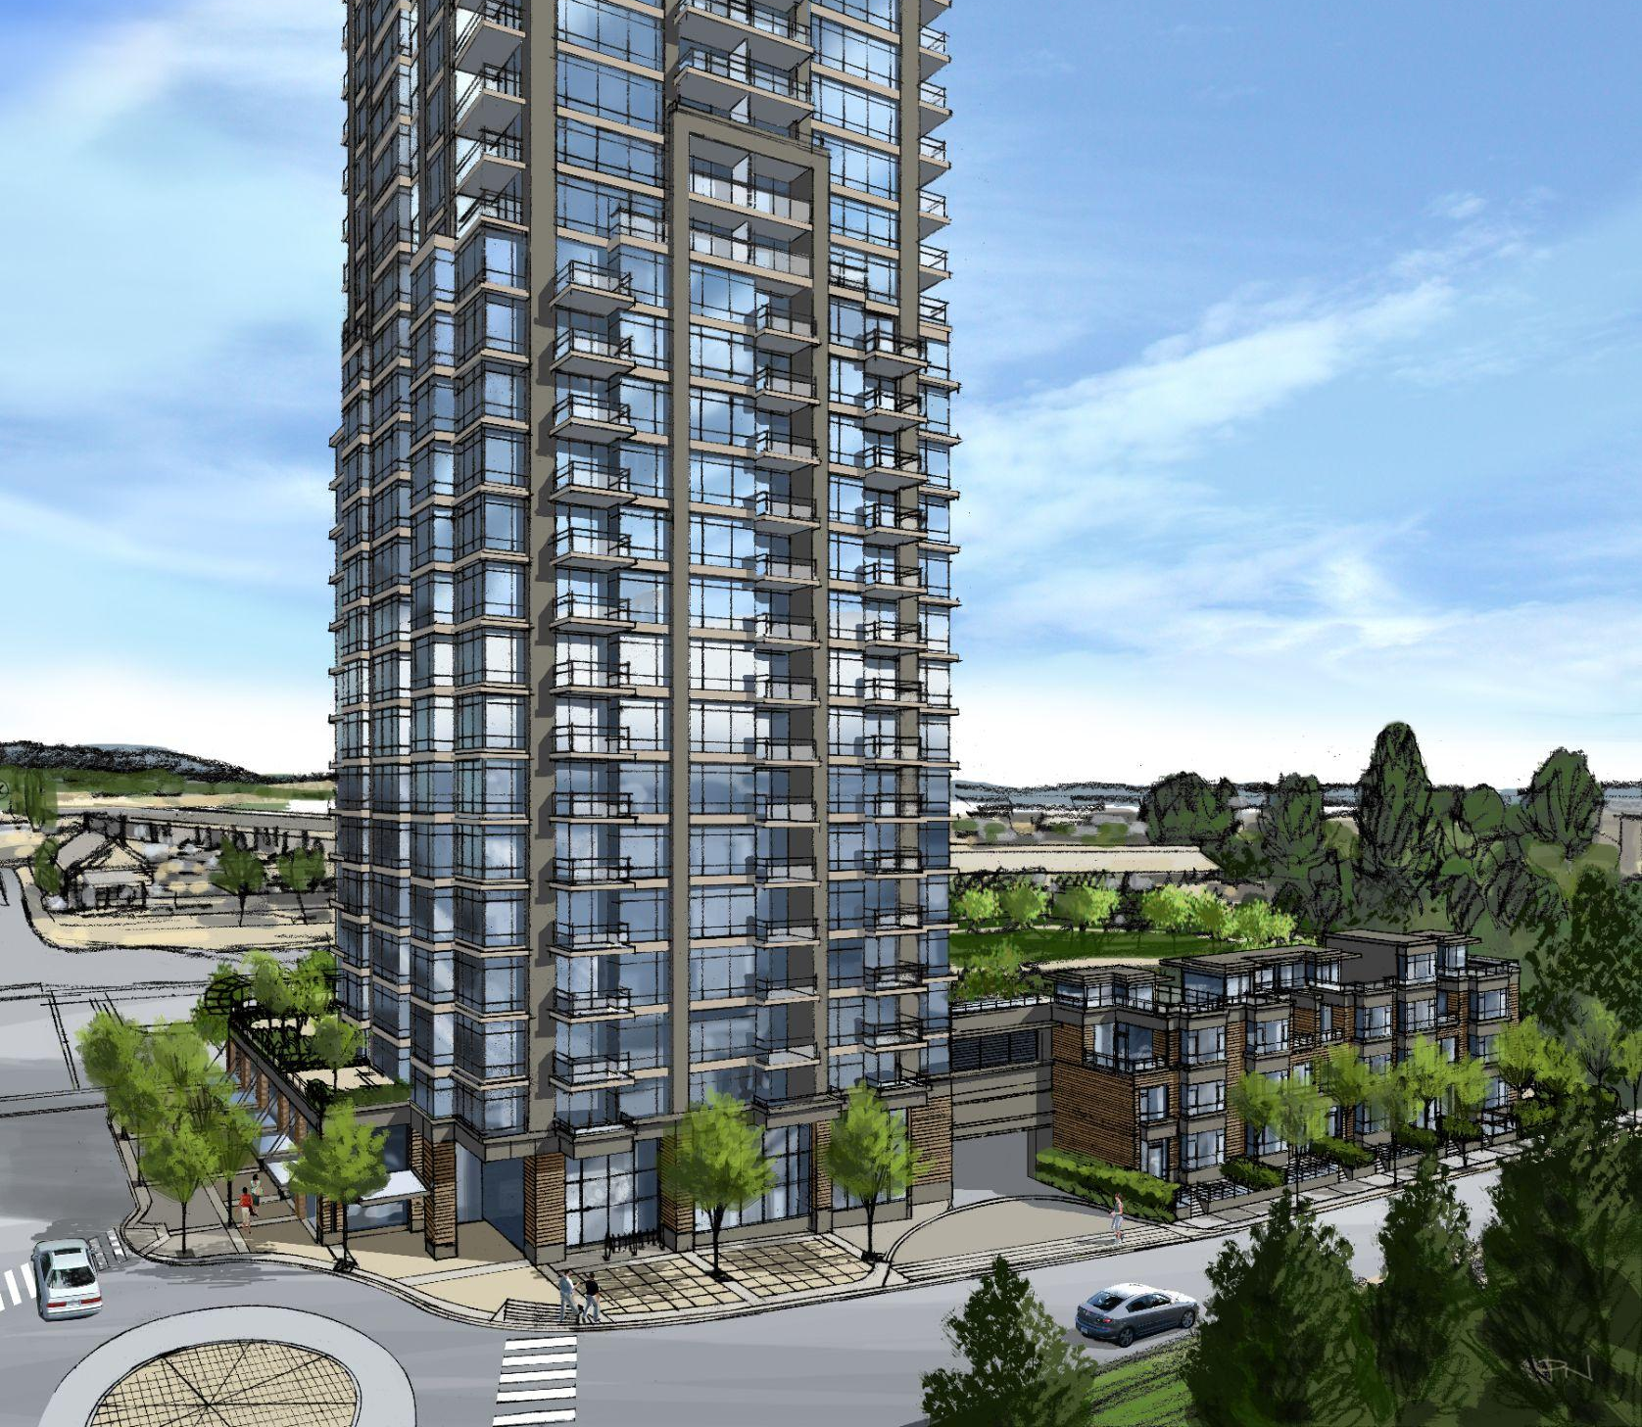
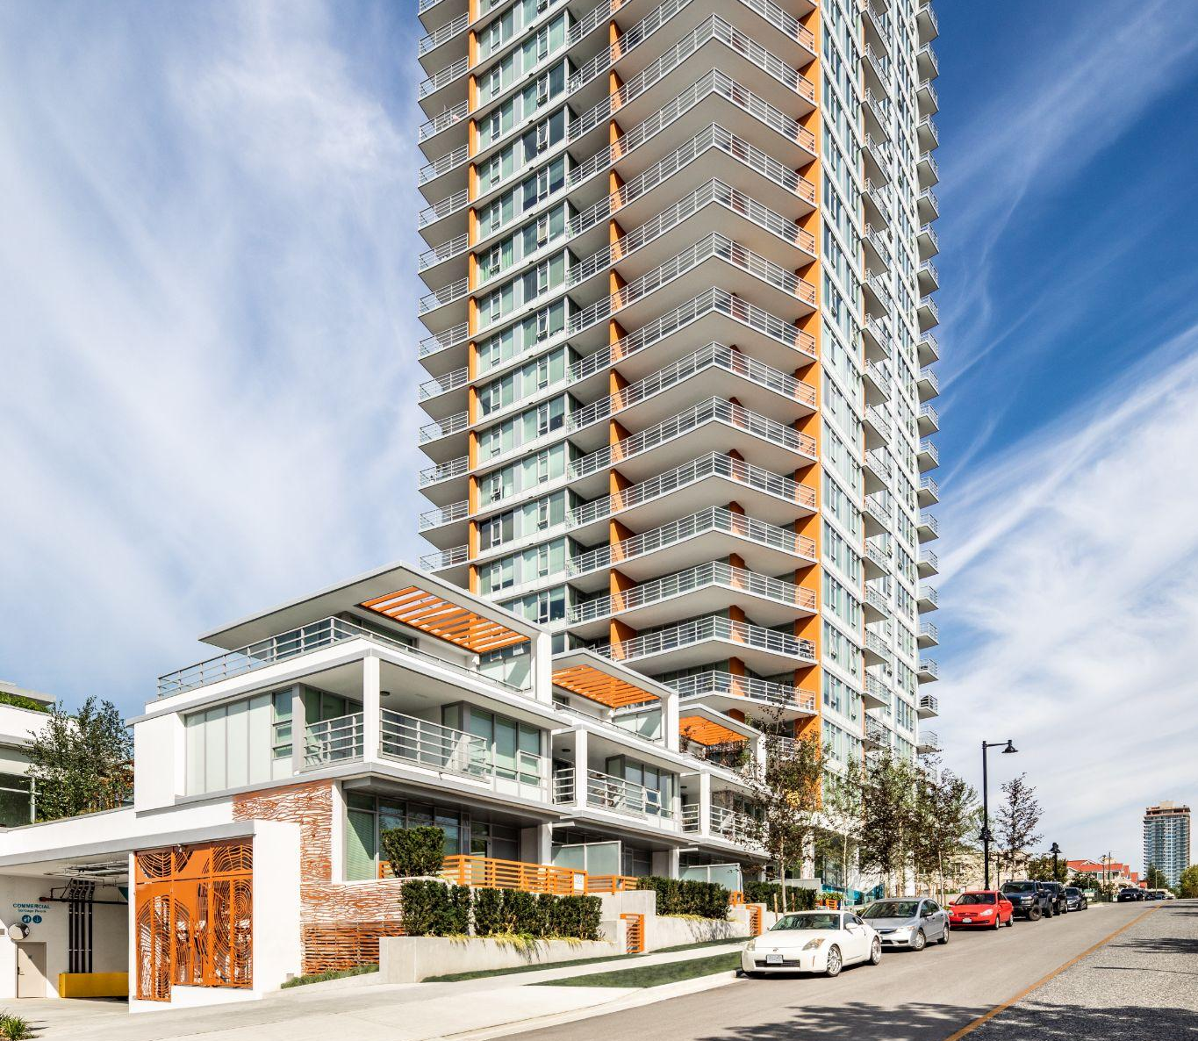
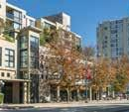
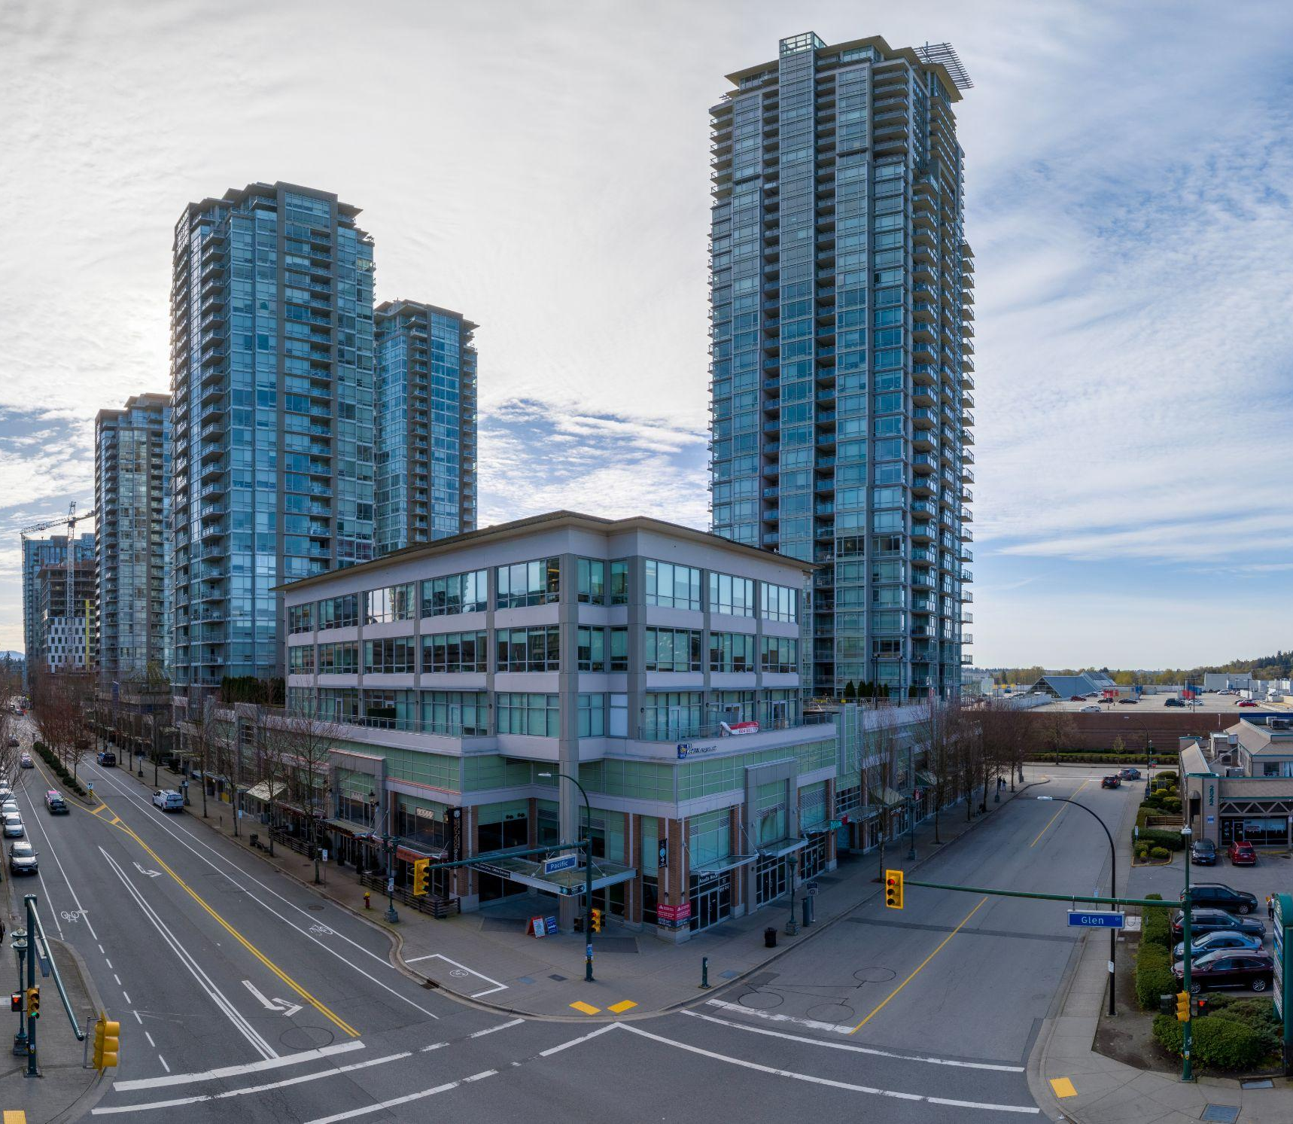
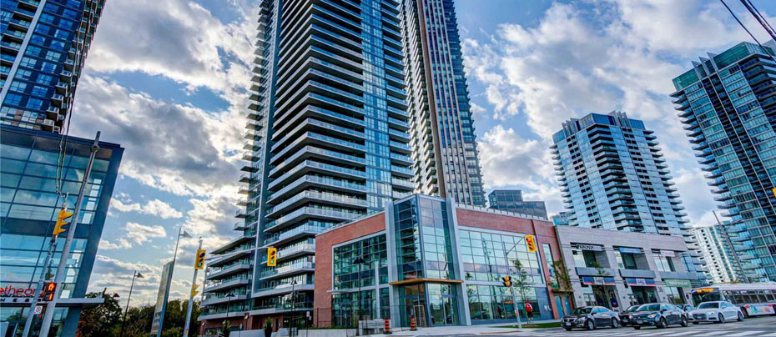
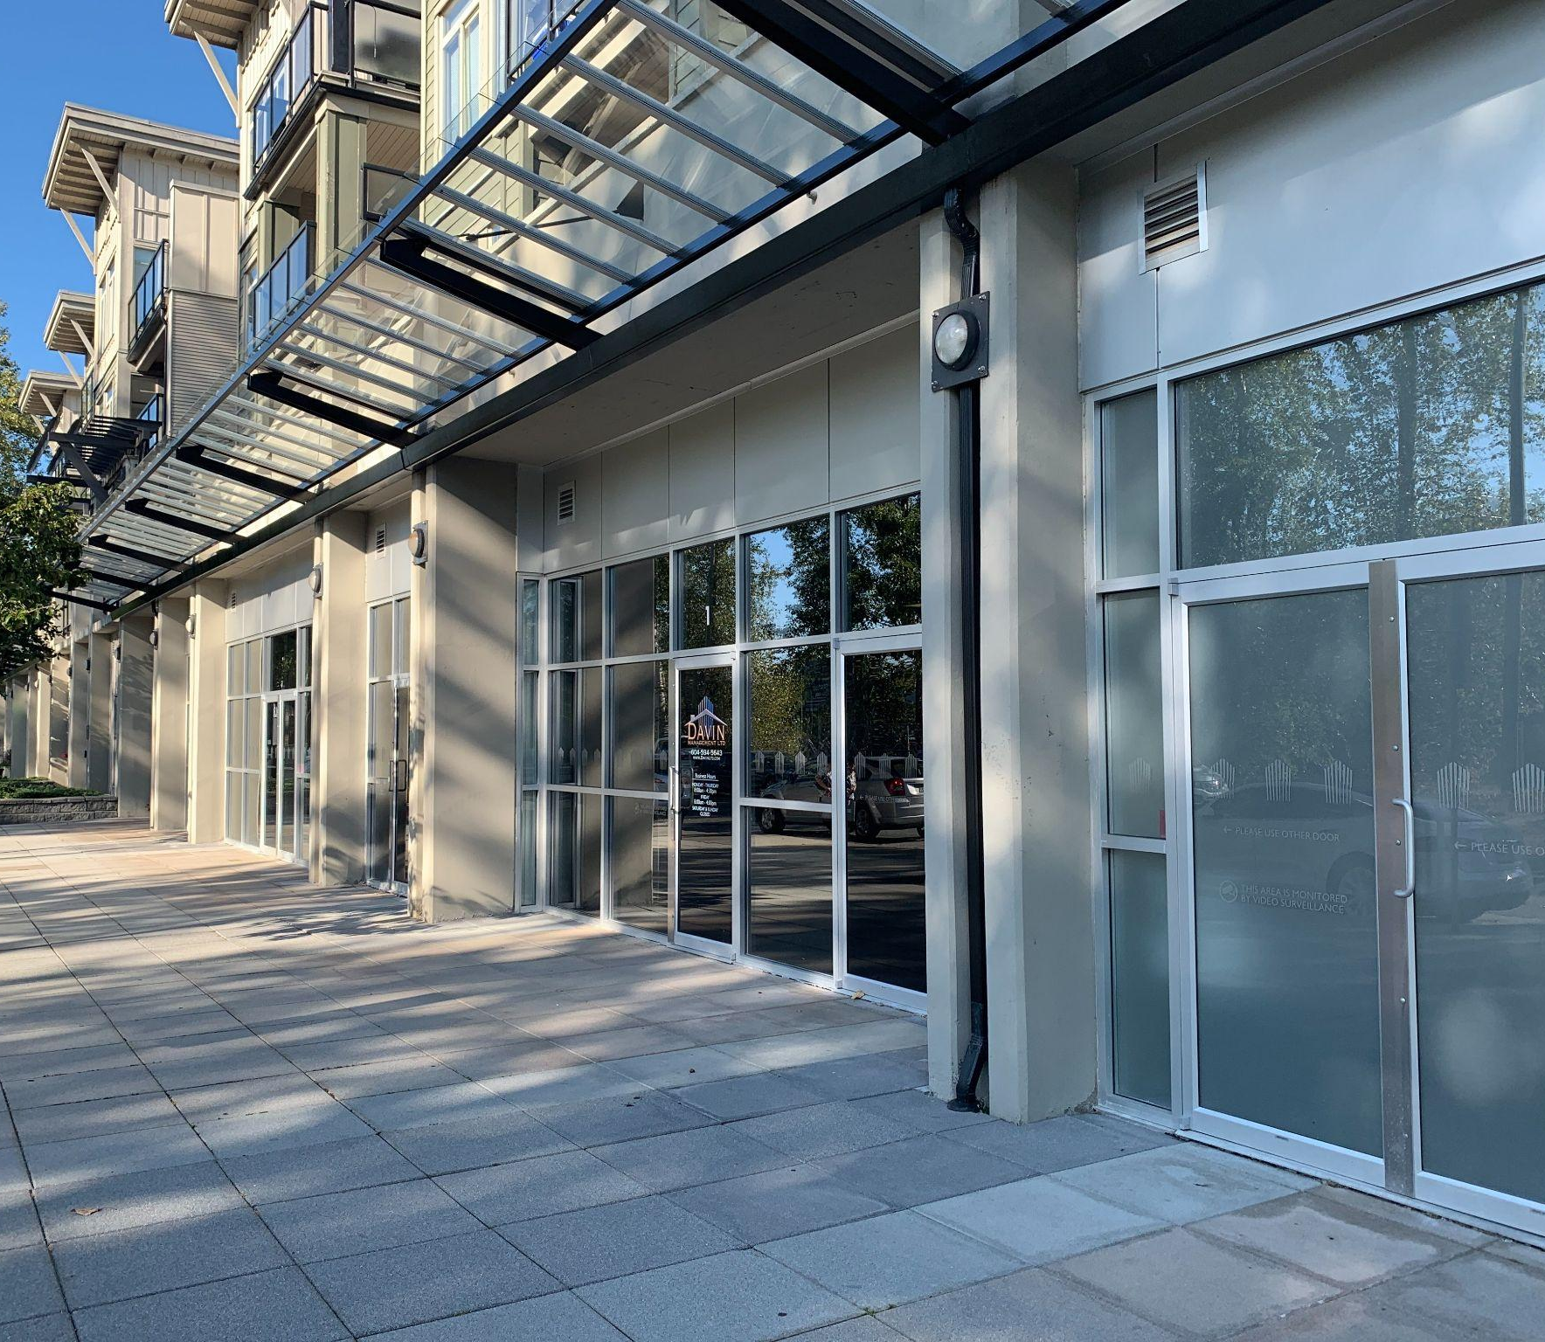
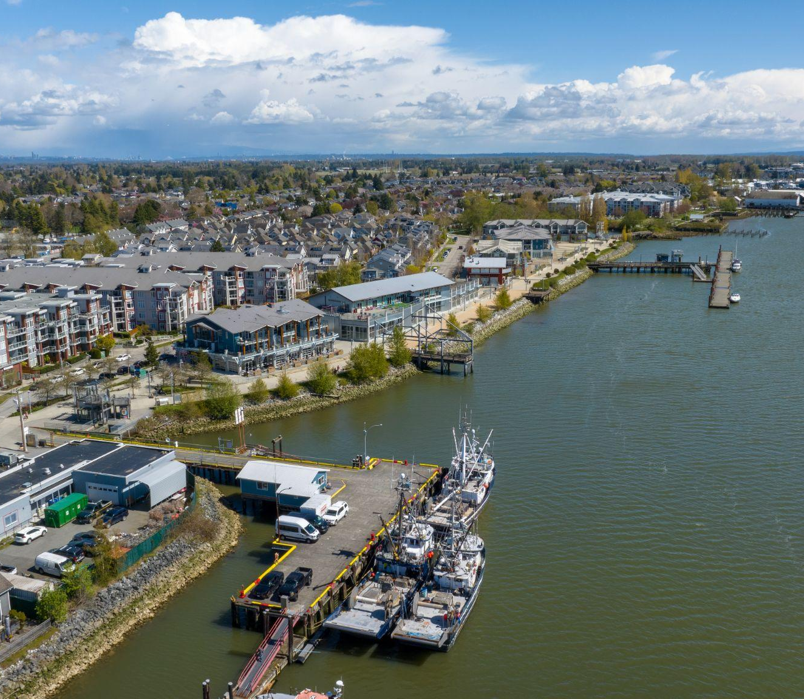
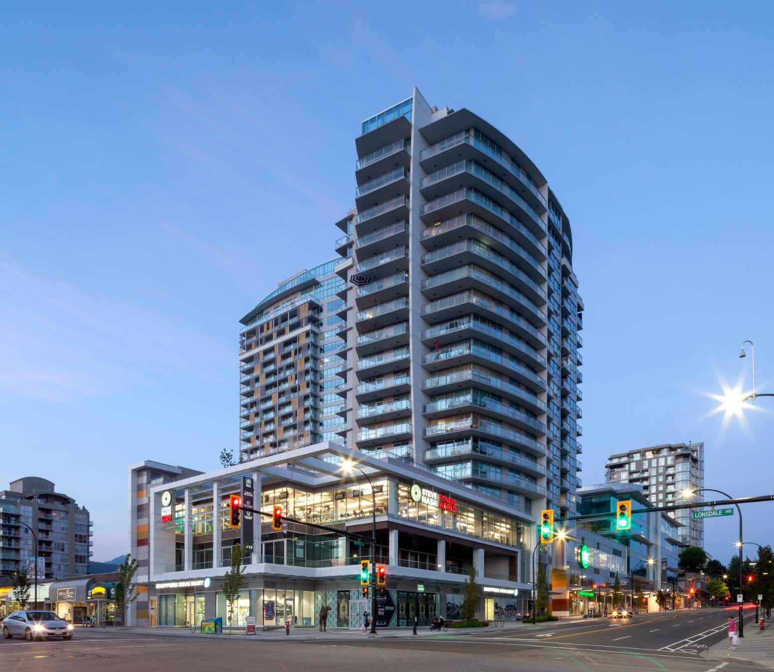
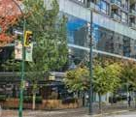
FULLY LEASED
COQUITLAM, BC
PORT COQUITLAM, BC
Westwood
1123 Westwood Street
The Shaughnessy
2789 Shaughnessy St
COQUITLAM, BC
RICHMOND, BC
Brookmere
525-535 North Road
Capri
7831 Westminster Hwy
COQUITLAM, BC
TORONTO, ON
Oasis
2950 Glen Drive
Encore
SURREY, BC
RICHMOND, BC
Charlton Park A
15380 102A Street
Imperial Landing 4180 Bayview Street
NORTH VANCOUVER, BC
VANCOUVER, BC
Centreview
13th & Lonsdale Ave
Seymour
1022 Seymour Street
200 - 1010 SEYMOUR STREET, VANCOUVER, BC | 604.688.8783 | LEASING@ONNI.COM

Slide 9
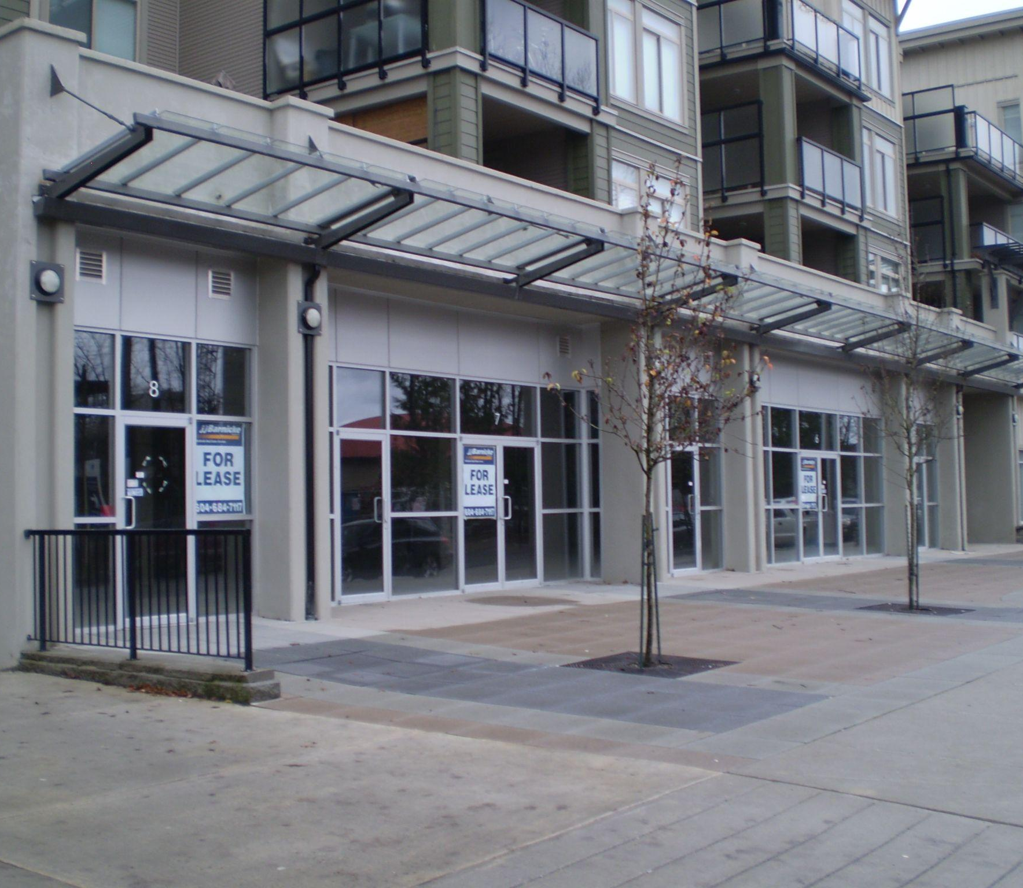
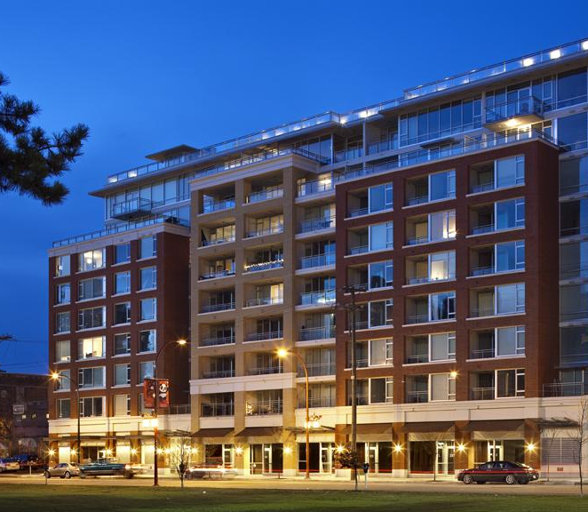
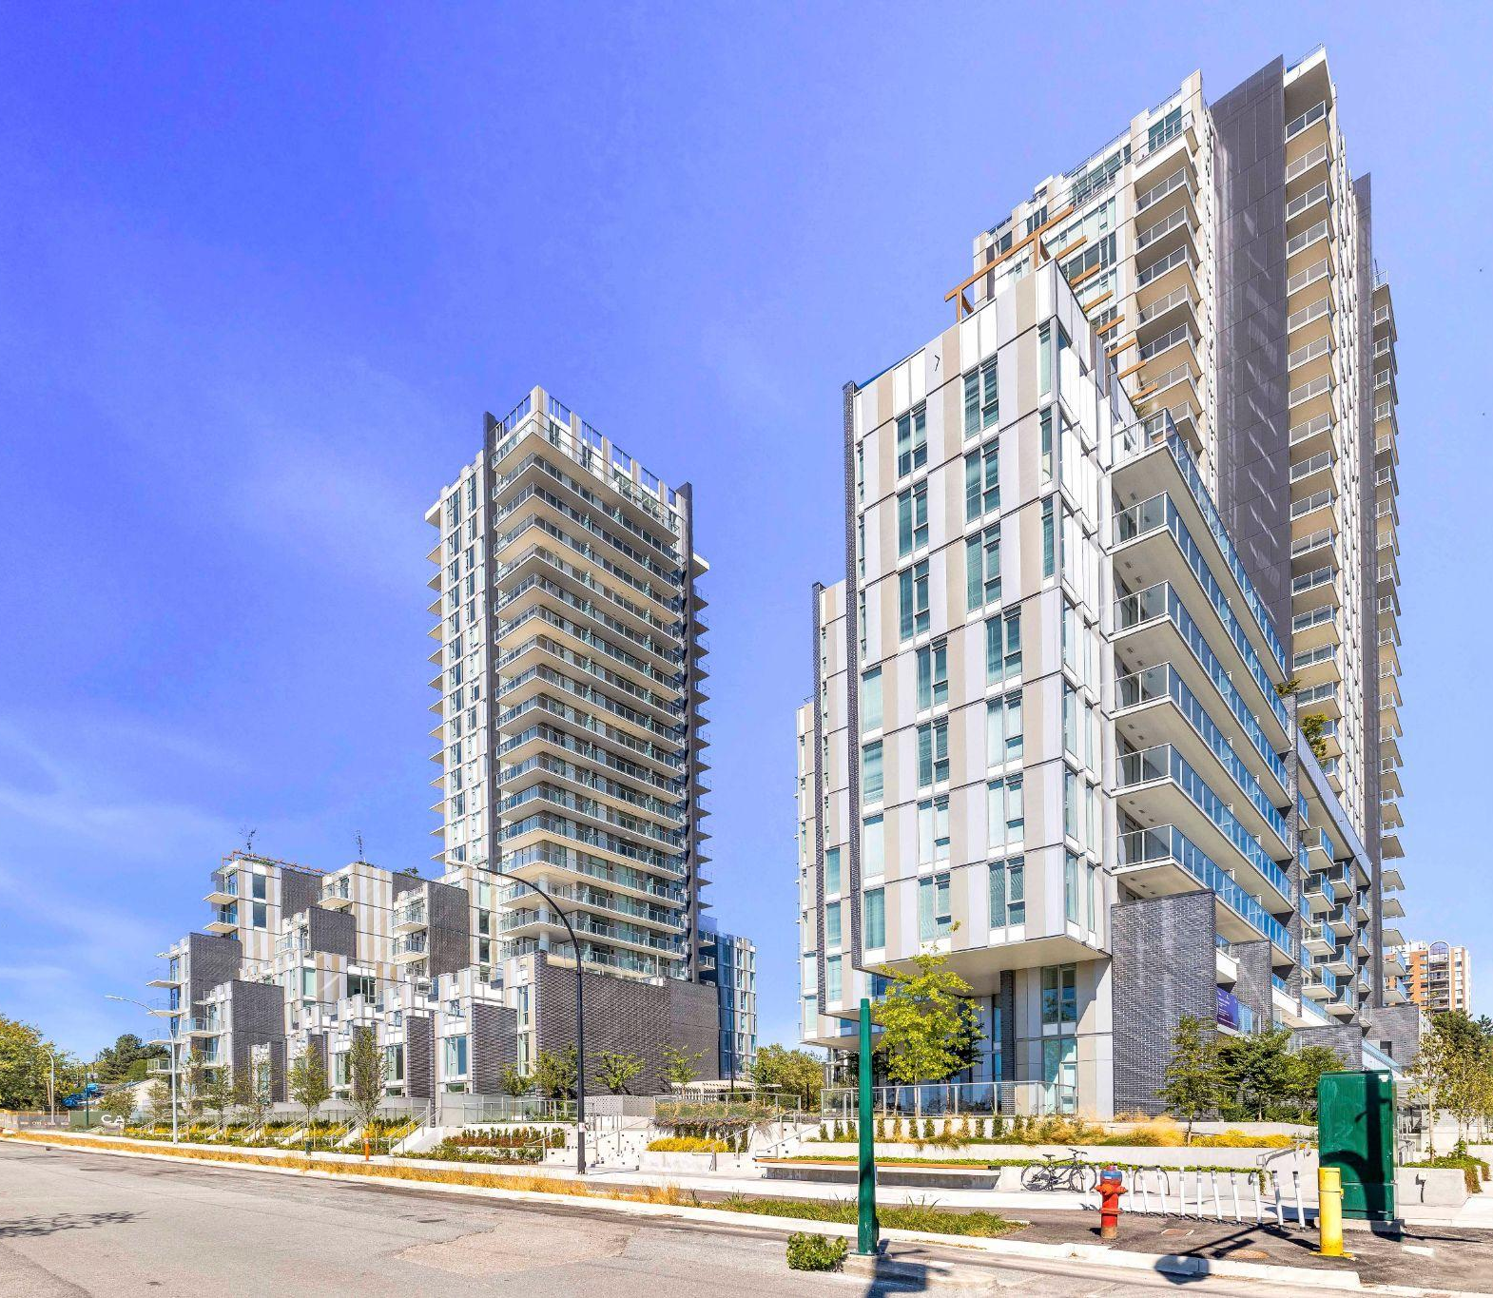
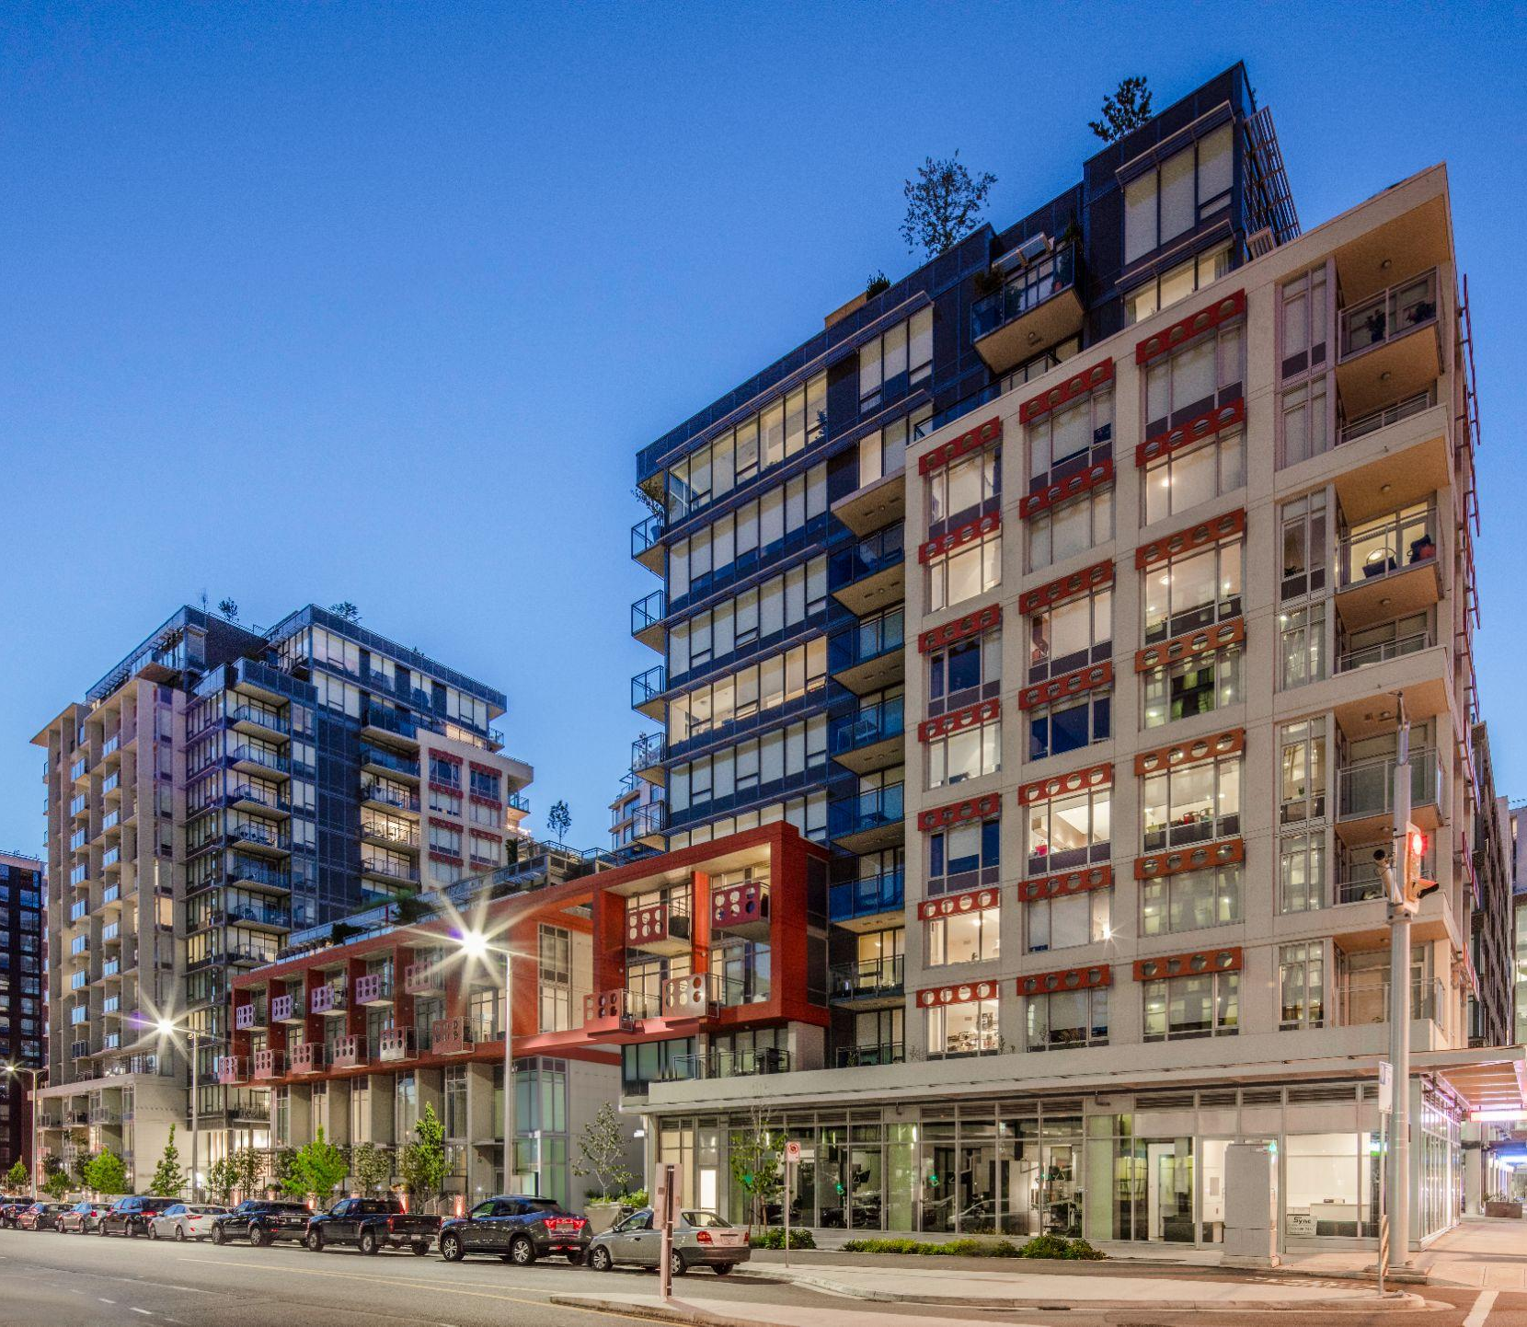
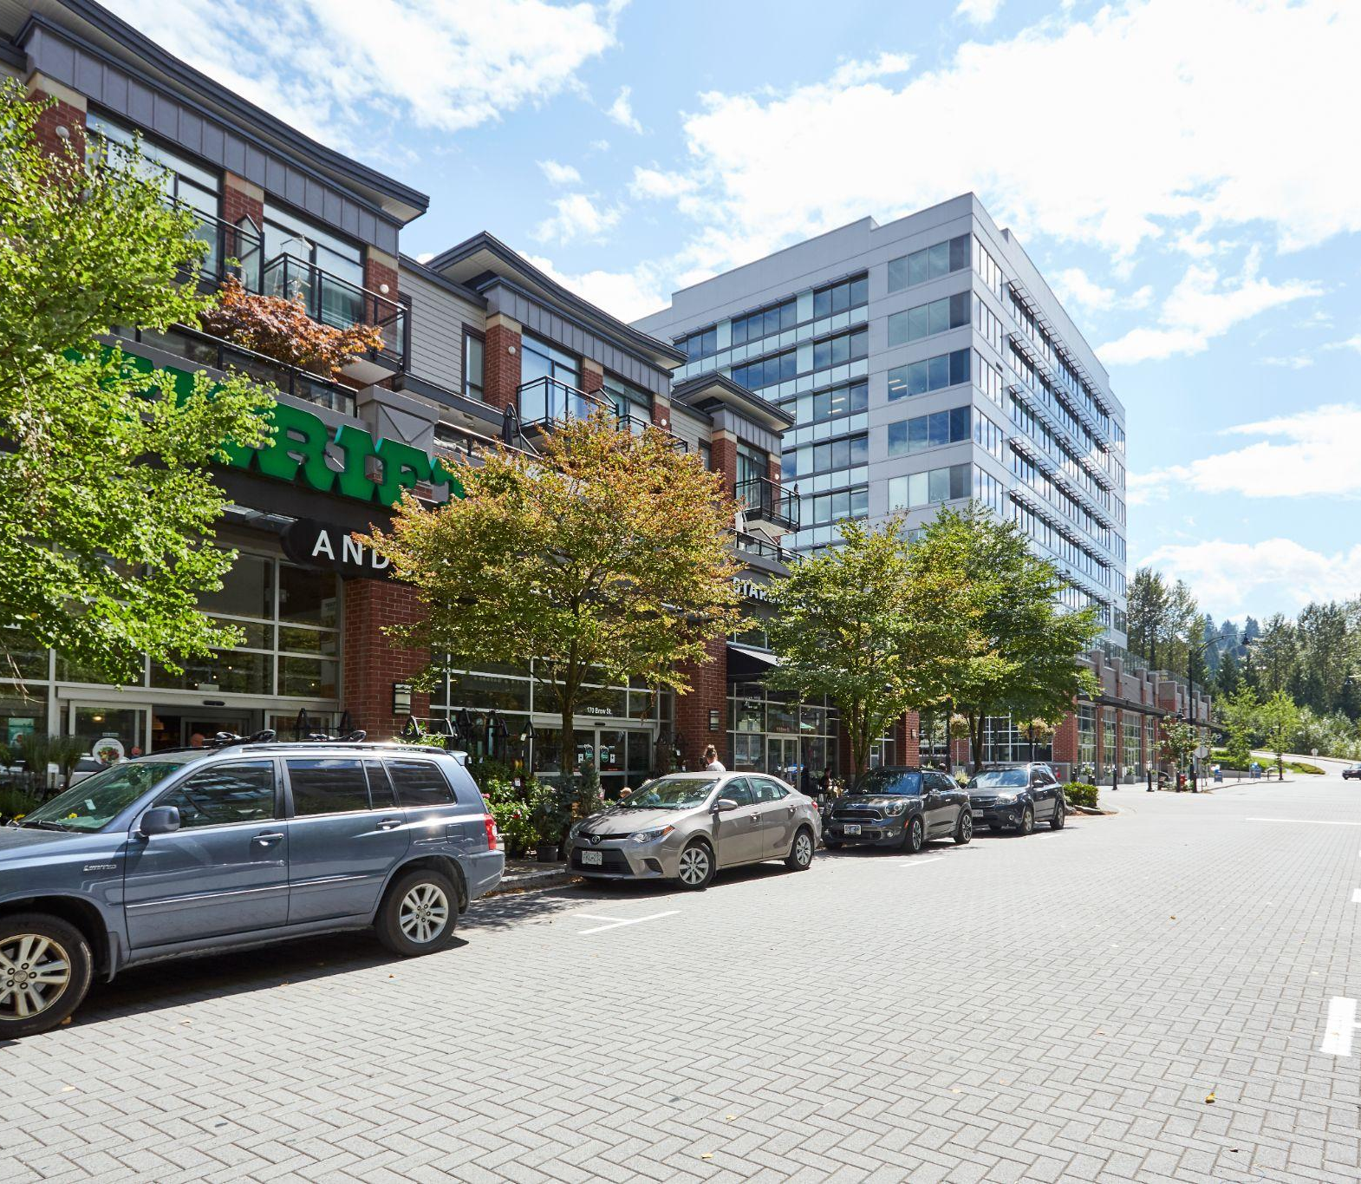
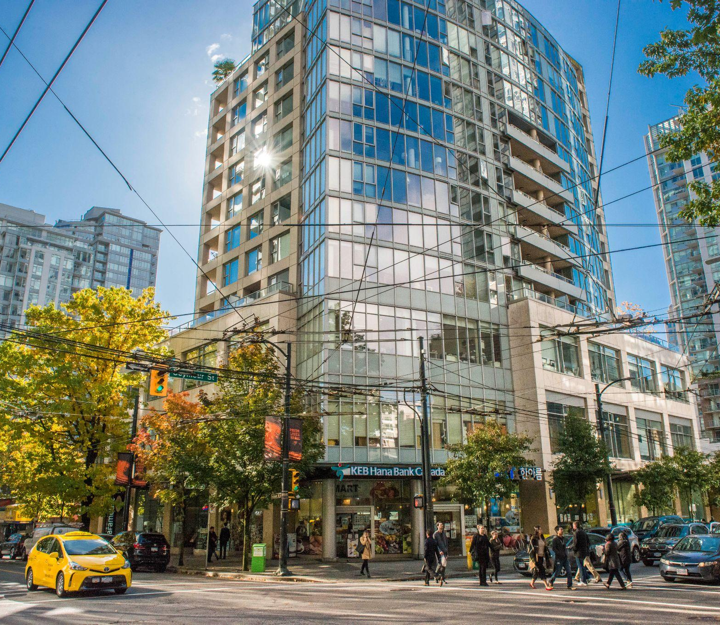
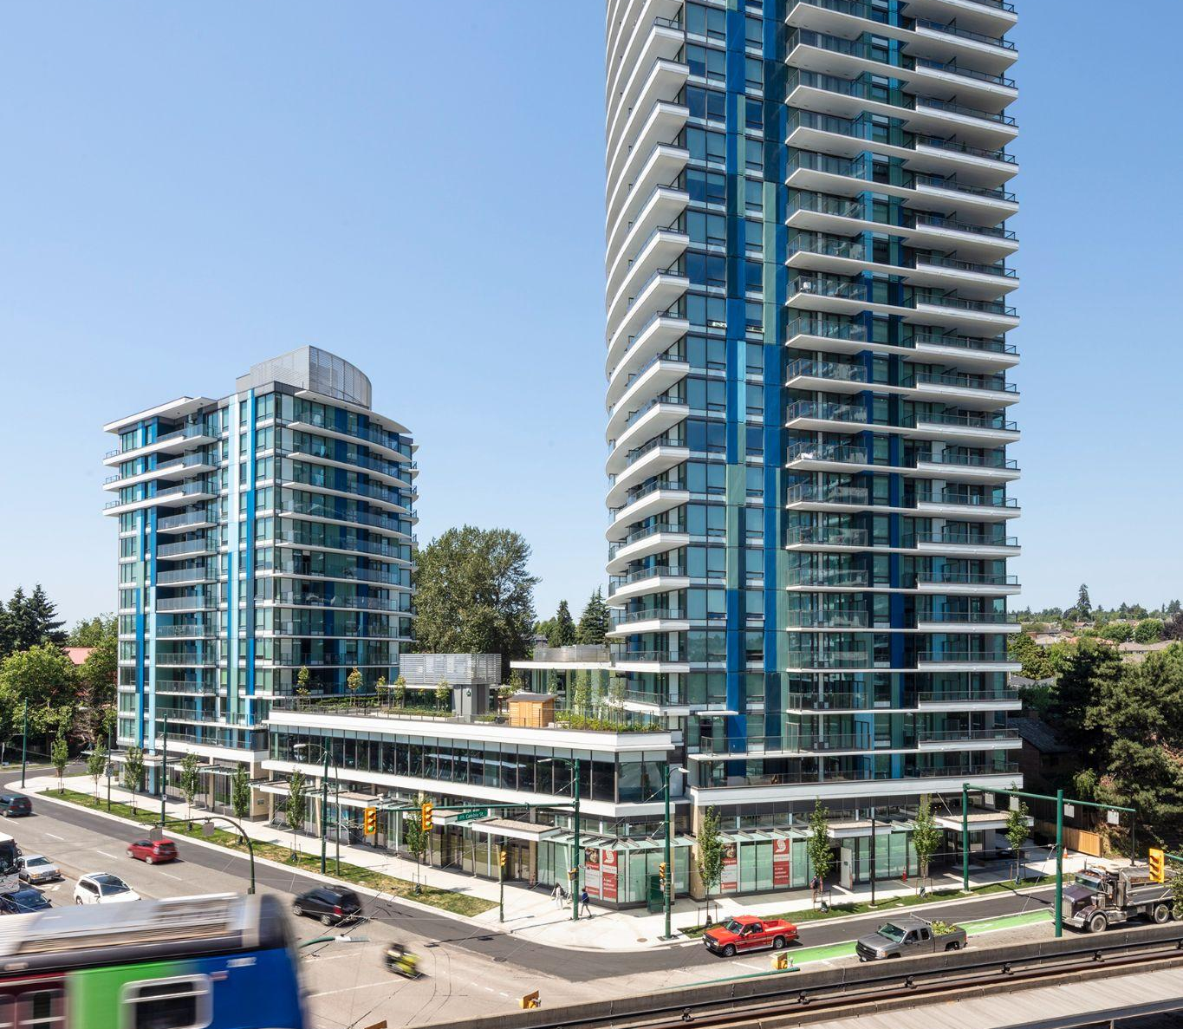
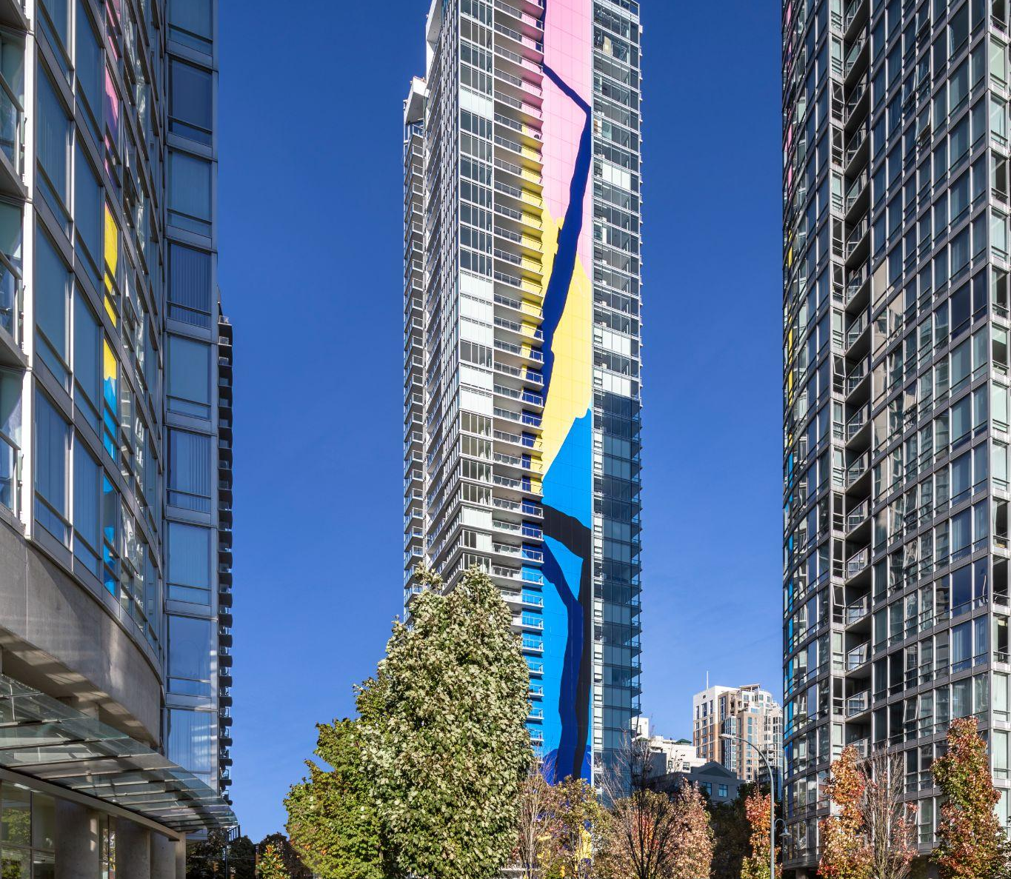
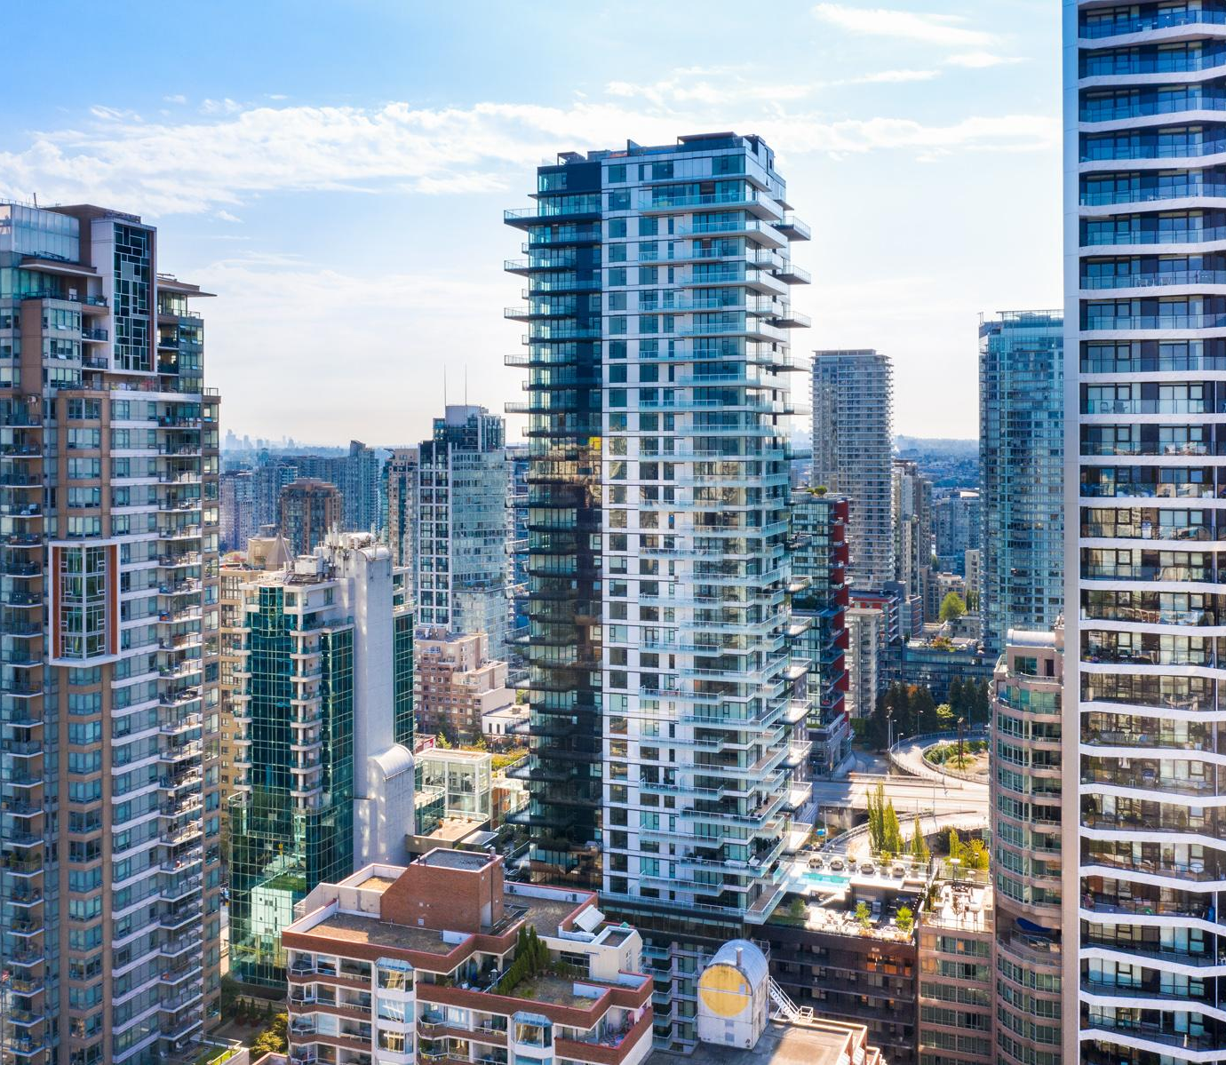
FULLY LEASED
SURREY, BC
VANCOUVER, BC
Charlton Park C
10180 153rd Street
V6A
221 Union Street
VANCOUVER, BC
VANCOUVER, BC
Cambie Gardens
Cambie & Heather Street
Block 100
1695 Main Street
PORT MOODY, BC
VANCOUVER, BC
Suter Brook Village
Robson
550 Robson Street
VANCOUVER, BC
VANCOUVER, BC
Northwest
8199 Cambie Street
The Charleson
1936 Richards Street
VANCOUVER, BC
1335 Howe
1335 Howe Street
200 - 1010 SEYMOUR STREET, VANCOUVER, BC | 604.688.8783 | LEASING@ONNI.COM

Slide 10
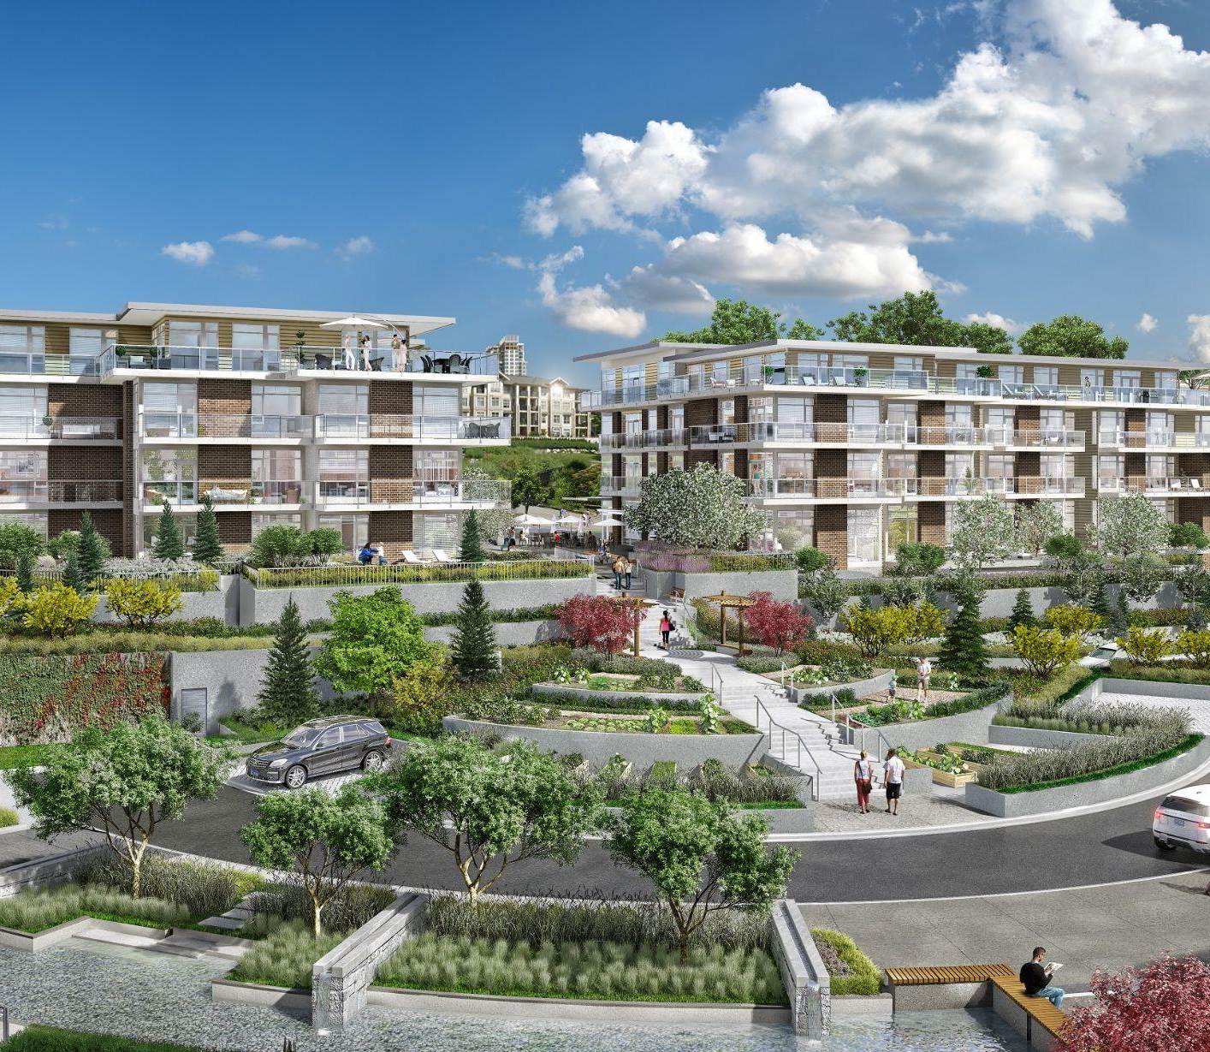
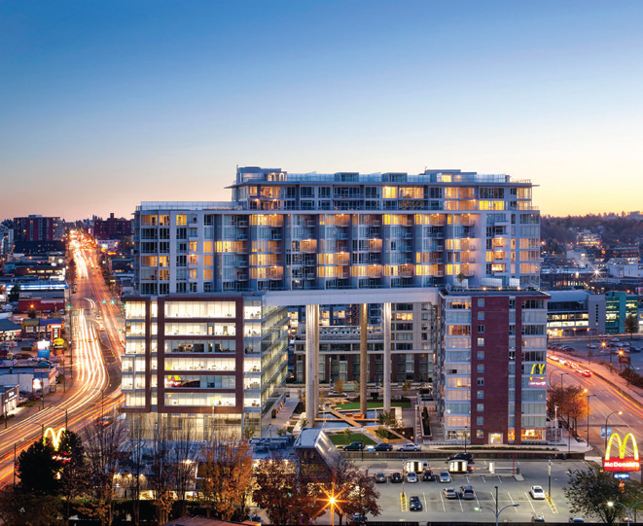
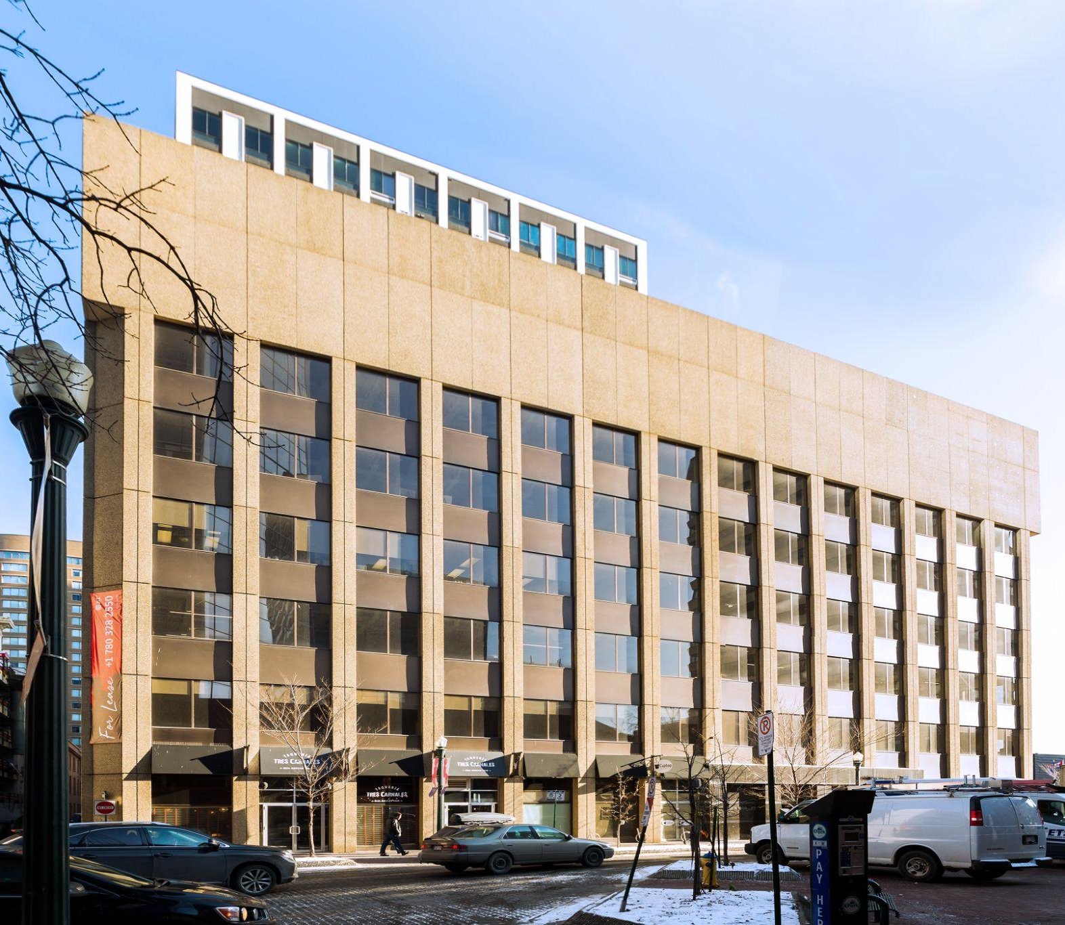
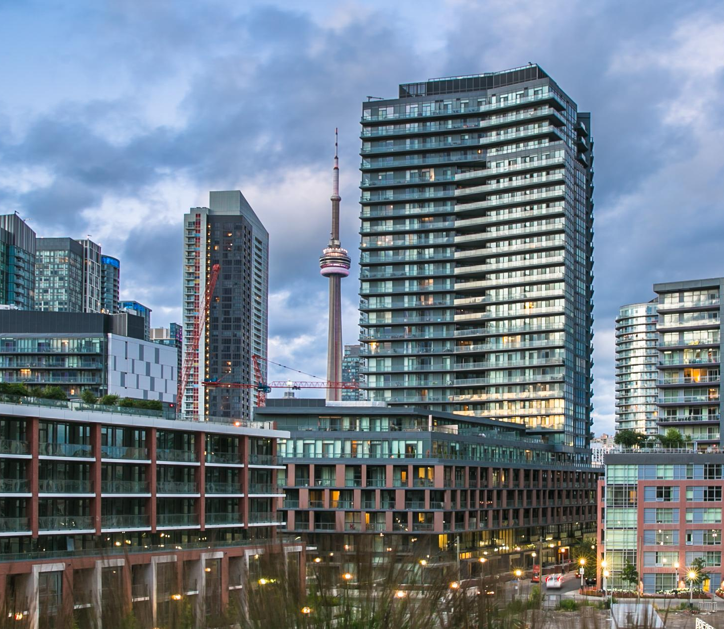
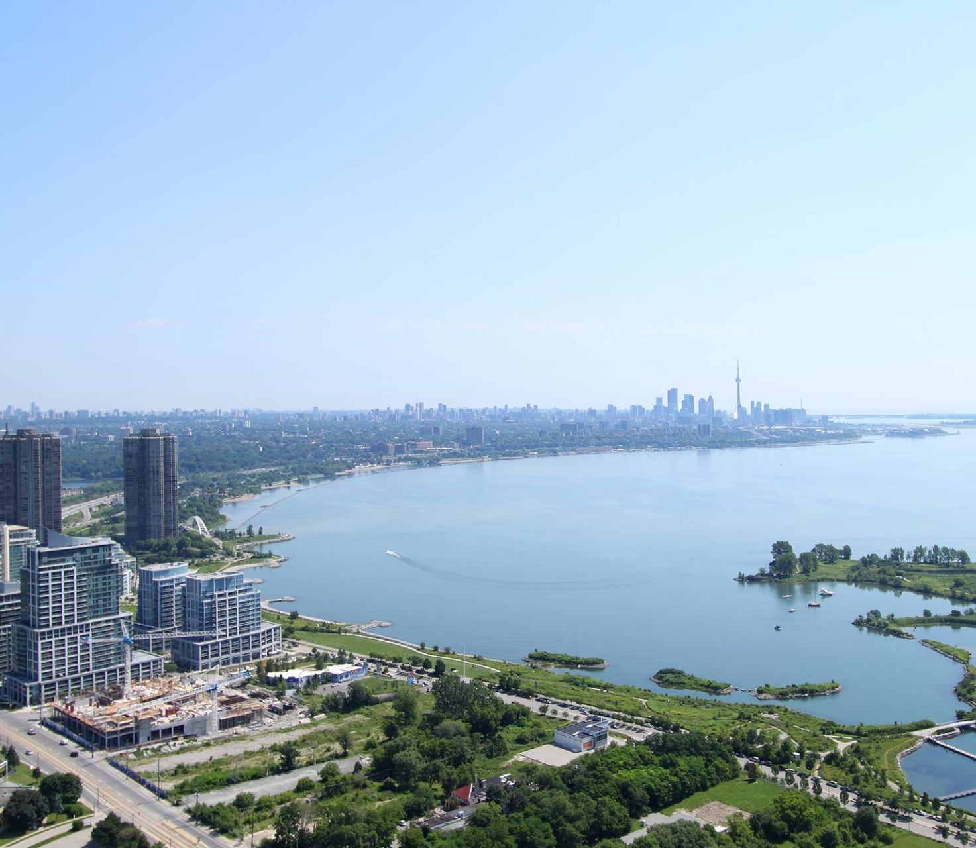
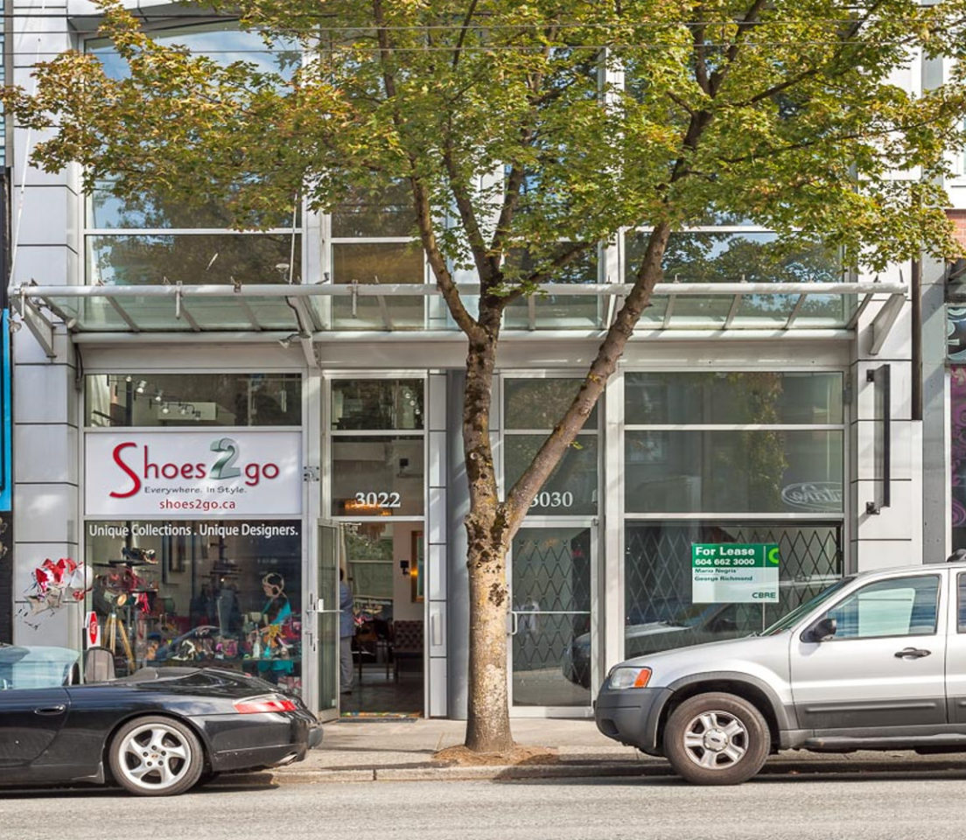
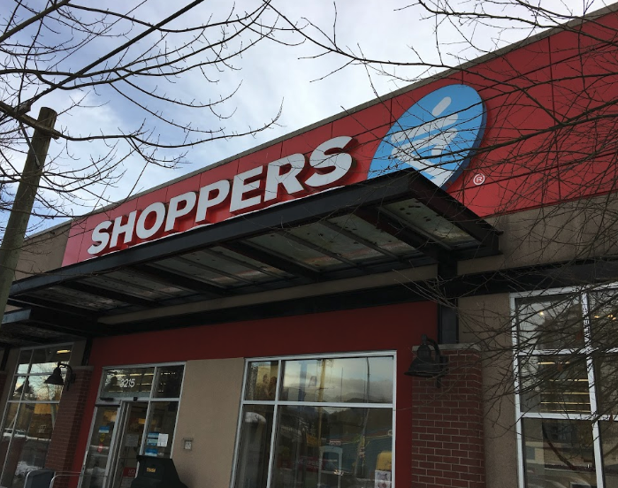
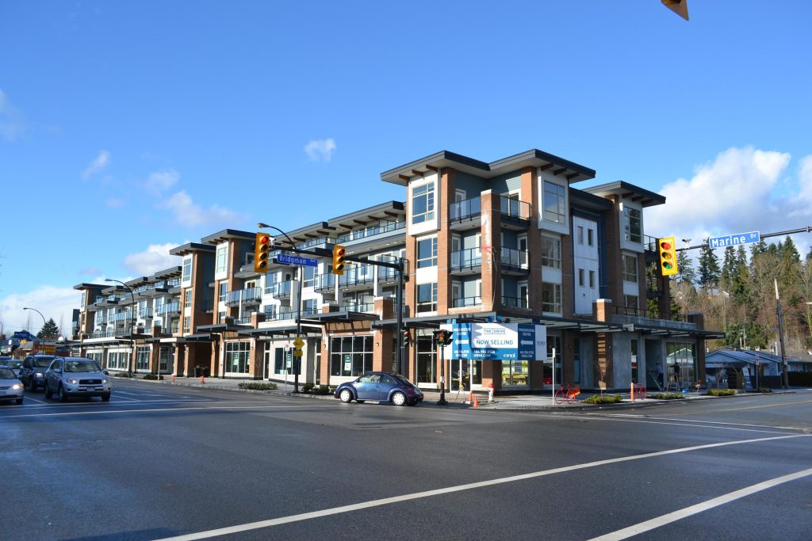
FULLY LEASED
NEW WESTMINSTER, BC
VANCOUVER BC
The Royal
East 26th Royal Avenue
Central
1611 Main Street
EDMONTON, AB
TORONTO, ON
The Jasper
10115 - 100A Street
The Yards (Toronto)
TORONTO, ON
VANCOUVER, BC
Westlake Village
2200 Lakeshore Blvd
3022-3030 Granville Street
PORT MOODY, BC
NORTH VANCOUVER, BC
3215 St John’s Street
The Drive
1300 Marine Drive
200 - 1010 SEYMOUR STREET, VANCOUVER, BC | 604.688.8783 | LEASING@ONNI.COM

Slide 11
CONTACT
HILARY TURNBULL hturnbull@onni.com | 604.488.8988
MARK REID mreid@onni.com | 604.488.2773
NICHOLAS GLAVAS nglavas@onni.com | 604.209.7244
PETER MCFETRIDGE pmcfetridge@onni.com 604.373.4914
200 - 1010 SEYMOUR STREET VANCOUVER, BC V6B 3M6
ONNI.COM
Availabilities may vary. Please speak with an Onni Representative for details. Developer reserves the right to make modifications to floorplans, project design, materials, features and specifications without notification. All maps, renderings and illustrations reflect the artist’s interpretation only and may differ from the final product. E. & O. E.

