Slide 1
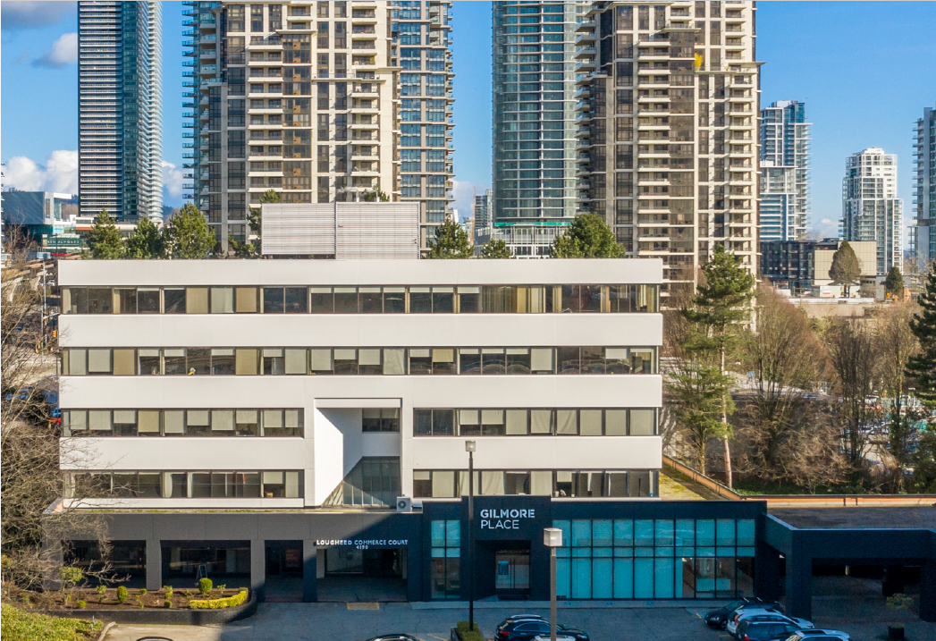
CANADA COMMERCIAL LEASING OFFICE AVAILABILITIES
MAY 2026
OFFICE
200 - 1010 SEYMOUR STREET, VANCOUVER, BC
604.688.8783 | LEASING@ONNI.COM
ONNI.COM

Slide 2
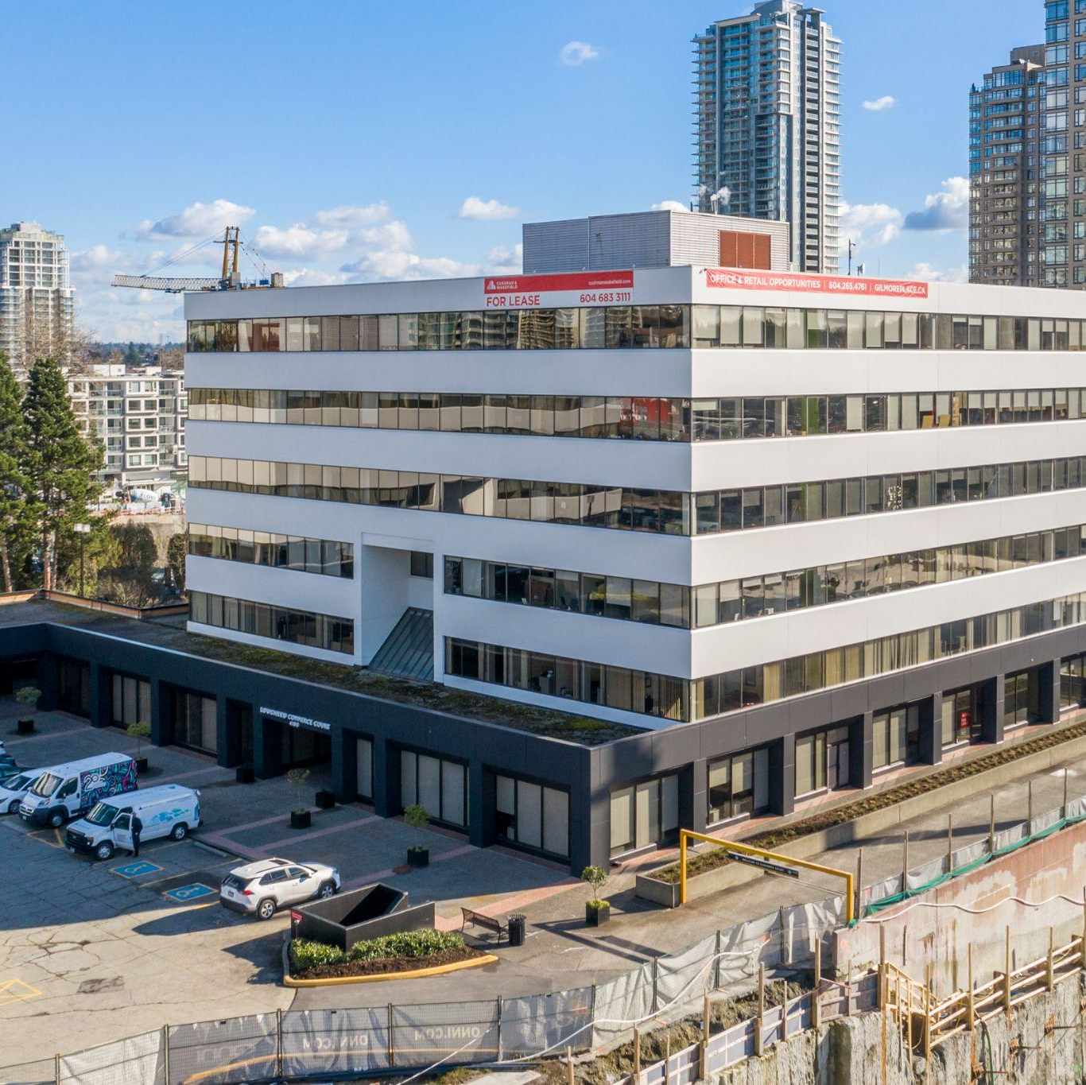

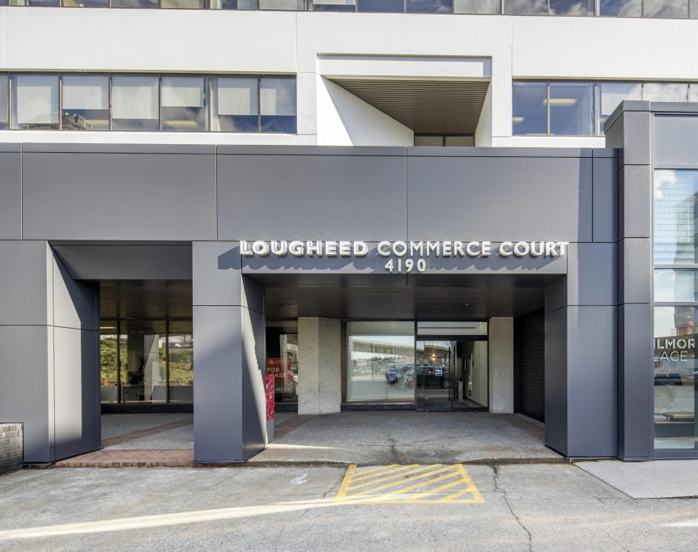
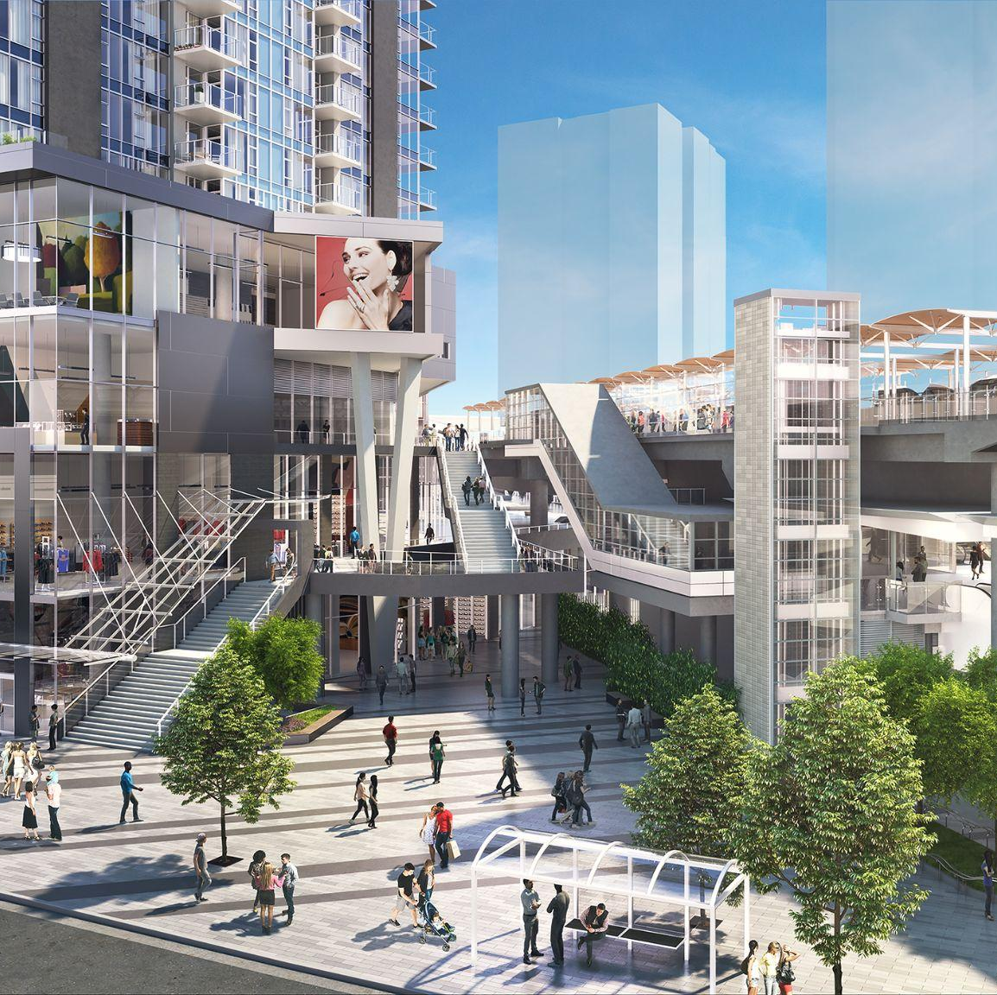
NOW LEASING
BURNABY, BC
Lougheed Commerce Court
ADDRESS: 4180 LOUGHEED HIGHWAY
CONTACT: MARK TREPP & CAM BERTSCH
COMPANY: JLL
PHONE: 604.998.6001
BUILDING FEATURES:
Adjacent to Gilmore SkyTrain Stn (3 min walk)
Landlord inducement and turnkey packages offered for shell space
Secure bike storage and end of trip facilities
Tenant lounge with kitchen
AVAILABILITY
#103 | 2,094 SF | Leased
#104 #305 #306 | 1,369 SF 2,103 SF 1,151 SF | Leased Available August 1, 2026 Under contract
BURNABY, BC
Lougheed Commerce Court
ADDRESS: 4190 LOUGHEED HIGHWAY
CONTACT: MARK TREPP & CAM BERTSCH
COMPANY: JLL
PHONE: 604.998.6001
BUILDING FEATURES:
Transit-oriented office space
Directly next to Gilmore SkyTrain Station
Surrounded by top dining options, including Cactus Club Café and Joey Burnaby
Across the street from Club 16 Fitness
Tenant lounge with kitchen
AVAILABILITY
#102 #207 | 1,046 SF 2,002 SF | Available August 1, 2026 Available Immediately
BURNABY, BC
Gilmore Place - Phase 1
ADDRESS: LOUGHEED HIGHWAY &
GILMORE AVENUE
CONTACT: MAX ZESSEL & ROGER LEGGATT
COMPANY: CUSHMAN & WAKEFIELD
PHONE: 604.683.3111
BUILDING FEATURES:
A transit orientated site, located directly adjacent to the Gilmore Skytrain Station
Direct access to 200,000 SF of retail amenities
Excellent exposure and building signage opportunities are available
High quality end of trip facilities with secure bicycle storage
Large format contiguous space
Demise opportunities available
AVAILABILITY
Suite 300 | 58,065 SF
200 - 1010 SEYMOUR STREET, VANCOUVER, BC | 604.688.8783 | LEASING@ONNI.COM

Slide 3
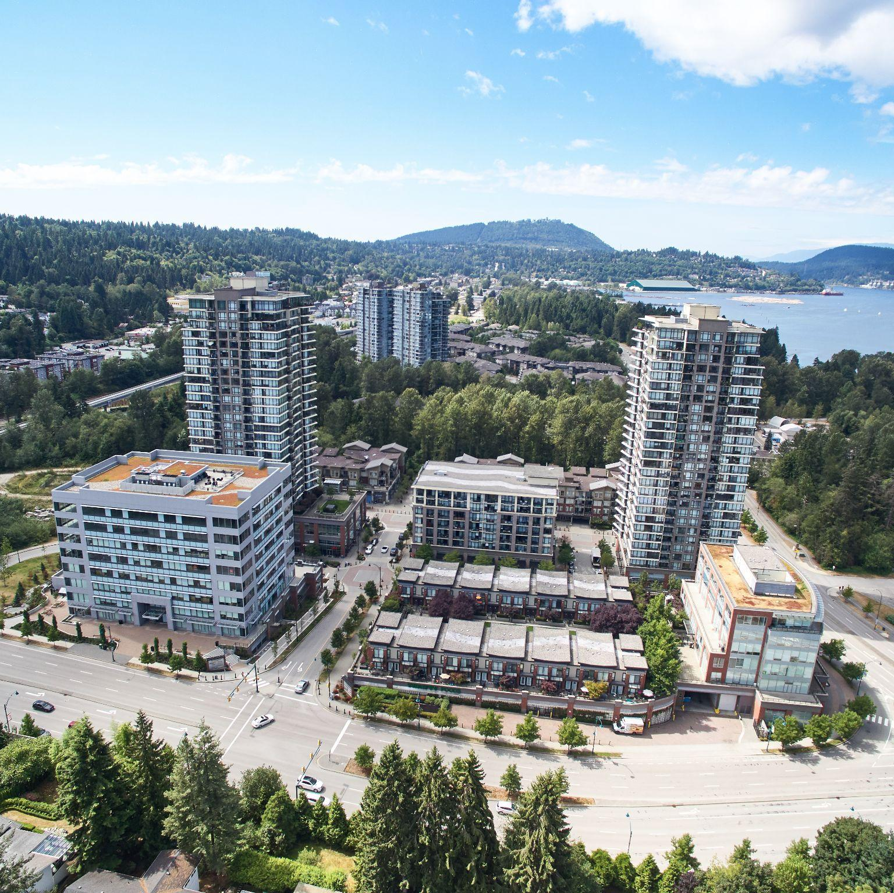
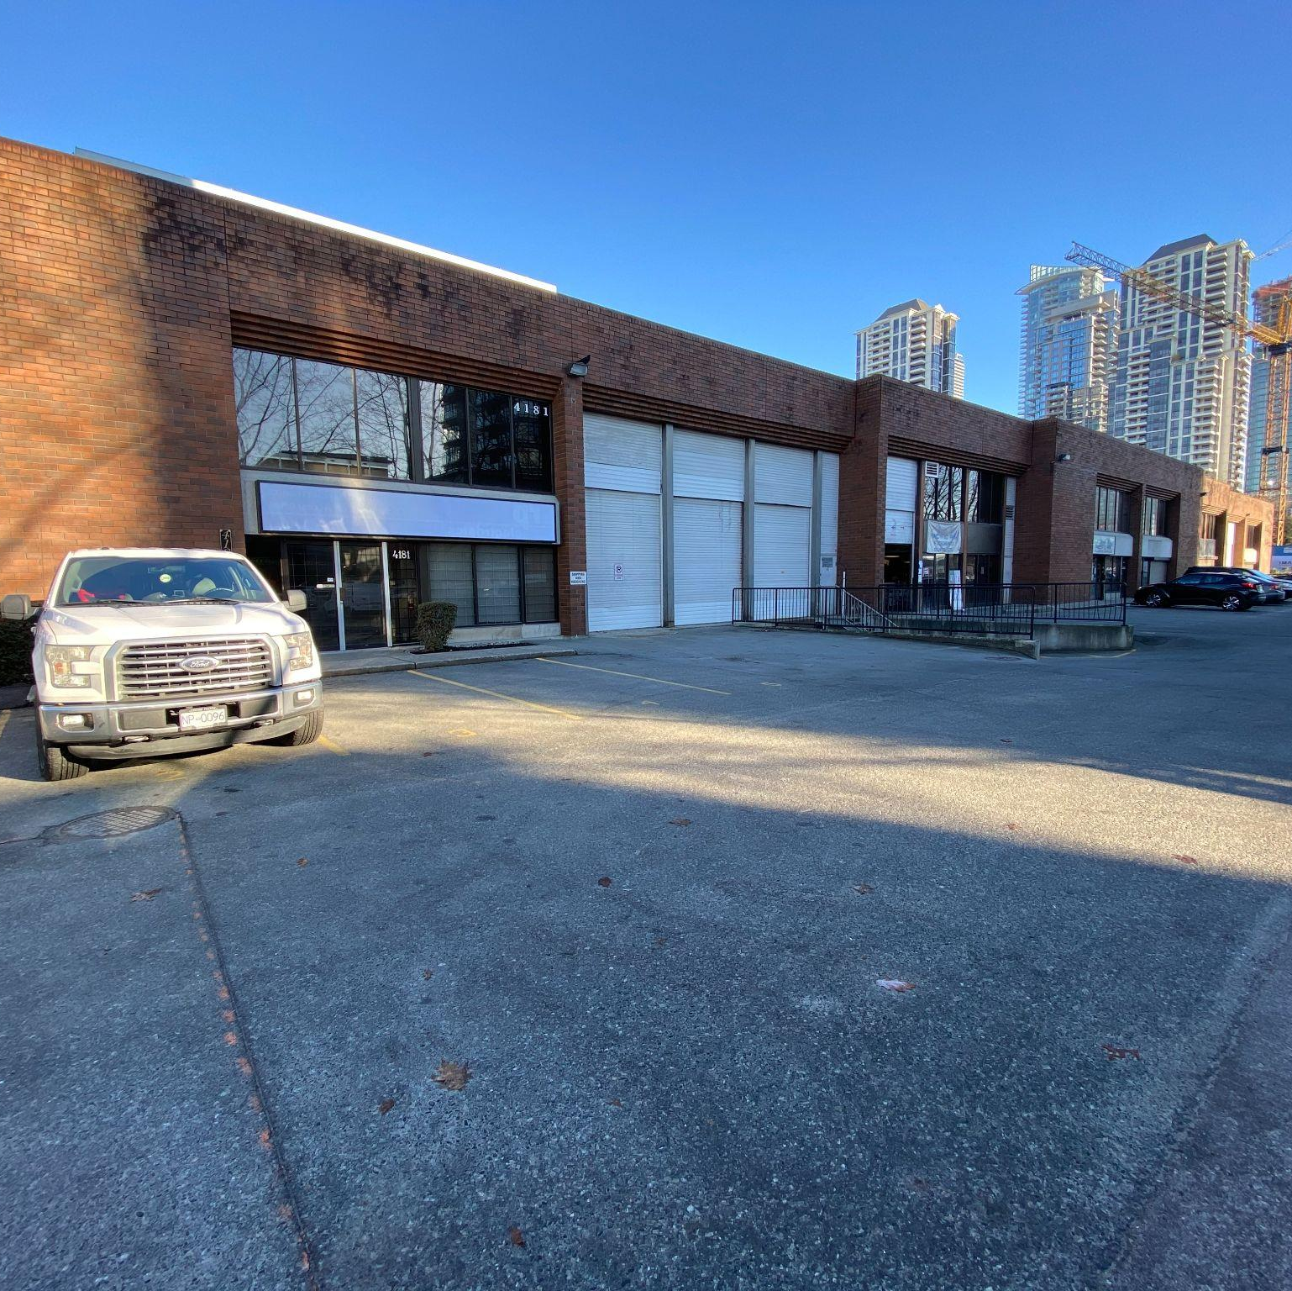
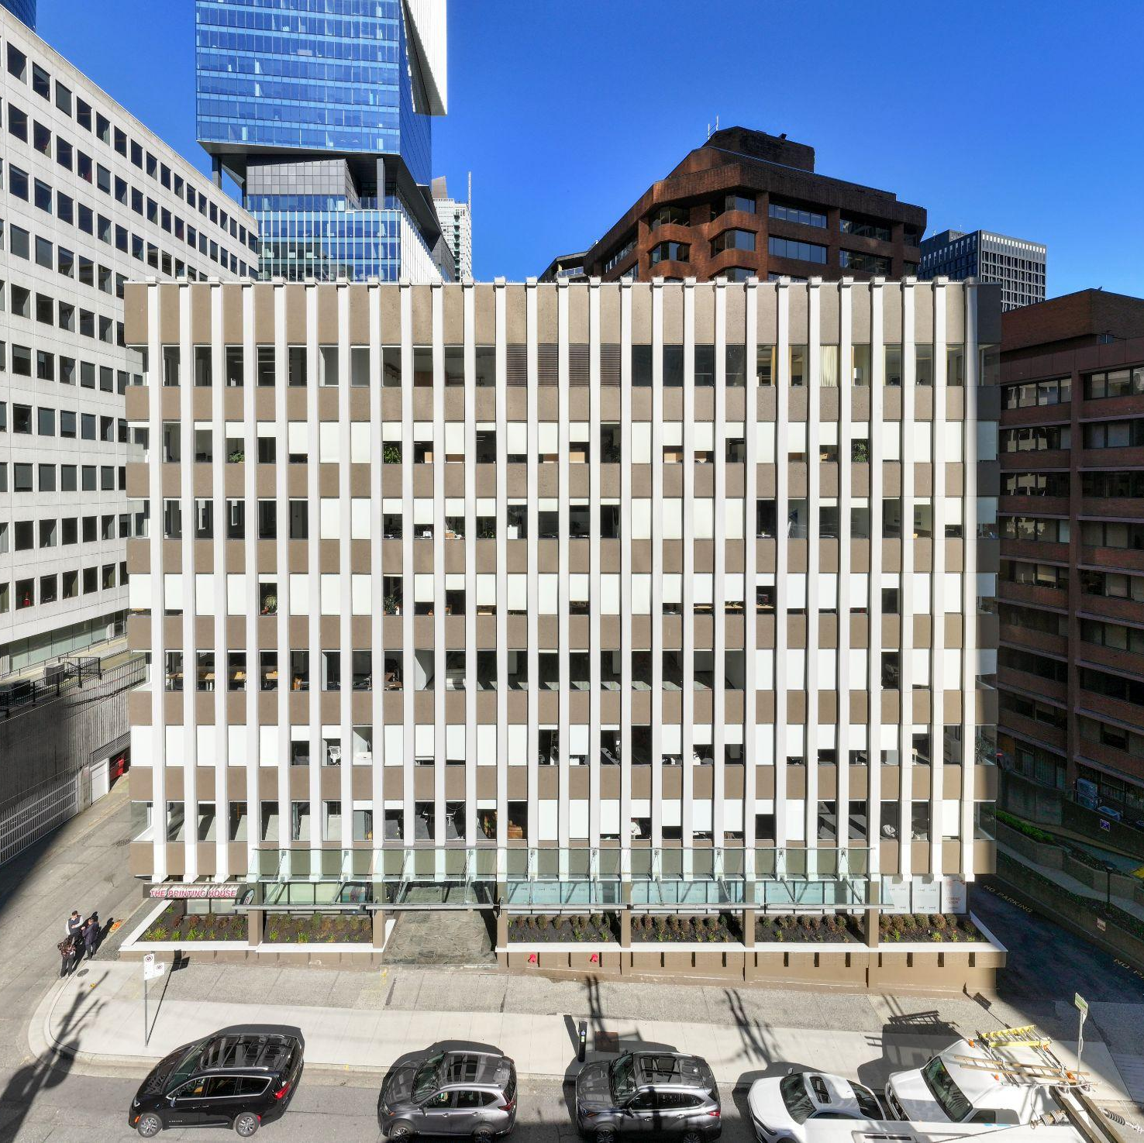
NOW LEASING
PORT MOODY, BC
Suter Brook Village Office - North
ADDRESS: 130 BREW STREET
CONTACT: CRAIG BALLANTYNE & LIAM BOULTBEE
COMPANY: CUSHMAN & WAKEFIELD
PHONE: 604.683.3111
BUILDING FEATURES:
Fully fixtured and move in ready units available
Located next to Loco & St. John’s Evergreen Line Station
Abundant neighbouring amenities
Landlord turnkey and build to suit options available
Secure bicycle storage room
#401 | 1,855 SF | Under Contract
#203 | 1,932 SF | Available Immediately
#204 #530 | 1,826 SF 6,640 SF | Available Immediately Available Immediately
AVAILABILITY
BURNABY, BC
Dawson
ADDRESS: 4185 DAWSON ST
CONTACT: BRADEN & STEVE HALL
COMPANY: DAVIES/HALL COMMERCIAL REALTY-RE/MAX
PHONE: 604.718.7300
BUILDING FEATURES:
Easy and quick access to Trans Canada Highway
Close proximity to Gilmore Place SkyTrain Station (2 min walk)
AVAILABILITY
Unit 4183B | 1,172 SF | Available Immediately *Second Floor Office
VANCOUVER, BC
535 Thurlow Street
ADDRESS: 535 THURLOW STREET
CONTACT: ANDREW ASTLES &
CONTACT: SCOTT MACDONALD
COMPANY: JLL
PHONE: 604.998.6001
BUILDING FEATURES:
Located one block from Burrard Station
Many nearby amenities including shopping, restaurants, hotels, financial institutions
Landlord turnkey and demise options
Secure bike storage and end of trip facilities
AVAILABILITY
 | #802 #800 #500 | 2,222 SF 1,915 SF 3,362 SF | Available Immediately Under contract Available Immediately
200 - 1010 SEYMOUR STREET, VANCOUVER, BC | 604.688.8783 | LEASING@ONNI.COM

Slide 4
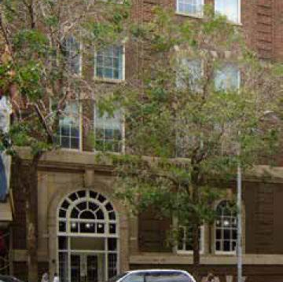
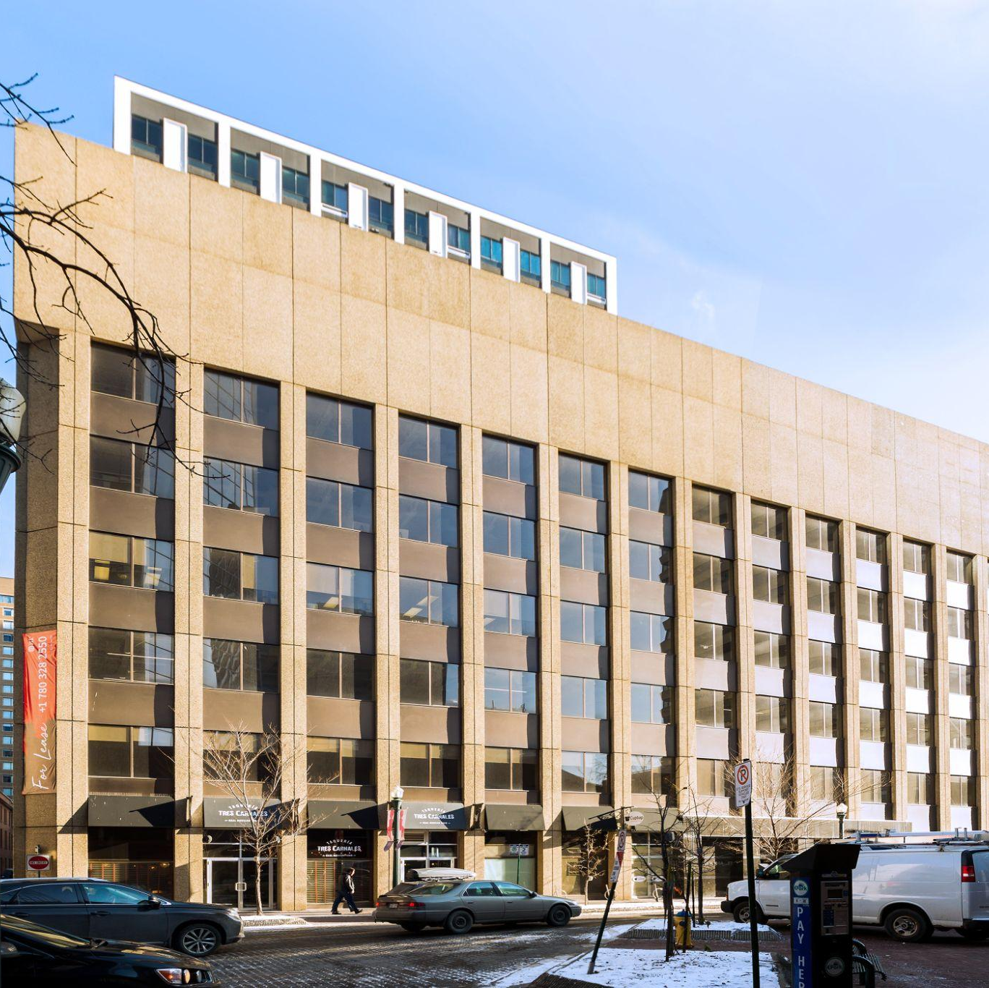
NOW LEASING
EDMONTON, AB
Beaver House
ADDRESS: 10158 103RD STREET
CONTACT: CORY WOSNACK & HILLARY WILLIAMS
COMPANY: AVISON YOUNG
PHONE: 780.909.7850
BUILDING FEATURES:
Character heritage building with modern improvements
Steps away from Edmonton’s new Ice District
Located across from the YMCA and University of Alberta downtown campus
New tenant amenities including: bike storage, tenant lounge with games and kitchen pantry
AVAILABILITY
#100 | 11,694 SF | Available Immediately
#200 | 3,395 SF | Available Immediately
#220 | 2,939 SF | Available Immediately
#300 | 14,275 SF | Available Immediately
#401 | 4,160 SF | Available Immediately
#404 | 2,766 SF | Available Immediately
#406 | 1,754 SF | Available Immediately
#501 | 6,714 SF | Contiguous with 503
#503 | 7,609 SF | Contiguous with 501
EDMONTON, AB
The Jasper
ADDRESS: 10115 100A STREET
CONTACT: JEFF SIMKIN & RYAN O’SHAUGNESSY
COMPANY: CBRE EDMONTON
PHONE: 780.424.5475
AVAILABILITY
BUILDING FEATURES:
Direct access to LRT Station
Central downtown location
New tenant amenities including: bike storage and end of trip shower facilities, lounge chairs, TV’s and games, kitchen and pantry
Turnkey options available
Upgraded HVAC
2nd Floor | 7,320 SF | Available Immediately
3rd Floor | 7,303 SF | Available Immediately
#410 | 1,768 SF | Available Immediately
#415 | 2,307 SF | Available Immediately *spec suite*
#425 5th Floor | 3,226 SF 7,283 SF | Available Immediately Available Immediately
6th Floor | 7,286 SF | Available Immediately
200 - 1010 SEYMOUR STREET, VANCOUVER, BC | 604.688.8783 | LEASING@ONNI.COM

Slide 5
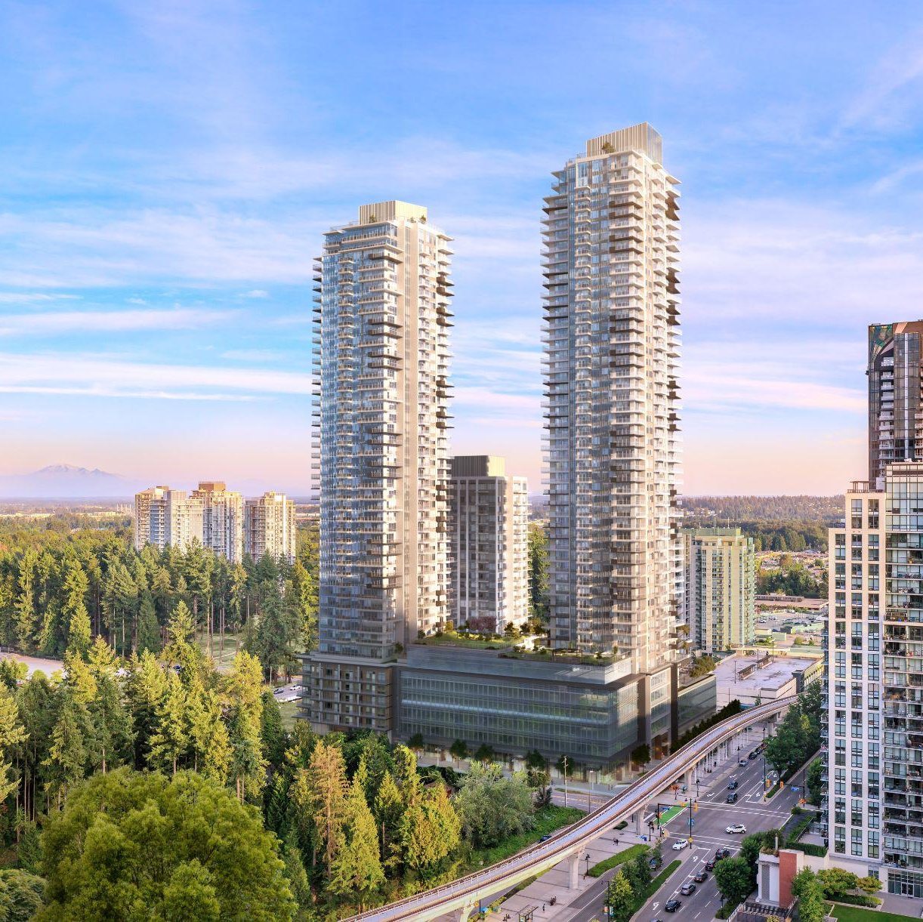
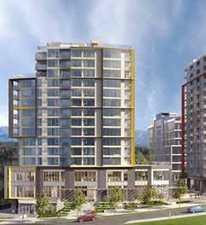
NOW PRE-LEASING
COQUITLAM, BC
Pine & Glen
ADDRESS: 3022 GLEN DRIVE, COQUITLAM
CONTACT: HILARY TURNBULL
COMPANY: ONNI GROUP
PHONE: 604.488.8988
BUILDING FEATURES:
Mixed-use development in the heart of Coquitlam
Over 900 residential units, 35,000 SF of office space, and 13,000 SF of ground floor retail space
Transit-oriented site, within walking distance to both Coquitlam central and Lafarge Lake /Douglas Skytrain Stations
AVAILABILITY
Level 2 Office | 9,844 SF | Available Q1 2027
Level 3 Office | 9,133 SF | Available Q1 2027
Level 5 Office | 8,162 SF | Available Q1 2027
Level 6 Office | 8,396 SF | Available Q1 2027
VANCOUVER, BC
East 1st
ADDRESS: 375 EAST 1ST AVENUE
CONTACT: PETER MCFETRIDGE
COMPANY: ONNI GROUP
PHONE: 604.373.4914
BUILDING FEATURES:
Located in the center of Vancouver’s undisputed creative hub
Adjacent to the future home of the Great Northern Way SkyTrain Station
Direct access to the Central Valley Greenway bike lane
10 minute walk to the Main Street SkyTrain Station
Close proximately to thousands of desirable retail amenities
Located next to the Emily Carr University of Art + Design Campus
Available Q1 2029
AVAILABILITY
Reverse Mezzanine | 37,701 SF
Building 1 - Level 2 | 11,995 SF
Building 4 - Level 1 | 3,668 SF
Building 4 - Levels 2 - 4 | 13,008 SF
Building 4 - Levels 5 - 7 | 12,273 SF
Building 4 -Total Office | 129,207 SF
200 - 1010 SEYMOUR STREET, VANCOUVER, BC | 604.688.8783 | LEASING@ONNI.COM

Slide 6
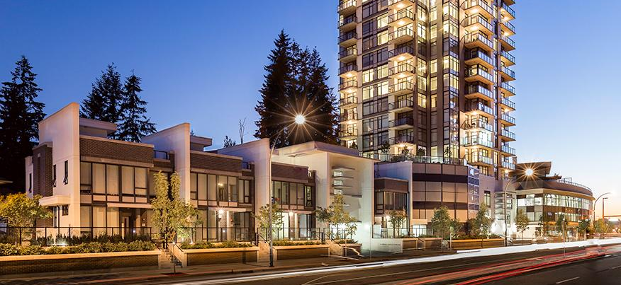
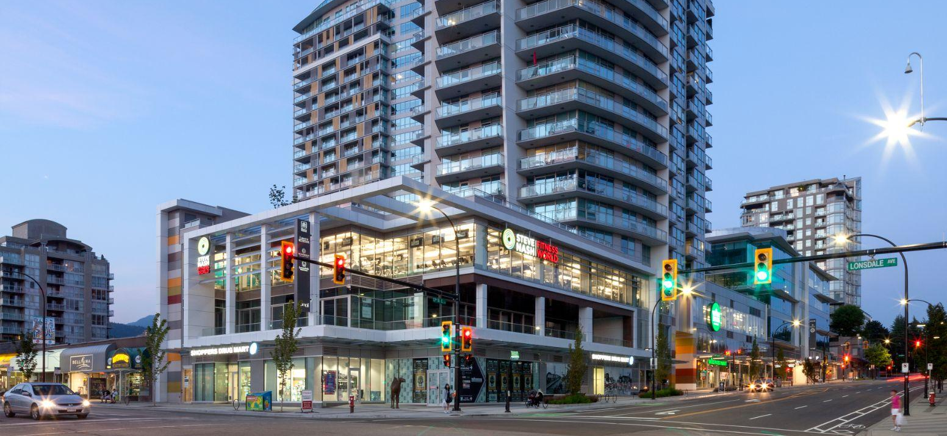
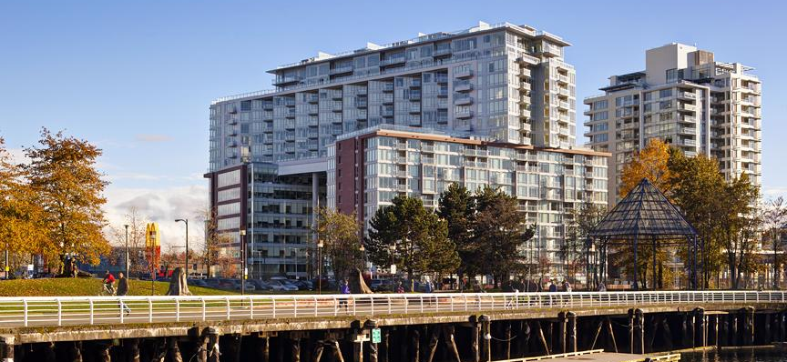
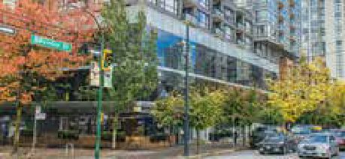
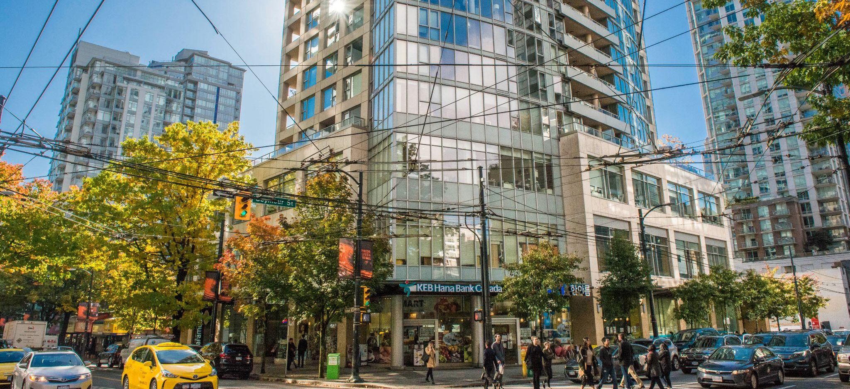
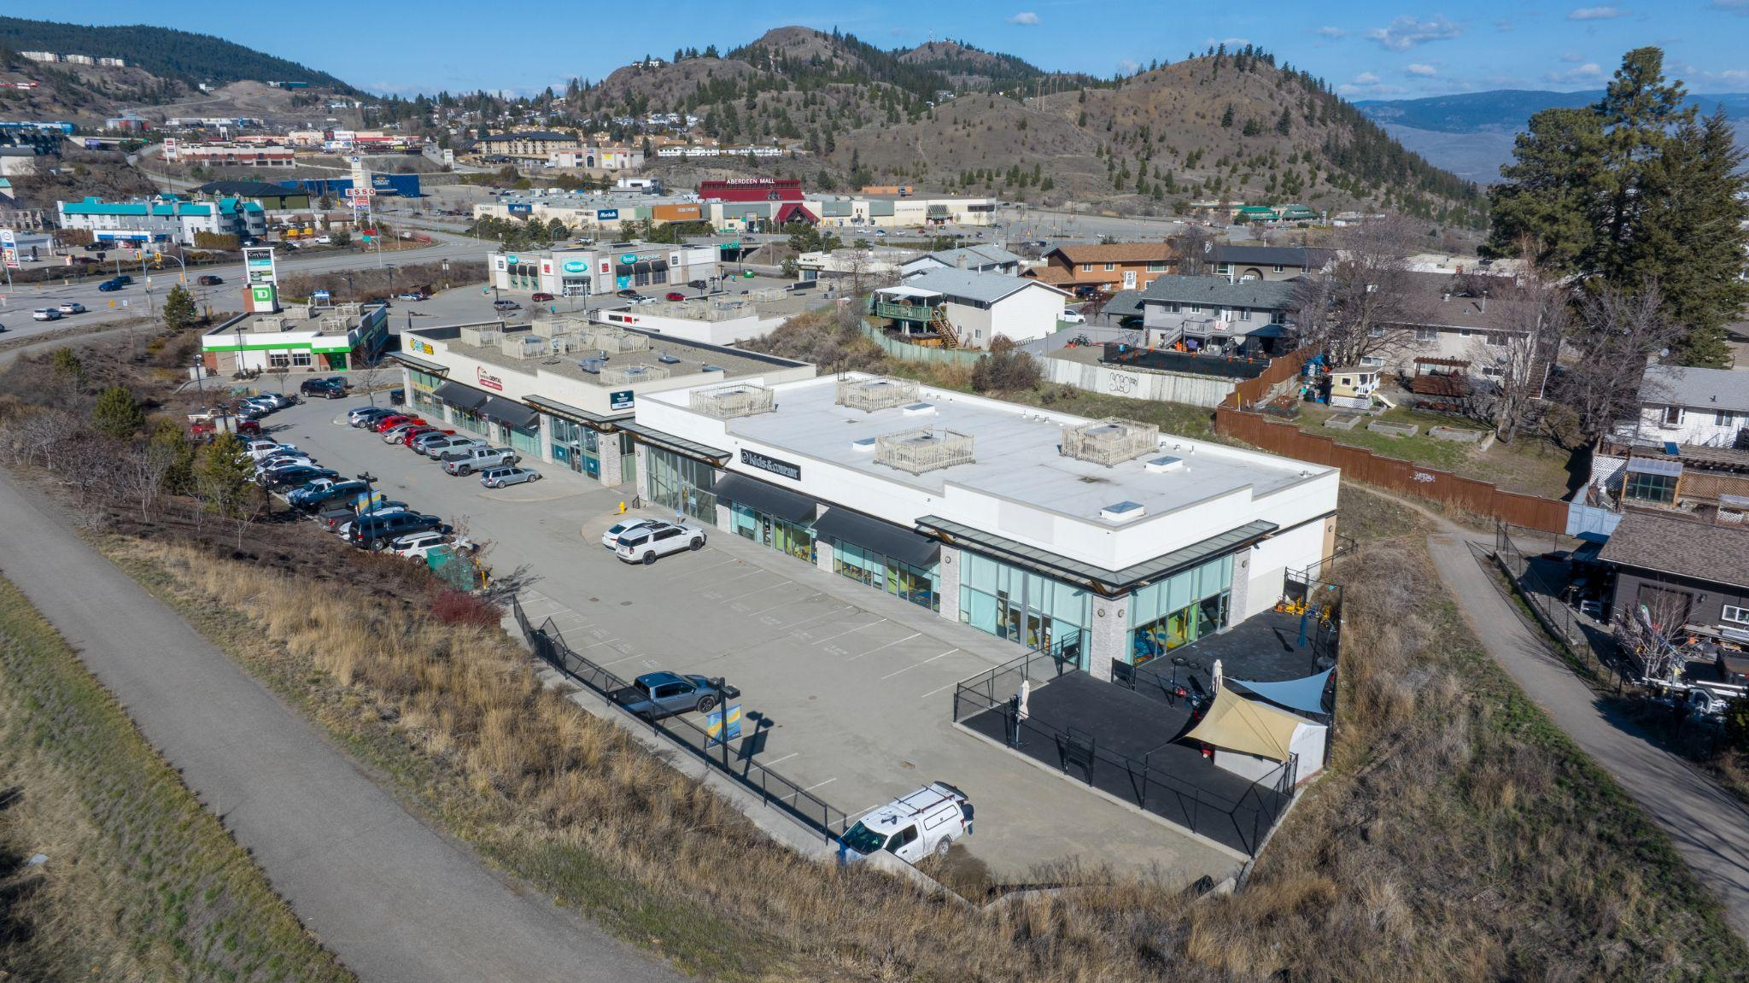
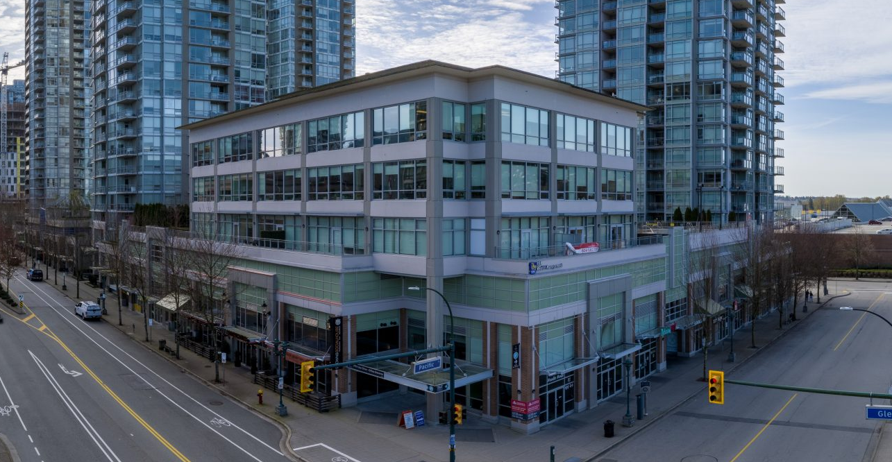
FULLY LEASED
COQUITLAM, BC
VIEW WEBSITE
Westwood
1123 Westwood Street
VANCOUVER, BC
VIEW WEBSITE
Centreview
13th & Lonsdale Avenue North
VANCOUVER, BC
VIEW WEBSITE
Central
1553-77 Main Street
VANCOUVER, BC
VIEW WEBSITE
1022 Seymour Street
VANCOUVER, BC
VIEW WEBSITE
550 Robson Street
KAMLOOPS, BC
VIEW WEBSITE
Cityview Centre
1801 Princeton-Kamloops Highway
COQUITLAM, BC
VIEW WEBSITE
Oasis
2950 Glen Drive
200 - 1010 SEYMOUR STREET, VANCOUVER, BC | 604.688.8783 | LEASING@ONNI.COM

Slide 7
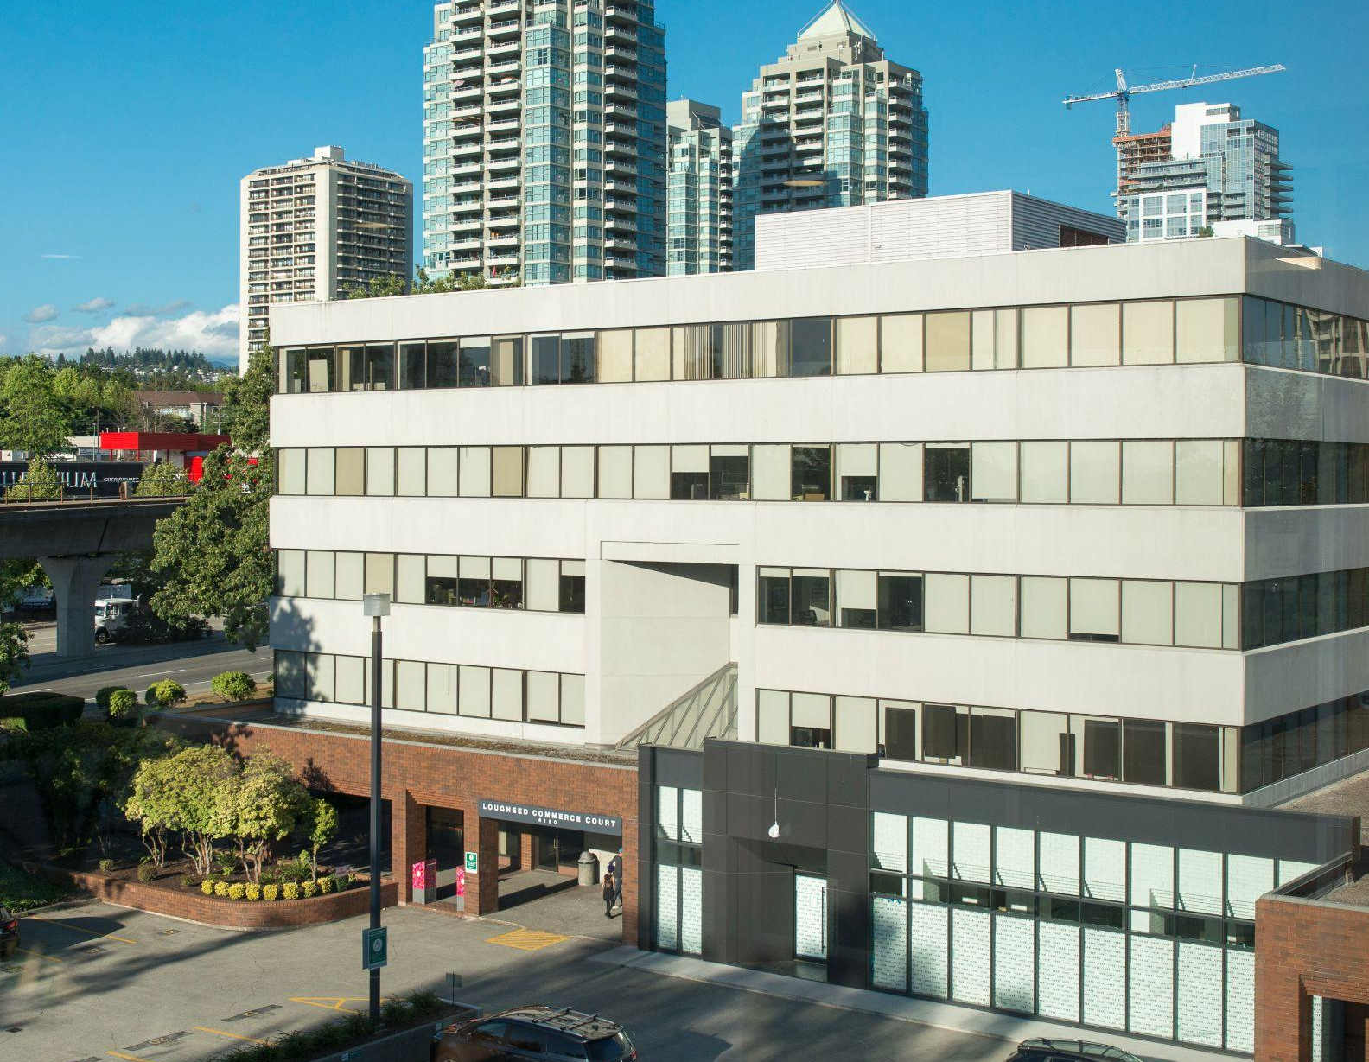
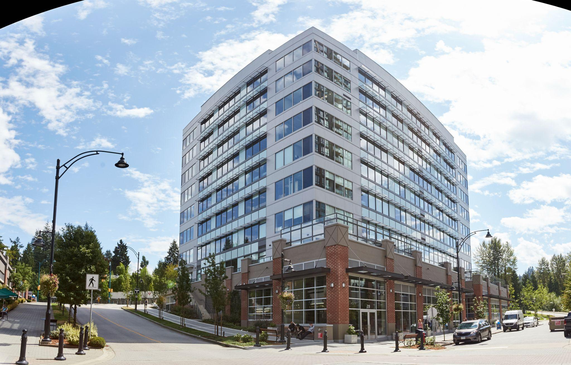
FULLY LEASED
BURNABY, BC
Lougheed Commerce Court
4190 Lougheed Highway
PORT MOODY, BC
Suter Brook Village Office - South
220 Brew Street
200 - 1010 SEYMOUR STREET, VANCOUVER, BC | 604.688.8783 | LEASING@ONNI.COM

Slide 8
CONTACT
MARK REID
MREID@ONNI.COM | 604.488.2773
HILARY TURNBULL
HTURNBULL@ONNI.COM | 604.488.8988
200 - 1010 SEYMOUR STREET VANCOUVER, BC V6B 3M6
ONNI.COM
Availabilities may vary. Please speak with an Onni Representative for details. Developer reserves the right to make modifications to floorplans, project design, materials, features and specifications without notification. All maps, renderings and illustrations reflect the artist’s interpretation only and may differ from the final product. E. & O. E.

