Slide 1
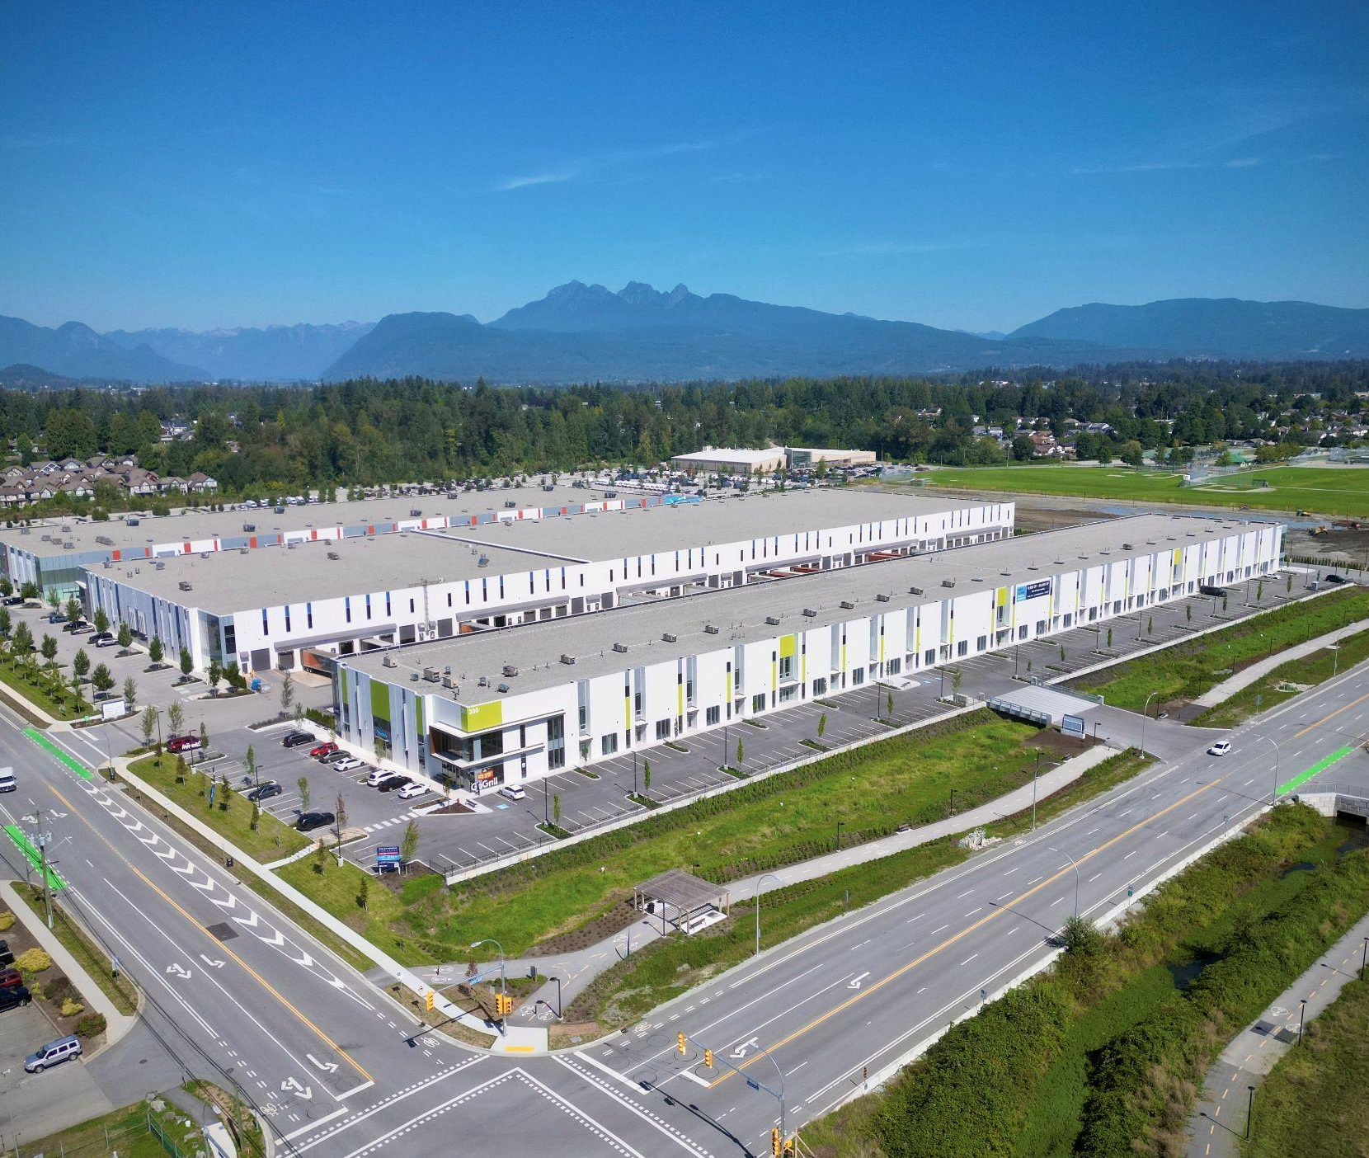
CANADA COMMERCIAL LEASING INDUSTRIAL AVAILABILITIES
MAY 2026
INDUSTRIAL
200 - 1010 SEYMOUR STREET, VANCOUVER, BC
604.688.8783 | LEASING@ONNI.COM
ONNI.COM

Slide 2
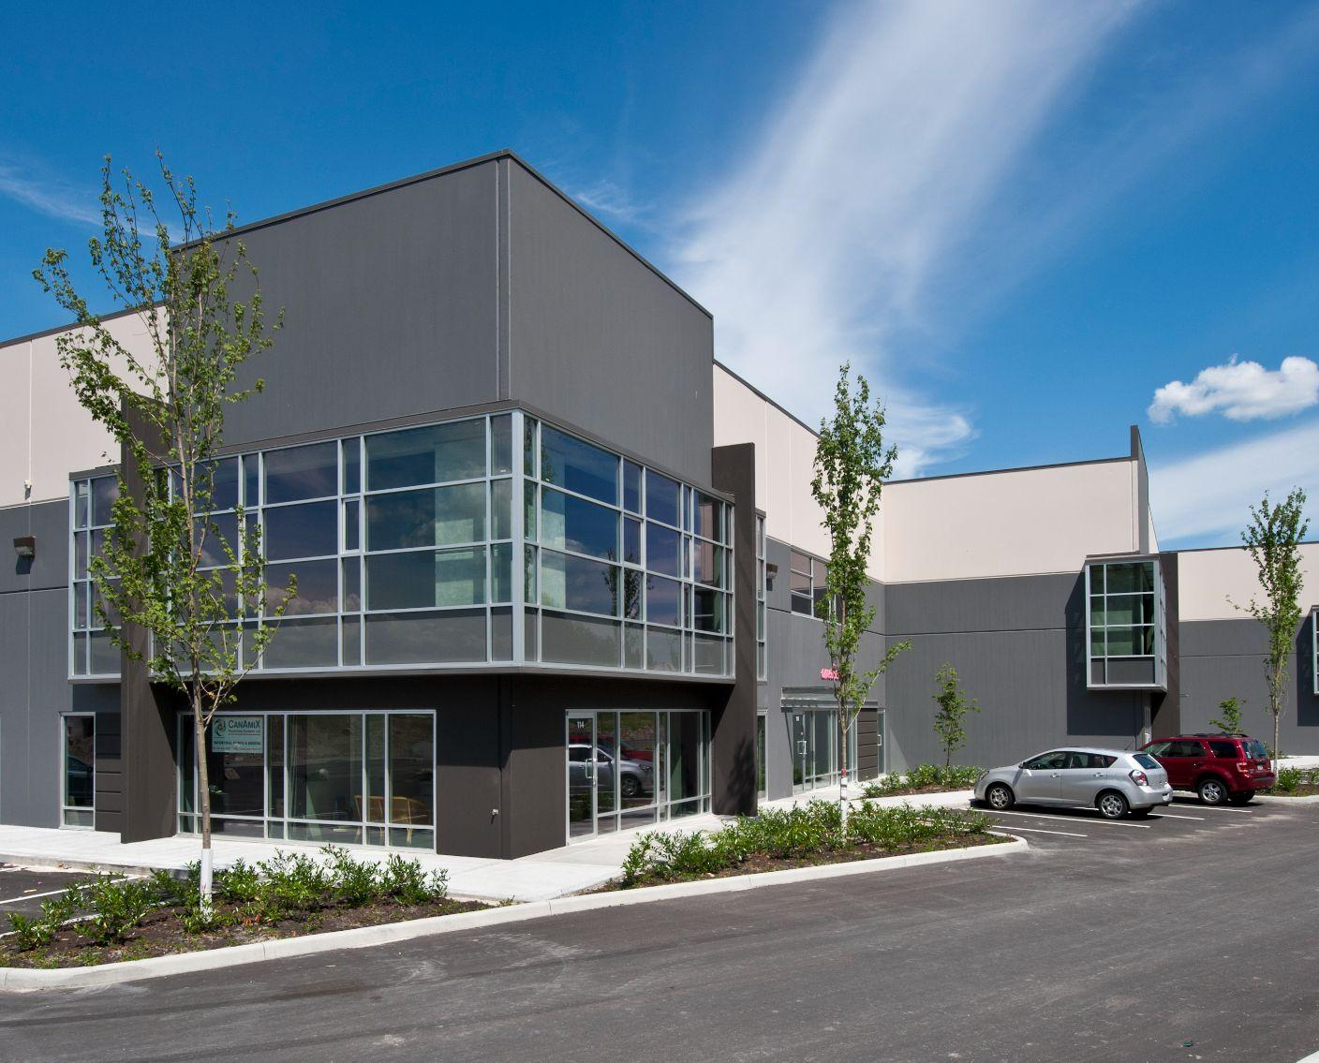

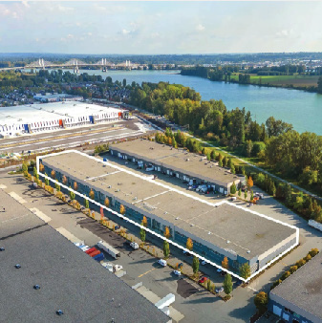
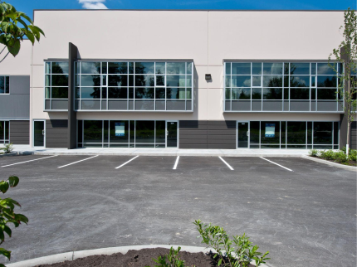
FEATURE PROPERTY
PITT MEADOWS, BC
Golden Ears Business Park I
ADDRESS: 19100 AIRPORT WAY
CONTACT: BEN LUTES, RYAN KERR & BRYN CARTWRIGHT
COMPANY: AVISON YOUNG
PHONE: 604.687.7331
BUILDING FEATURES:
26’ & 32’ clear ceiling height
Energy efficient, T5HO lighting
ESFR sprinkler system
Dock equipment (hydraulic levelers, bumpers, and concrete apron)
Dock and grade loading per bay
AVAILABILITY
Unit 304 | 20,168 SF | Available Immediately - Includes 500 SF of office space
PITT MEADOWS, BC
Golden Ears Business Park I
Building 200
ADDRESS: 19100 AIRPORT WAY
CONTACT: BEN LUTES, RYAN KERR & BRYN CARTWRIGHT
COMPANY: AVISON YOUNG
PHONE: 604.687.7331
BUILDING FEATURES:
26’ & 32’ clear ceiling height
Energy efficient, T5HO lighting
ESFR sprinkler system
Dock equipment (hydraulic levelers, bumpers, and concrete apron)
Dock and grade loading per bay
Custom office build out available
AVAILABILITY
Unit 205* | 4,600 SF | Available Immediately
Unit 214* | 4,550 SF | Leased
Unit 215* | 4, 550 SF | Leased
Unit 216* | 4, 550 SF | Leased
Unit 217* | 4, 600 SF | Leased
Unit 218* | 4, 600 SF | Available Immediately
Unit 219* | 7, 040 SF | Available Immediately
Unit 220* | 7, 040 SF | Available Immediately
* units can be combined
PITT MEADOWS, BC
Golden Ears Business Park II
ADDRESS: 19055 AIRPORT WAY
CONTACT: BEN LUTES, RYAN KERR & BRYN CARTWRIGHT
COMPANY: AVISON YOUNG
PHONE: 604.687.7331
BUILDING FEATURES:
32’ clear ceiling height
Energy efficient, T5HO lighting
ESFR sprinkler system
Dock equipment (hydraulic levelers, bumpers, and concrete apron)
Dock and grade loading per bay
Modern office
AVAILABILITY
Unit 606-609 Unit 801-806 Unit 109 Unit 103 Unit 104/105 | 75,156 SF 119,306 SF 4,178 SF 4,178 SF 8,396 SF | Under Contract Available Immediately Available June 1, 2026 Available October 1, 2026 Available October 1, 2026
*Units can be combined
200 - 1010 SEYMOUR STREET, VANCOUVER, BC | 604.688.8783 | LEASING@ONNI.COM

Slide 3
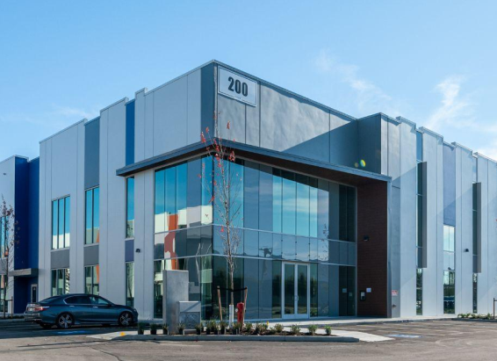
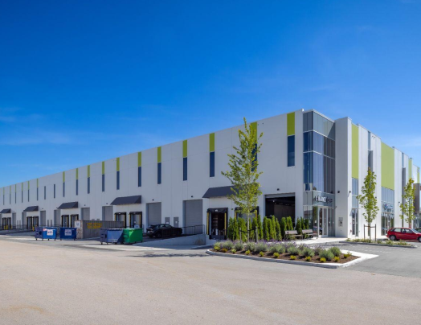
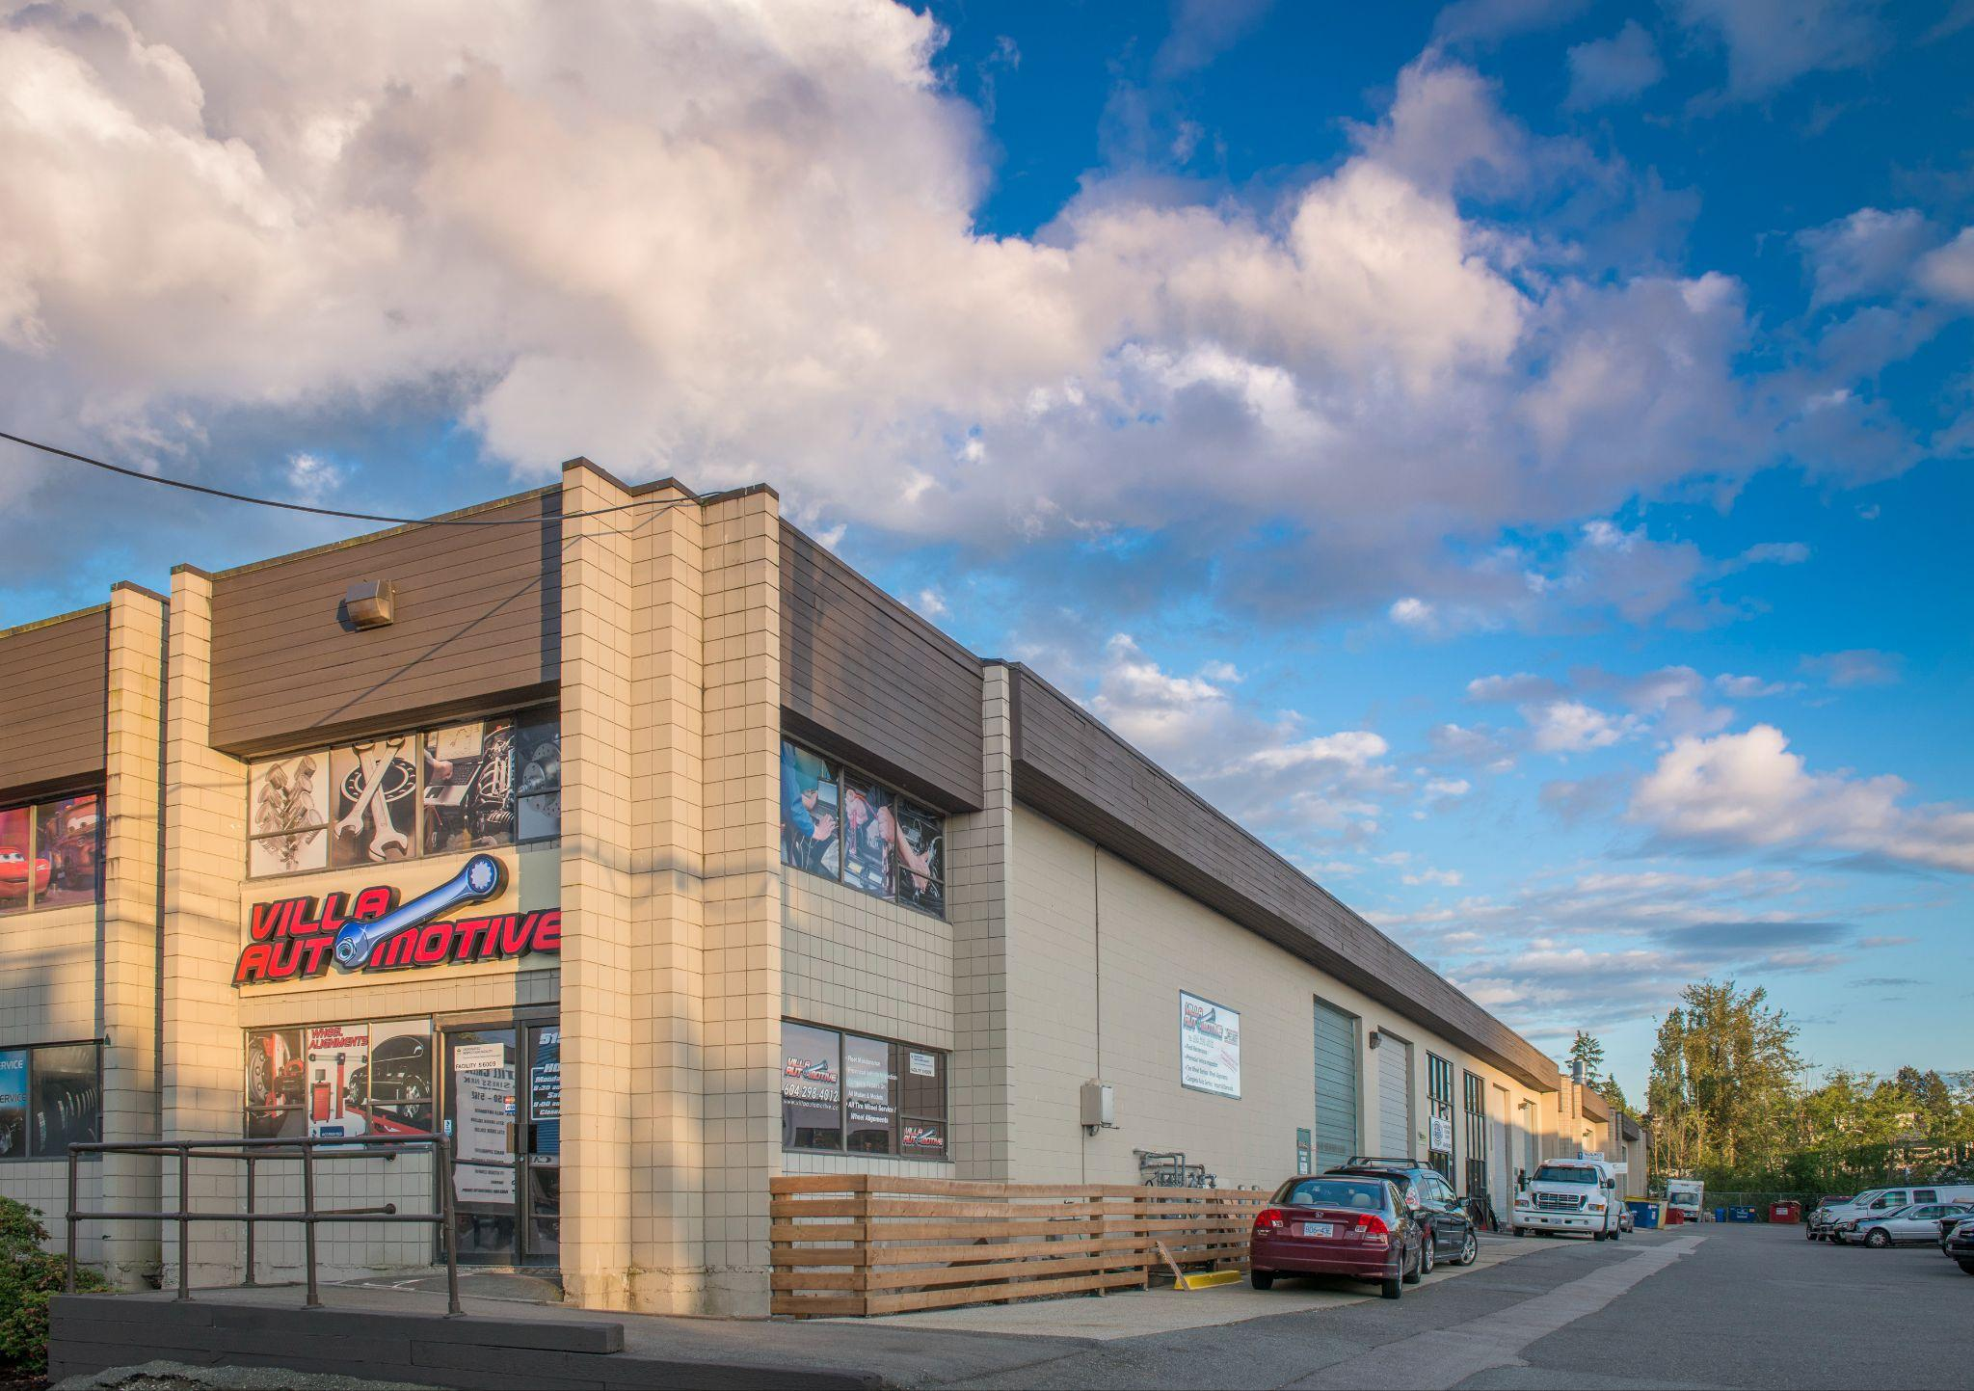
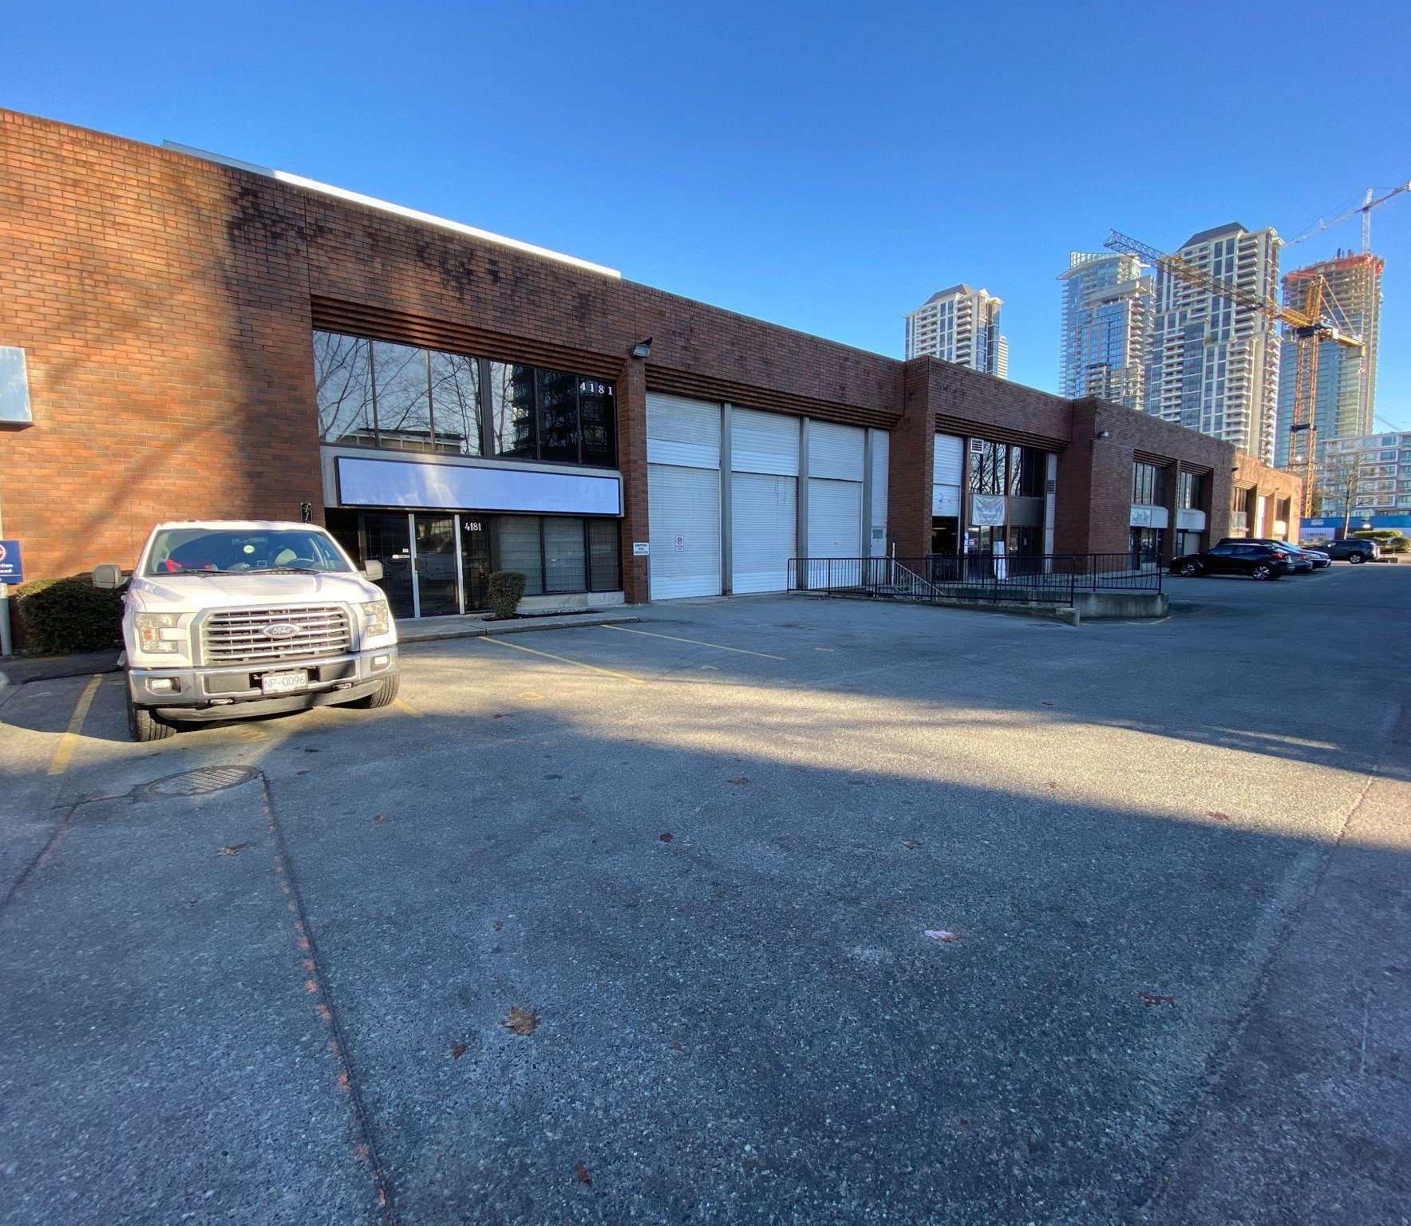
NOW LEASING
PITT MEADOWS, BC
Golden Ears Business Park III
Building 200
ADDRESS: 19265 AIRPORT WAY
CONTACT: MIKE THOMPSON, BRUNO FIORVENTO, KEEGAN MATHESON
COMPANY: JLL
PHONE: 604.998.6001
BUILDING FEATURES:
32’ clear ceiling height
Energy efficient, T5HO lighting
ESFR sprinkler system
Dock equipment (hydraulic levelers, bumpers, and concrete apron)
Dock and grade loading per bay
AVAILABILITY
Unit 207-208* Unit 209 | 39,353 SF 19,802 SF | Under Contract Available Immediately - Includes ~2000 SF of Office Space with HVAC
*Units can be demised
PITT MEADOWS, BC
Golden Ears Business Park III
Building 300
ADDRESS: 19265 AIRPORT WAY
CONTACT: PETER HALL, STEVEN HALL & BRADEN HALL
COMPANY: DAVIES HALL - RE/MAX
PHONE: 604.718.7300
BUILDING FEATURES:
32’ clear ceiling height
Energy efficient, T5HO lighting
ESFR sprinkler system
Dock equipment (hydraulic levelers, bumpers, and concrete apron)
Dock and grade loading per bay
AVAILABILITY
Unit 315 Unit 316 Unit 320* | 4,923 SF 5,168 SF 5,164 SF | Under Contract Under Contract Available Immediately - 650 SF of Ground floor Office with HVAC
BURNABY, BC
5150 Still Creek
ADDRESS: 5150 Still Creek
CONTACT: PETER, STEVEN & BRADEN HALL
COMPANY: DAVIES HALL - RE/MAX
PHONE: 604.718.7300
AVAILABILITY:
BUILDING FEATURES:
Grade loading
Easy and quick access to Trans Canada Highway
5160 Still Creek 2,975 SF |  | Leased
BURNABY, BC
4181-85 Dawson Street
ADDRESS: 4185 Dawson Street
CONTACT: STEVEN HALL, PETER HALL, BRADEN HALL
COMPANY: DAVIES/HALL COMMERCIAL REALTY
PHONE: 604.718.7300
AVAILABILITY:
BUILDING FEATURES:
Grade loading
Easy and quick access to the TransCanada Highway
Close proximity to SkyTrain
4181 DAWSON | 13,467 SF | Under contract
4183B DAWSON | 1,172 SF | Available Immediately
200 - 1010 SEYMOUR STREET, VANCOUVER, BC | 604.688.8783 | LEASING@ONNI.COM

Slide 4
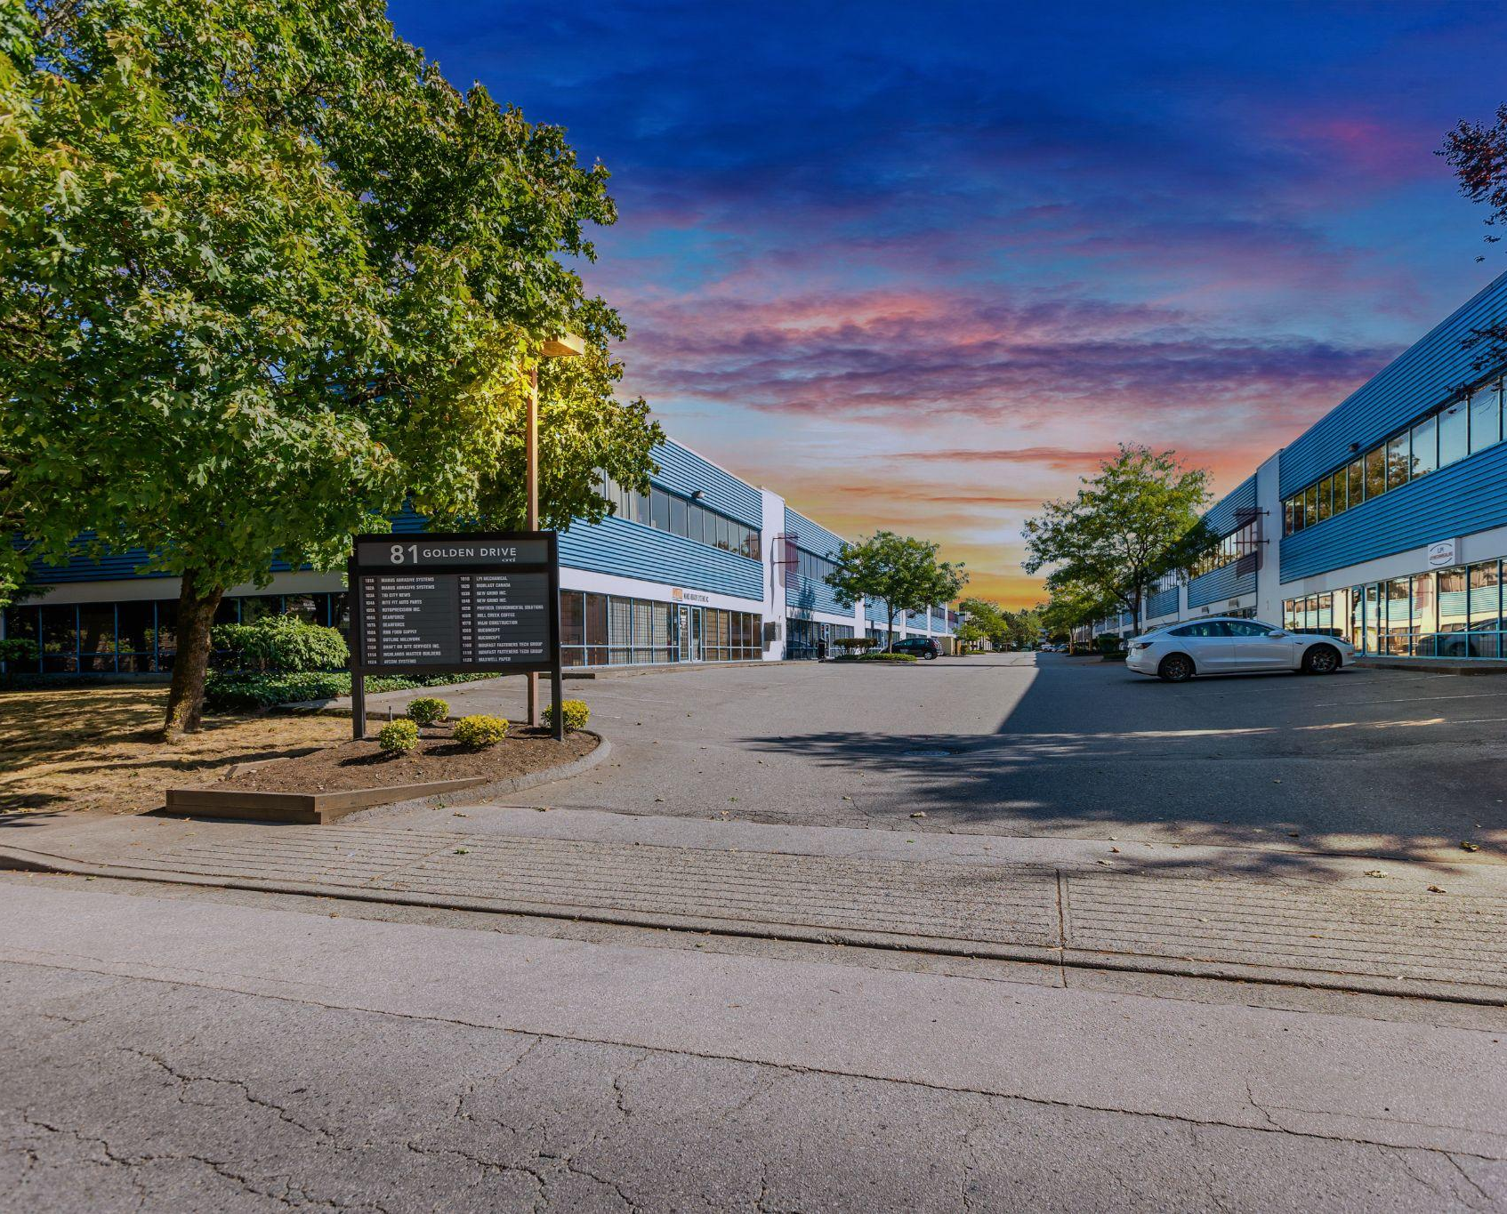
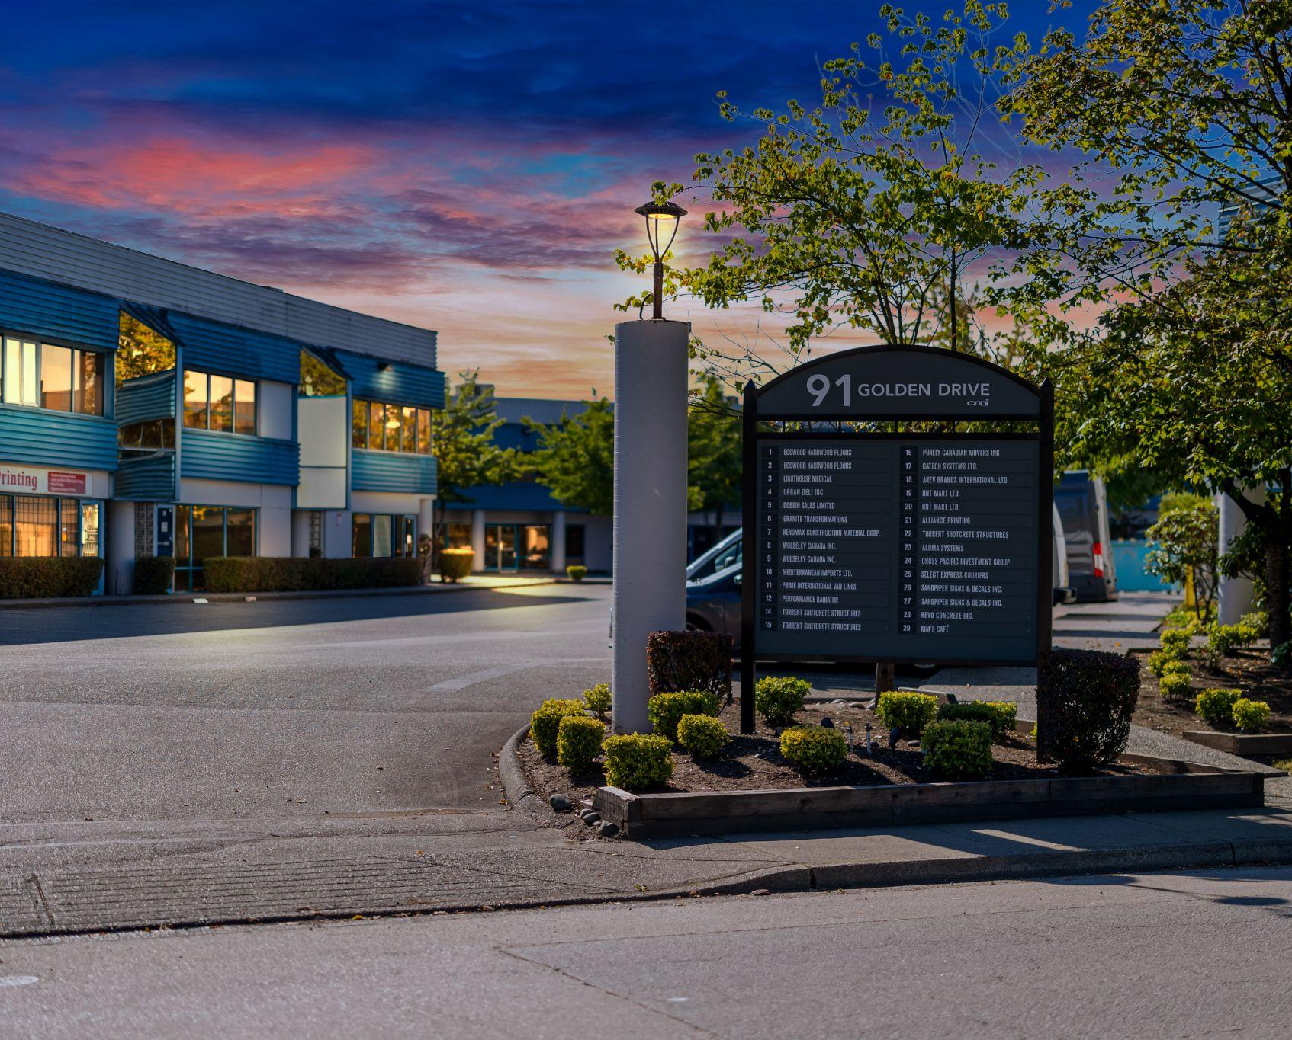
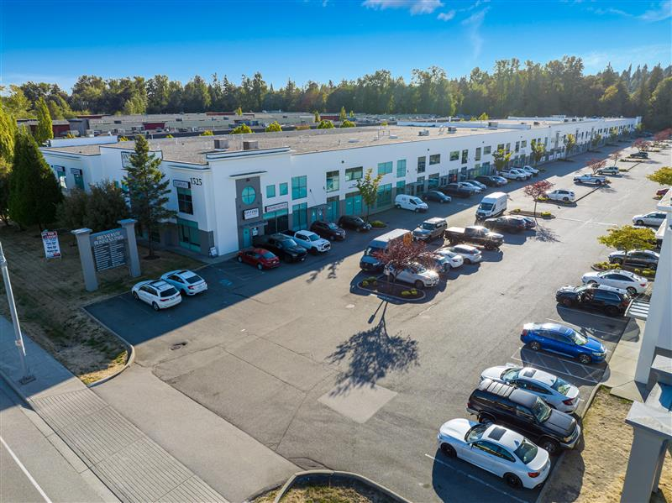
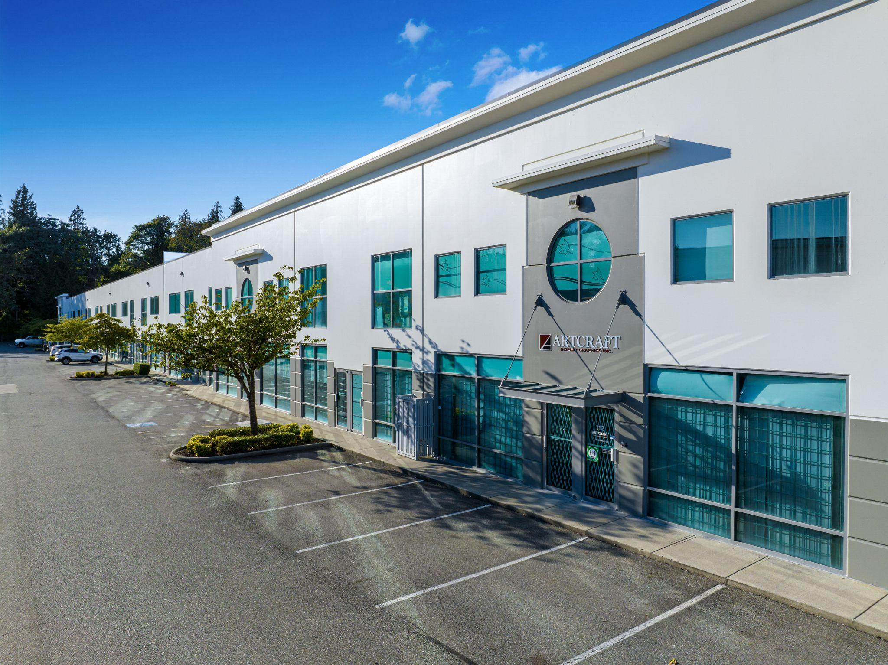
NOW LEASING
COQUITLAM, BC
81 Golden Drive
ADDRESS: 81 GOLDEN DR
CONTACT: BEN LUTES & KYLE BLYTH
COMPANY: AVISON YOUNG
PHONE: 604.687.7331
AVAILABILITY:
BUILDING FEATURES:
Dock and grade loading
22’ clear ceilings
Unit 107A | 4,766 SF | Under contract
COQUITLAM, BC
91 Golden Drive
ADDRESS: 91 GOLDEN DR
CONTACT: BEN LUTES & KYLE BLYTH
COMPANY: AVISON YOUNG
PHONE: 604.687.7331
AVAILABILITY:
BUILDING FEATURES:
Dock and grade loading
22’ clear ceilings
Updated office with fresh carpet and paint
Unit 24 | 3,400 SF | Under contract
Unit 2 | 4,968 SF | Under contract
Unit 7 Unit 14/15 Unit 8 / 9 | 5,985 SF 8,549 SF 11,520 SF | Available Immediately Available Immediately Under contract
PORT COQUITLAM, BC
1525 Broadway
ADDRESS: 1525 BROADWAY
CONTACT: PETER, STEVEN & BRADEN HALL
COMPANY: DAVIES HALL REMAX
PHONE: 604.718.7300
AVAILABILITY:
BUILDING FEATURES:
Dock or grade loading
Easy and quick access to Mary Hill Bypass
24’ clear ceiling heights
Dock and grade per unit
Unit 124 | 4,300 SF | Available Immediately
Unit 112 | 4,301 SF | Under contract
Unit 105 | 4,665 SF | Under contract
Unit 120/121 | 8,444 SF | Available Immediately - Includes ~ 1,400 SF of Office Space
PORT COQUITLAM, BC
1533 Broadway
ADDRESS: 1533 BROADWAY
CONTACT: PETER, STEVEN & BRADEN HALL
COMPANY: DAVIES HALL REMAX
PHONE: 604.718.7300
AVAILABILITY:
BUILDING FEATURES:
Dock or grade loading
Easy and quick access to Mary Hill Bypass
24’ clear ceiling heights
Unit 110 | 4,271 SF | Available Immediately
Unit 117-119 Unit 120 | 12,425 SF 4,222 SF | Under contract Available September 1, 2026
200 - 1010 SEYMOUR STREET, VANCOUVER, BC | 604.688.8783 | LEASING@ONNI.COM

Slide 5
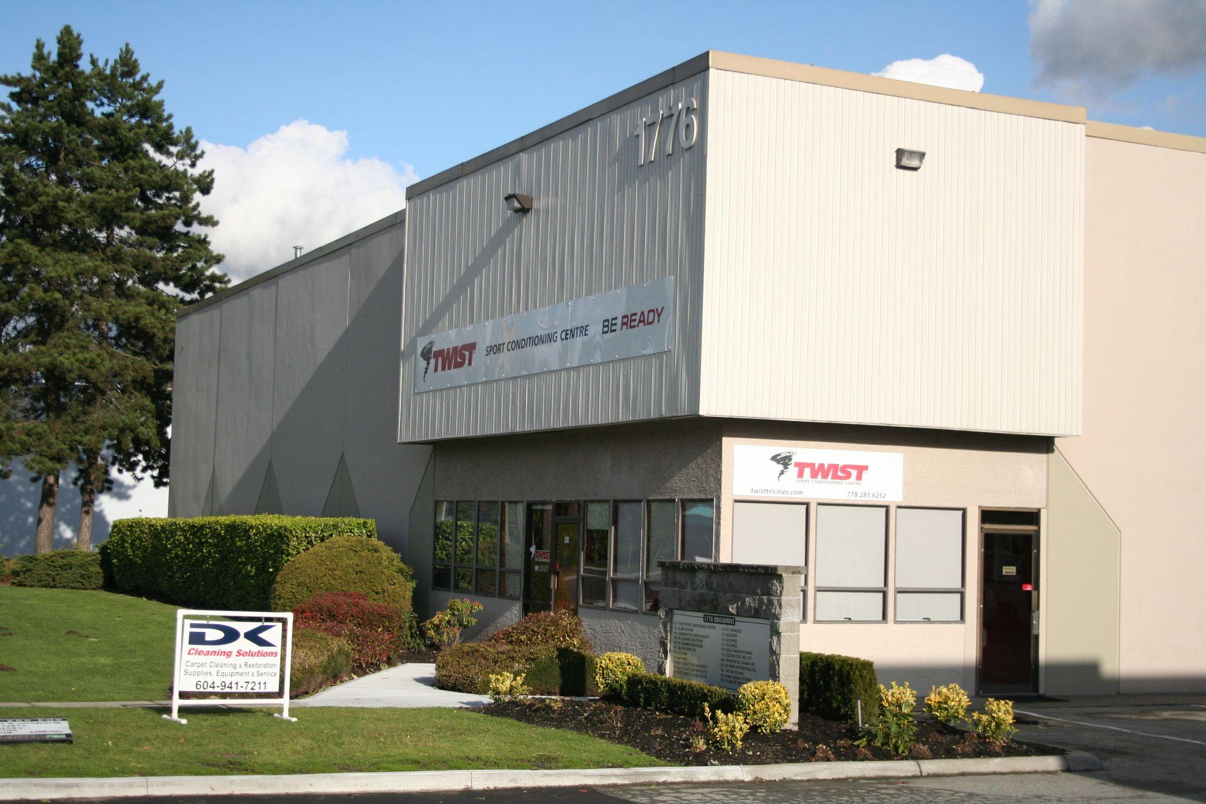
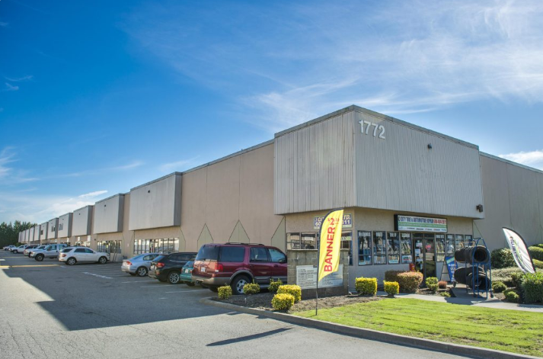
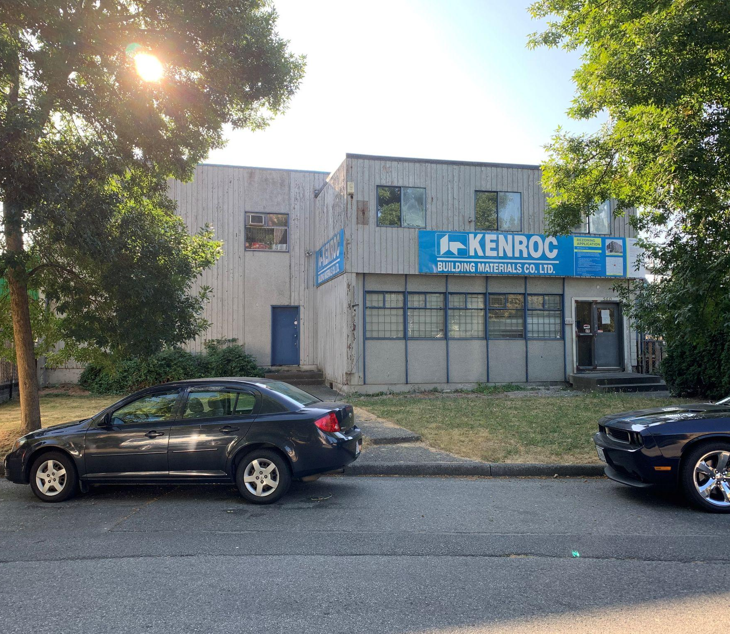
NOW LEASING
PORT COQUITLAM, BC
1776 Broadway
ADDRESS: 1776 BROADWAY
CONTACT: PETER, STEVEN & BRADEN HALL
COMPANY: DAVIES HALL REMAX
PHONE: 604.718.7300
AVAILABILITY:
BUILDING FEATURES:
Dock or grade loading
Easy and quick access to Mary Hill Bypass
22’ clear ceiling heights
Unit 114 Unit 120 Unit 106-107 Unit 111-112 | 2,616 SF 2,589 SF 5,276 SF 5,178 SF | Available Immediately Available November 1, 2026 Available August 1, 2026 Available December 1, 2026
PORT COQUITLAM, BC
1772 Broadway
ADDRESS: 1772 BROADWAY
CONTACT: PETER, STEVEN & BRADEN HALL
COMPANY: DAVIES HALL REMAX
PHONE: 604.718.7300
AVAILABILITY:
BUILDING FEATURES:
Dock or grade loading
Easy and quick access to Mary Hill Bypass
Unit 121/122 Unit 120 | 5,310 SF 2,589 SF | Under Contract Available August 1, 2026
VANCOUVER, BC
560 Raymur Avenue
ADDRESS: 560 RAYMUR AVENUE
CONTACT: GRAHAM WILLIAMS
COMPANY: CUSHMAN & WAKEFIELD
PHONE: 604.837.1819
AVAILABILITY:
BUILDING FEATURES:
18,735 SF fence and paved warehouse
Single Tenant building
19’9” ceiling heights
2 grade loading docks
560 Raymur |  | 10,169 SF | Available Immediately
200 - 1010 SEYMOUR STREET, VANCOUVER, BC | 604.688.8783 | LEASING@ONNI.COM

Slide 6
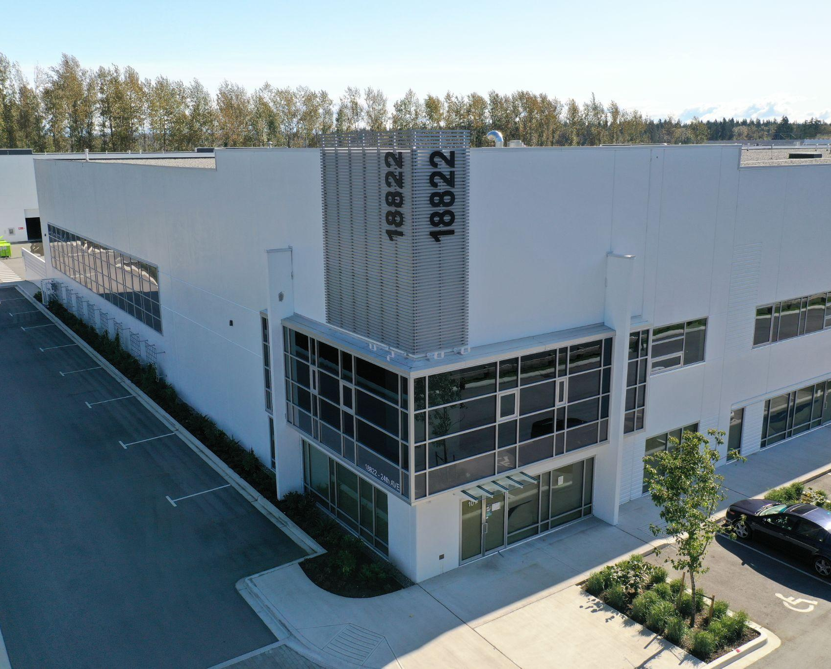
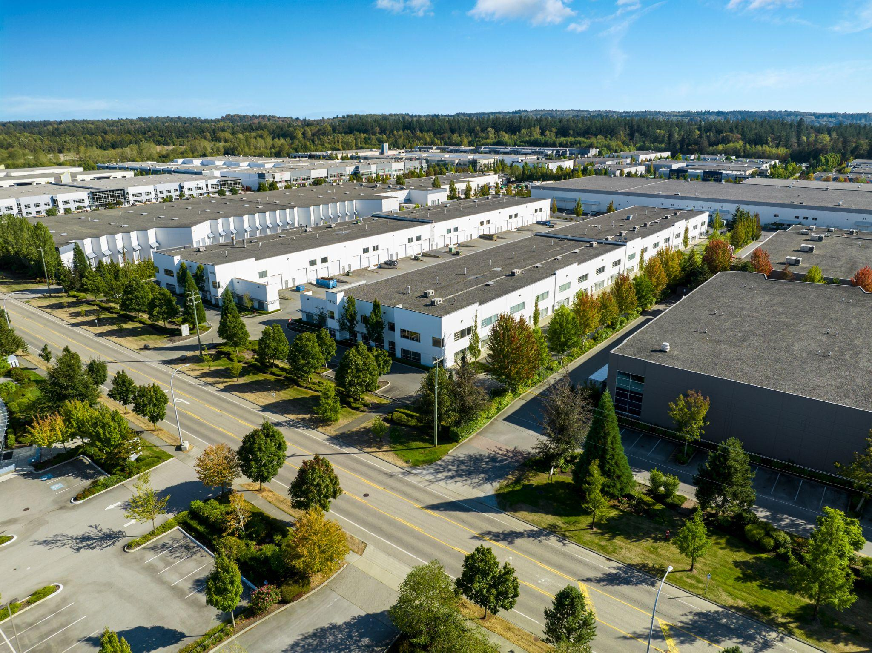
NOW LEASING
SURREY, BC
18822 / 18860 24th Avenue
ADDRESS: 18822-60 24TH AVE
CONTACT: JOE LEHMAN, GARTH WHITE & MATTHEW SUNDERLAND
COMPANY: AVISON YOUNG
PHONE: 604.687.7331
AVAILABILITY:
BUILDING FEATURES:
100A, 3 phase electrical service per unit
32’ clear ceiling height
Energy efficient, T5HO lighting on motion sensor
ESFR Sprinkler system
Dock and grade loading per bay with concrete apron
Energy efficient, insulated tilt up panel construction
Significant truck maneuverability
Demise options available
18860 24TH AVE
Unit 111 Unit 116-118 Unit 119 Unit 102 |  | 5,553 SF 15,048 SF 3,899 SF 4,159 SF | Leased Under Contract Leased Available May 1, 2026
SURREY, BC
19110 / 19130 24th Avenue
ADDRESS: 19110-19130 24TH AVE
CONTACT: JOE LEHMAN, GARTH WHITE & JEN SCHROER
COMPANY: AVISON YOUNG
PHONE: 604.687.7331
AVAILABILITY:
BUILDING FEATURES:
Dock and grade loading to each unit
26′ clear ceiling height
Significant truck maneuverability
Ample parking for tenants and visitors
Unit 101* - 19130 | 6,772 SF | Under Contract
Unit 102* - 19130 Unit 108 - 19110 | 3,397 SF 3,190 SF | Under Contract Available Immediately
* (Unit 101 & 102 can be combined)
200 - 1010 SEYMOUR STREET, VANCOUVER, BC | 604.688.8783 | LEASING@ONNI.COM

Slide 7
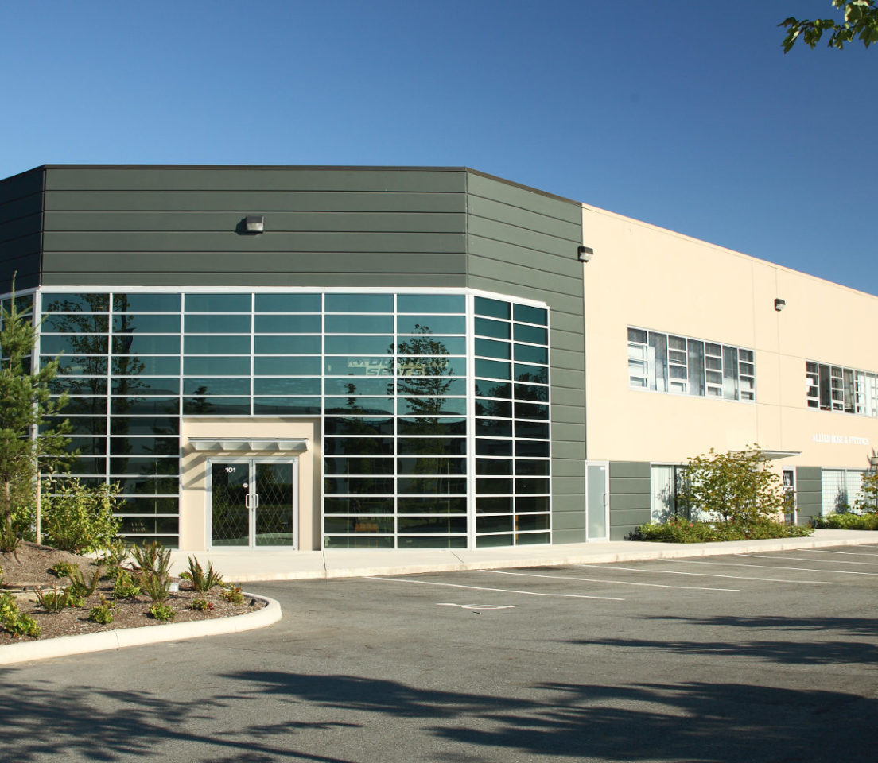
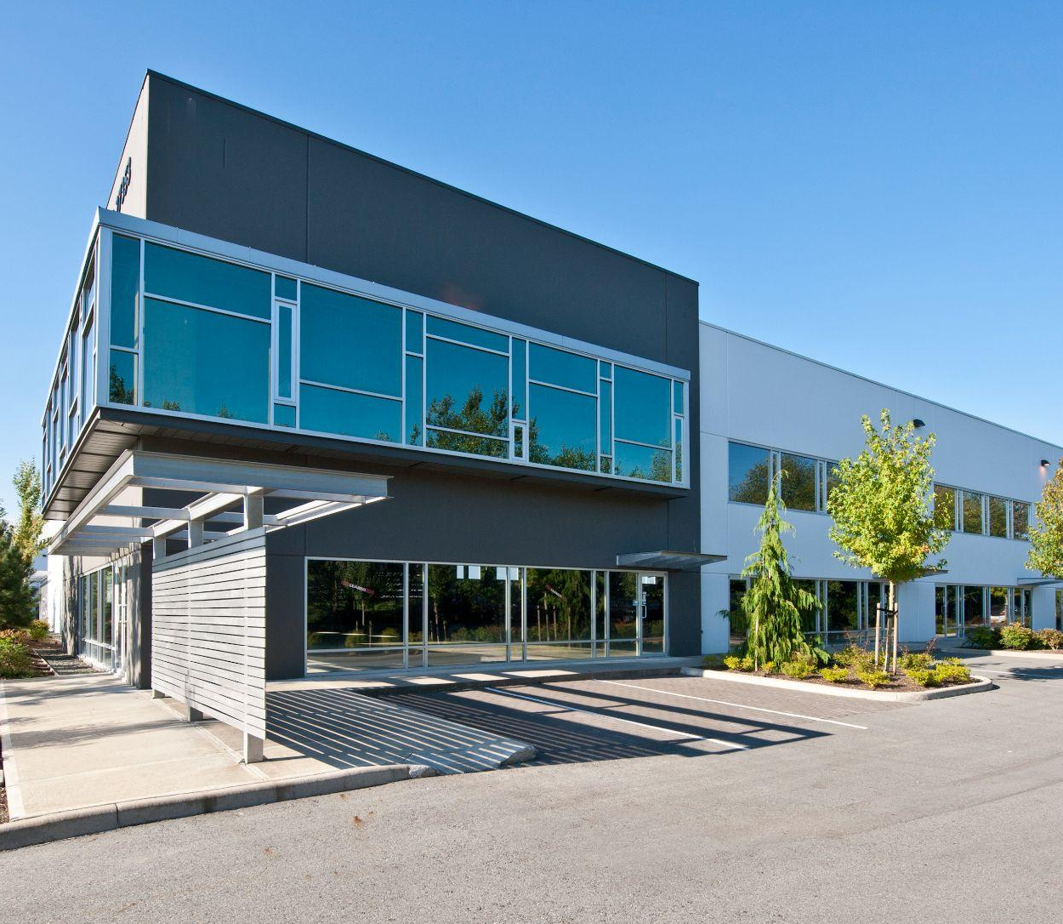
NOW LEASING
LANGLEY, BC
27090 Gloucester
ADDRESS: 27090 GLOUCESTER
CONTACT: JUSTIN FISHER
COMPANY: CBRE
PHONE: 604 665 4517
AVAILABILITY:
BUILDING FEATURES:
Dock and grade loading per bay
Well appointed office space in each unit
26’ ceilings
3 phase electrical service
ESFR sprinkler system
Unit 204 Unit 205 Unit 101 Unit 104-106 * |  | 4,228 SF 4,228 SF 2,962 SF 11,083 SF | Available Immediately Available October 1, 2026 Available October 1, 2026 Available October 1, 2026
*Units can be demised
LANGLEY, BC
27353 58th Crescent
ADDRESS: 27353 58th Crescent
CONTACT: SEBASTIAN ESPINOSA
COMPANY: LEE AND ASSOCIATES
PHONE: 604 783.8139
AVAILABILITY:
BUILDING FEATURES:
26’ clear ceiling heights in warehouse
3 phase electrical service
ESFR sprinkler system
Unit 208 Unit 209 - 214 * |  | 6,396 SF 38,278 SF | Under contract Available Immediately
*Units can be demised to 6,215 SF - 38,278 SF
200 - 1010 SEYMOUR STREET, VANCOUVER, BC | 604.688.8783 | LEASING@ONNI.COM

Slide 8
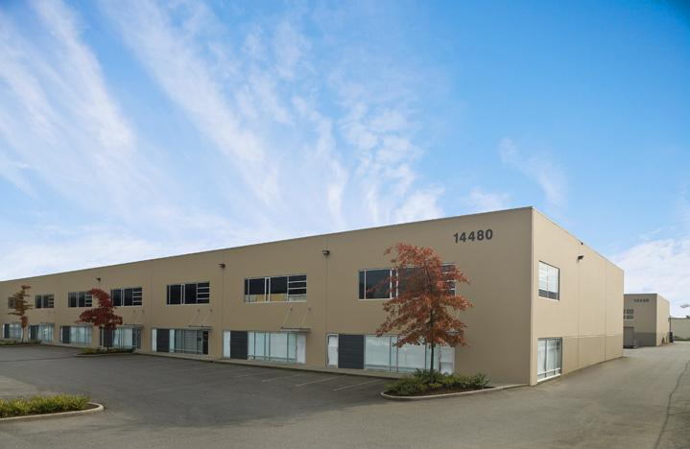
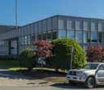
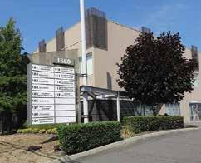
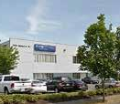

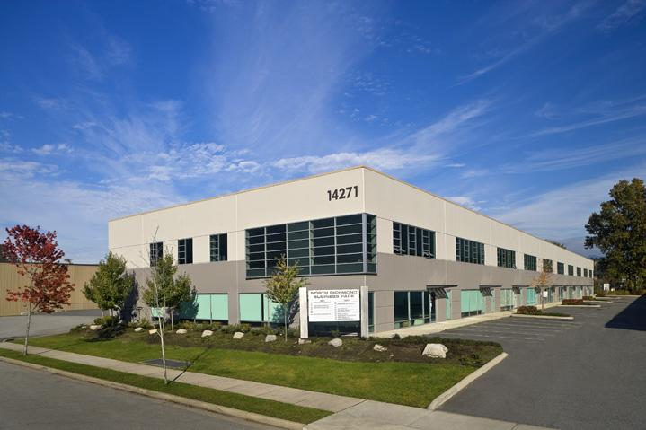
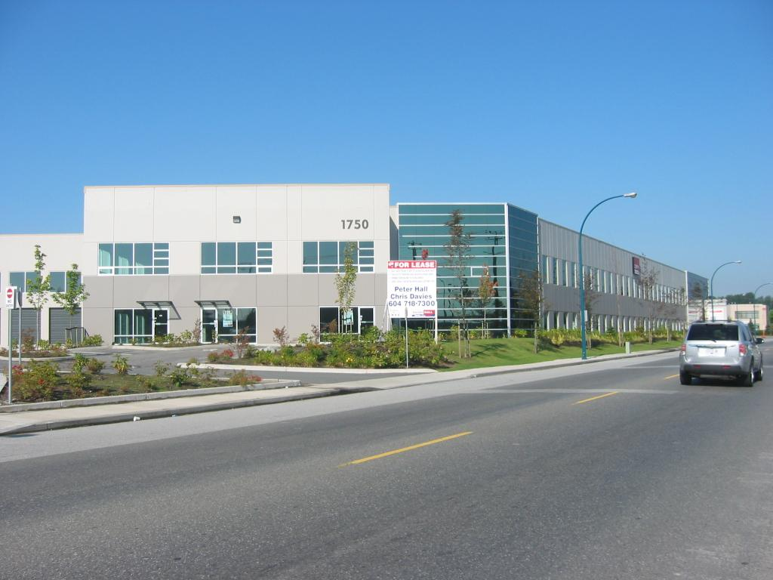
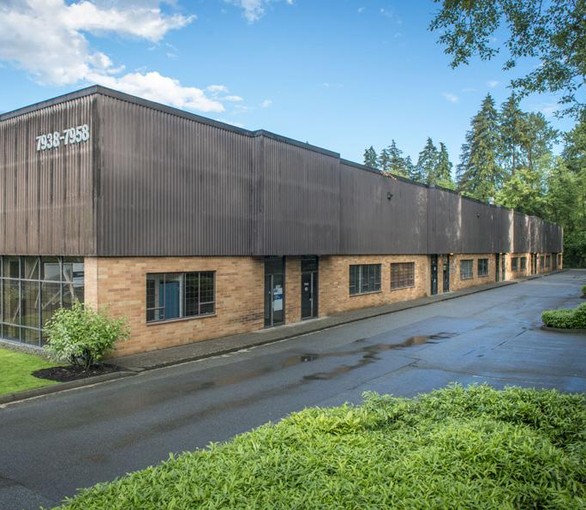
FULLY LEASED
RICHMOND, BC
VANCOUVER, BC
14480-14488 Knox Way
888 South East Marine Drive
PORT COQUITLAM, BC
RICHMOND, BC
1680 Broadway Street
1128 Burdette Street
RICHMOND, BC
RICHMOND, BC
14251 Burrows Road
14271 - 14273 Knox Way
PORT COQUITLAM, BC
BURNABY, BC
1750 Coast Meridian
7950 Winston Street
200 - 1010 SEYMOUR STREET, VANCOUVER, BC | 604.688.8783 | LEASING@ONNI.COM

Slide 9
CONTACT
PETER MCFETRIDGE
pmcfetridge@onni.com | 604.868.3274
SABRINA DEBONIS
sdebonis@onni.com | 604.839.7798
200 - 1010 SEYMOUR STREET VANCOUVER, BC V6B 3M6
ONNI.COM
Availabilities may vary. Please speak with an Onni Representative for details. Developer reserves the right to make modifications to floorplans, project design, materials, features and specifications without notification. All maps, renderings and illustrations reflect the artist’s interpretation only and may differ from the final product. E. & O. E.

